Slide 2
ARS Fall Meeting
Gettysburg, PA
September 27-29, 2022

Slide 3
Tuesday afternoon open house
at John Bartlett’s
Gettysburg Gardens

Slide 4
Tuesday Evening Program
Don Hyatt

Slide 5
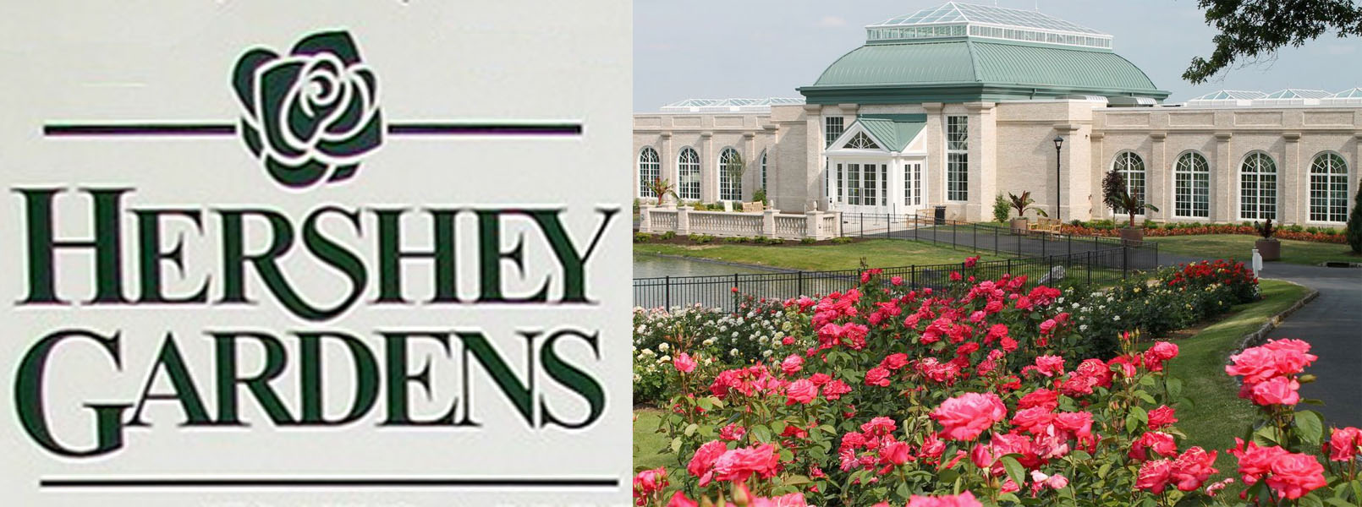
Wednesday Morning Tour

Slide 6
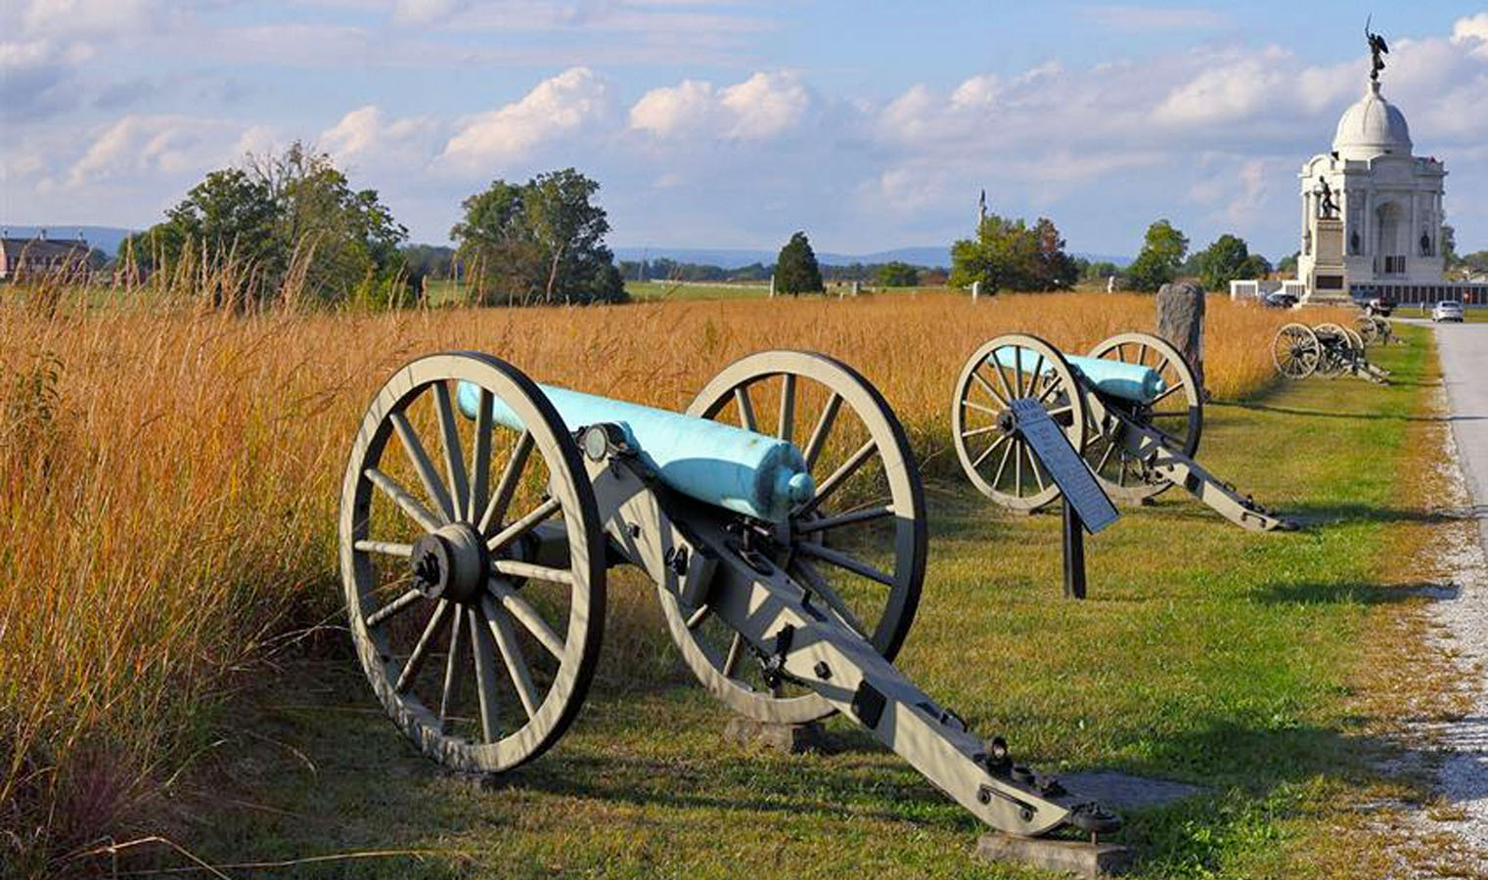
Wednesday Afternoon Tour
Gettysburg Battlefield

Slide 7
Wednesday Evening Program
Wayne Mezitt

Slide 8
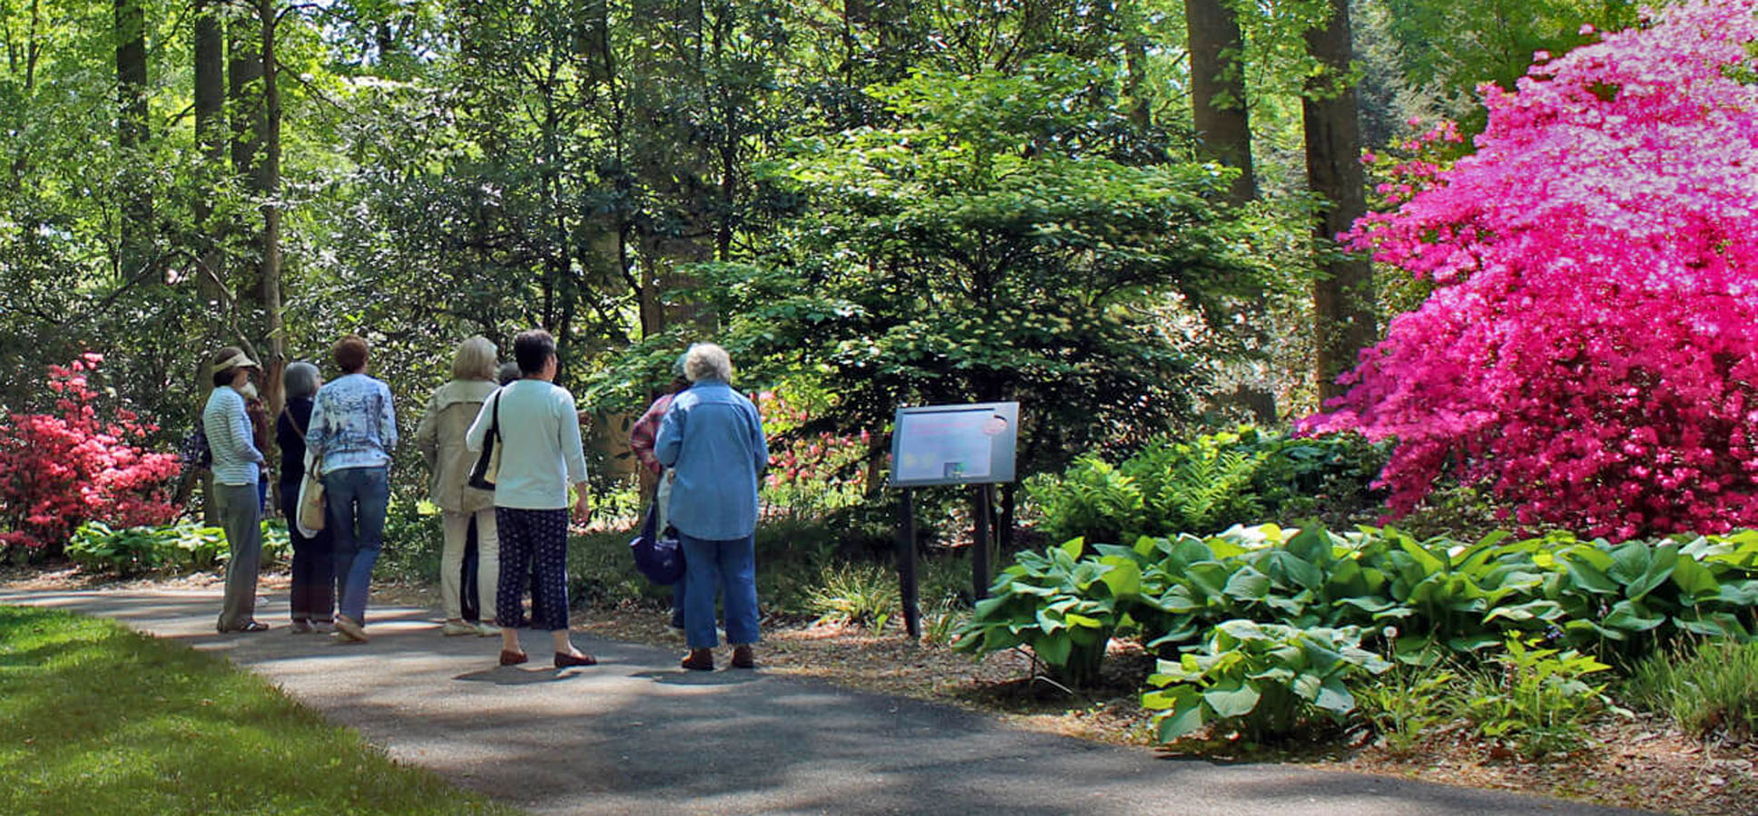
Thursday Morning
Hybridizer’s Roundtable
ARS/Tyler Hybrid Test Garden

Slide 9
The Convention Hotel
The Gettysburg Wyndham

Slide 10
ARS Fall Meeting
Gettysburg, PA
September 27-29, 2022

Slide 11
Tuesday afternoon open house
at John Bartlett’s
Gettysburg Gardens

Slide 12
Tuesday Evening Program
Don Hyatt

Slide 13
Wednesday Morning Tour

Slide 14
Wednesday Afternoon Tour
Gettysburg Battlefield

Slide 15
Wednesday Evening Program
Wayne Mezitt

Slide 16
Thursday Morning
Hybridizer’s Roundtable
ARS/Tyler Hybrid Test Garden

Slide 17
The Convention Hotel
The Gettysburg Wyndham

Slide 18
ARS Fall Meeting
Gettysburg, PA
September 27-29, 2022

