Slide 1
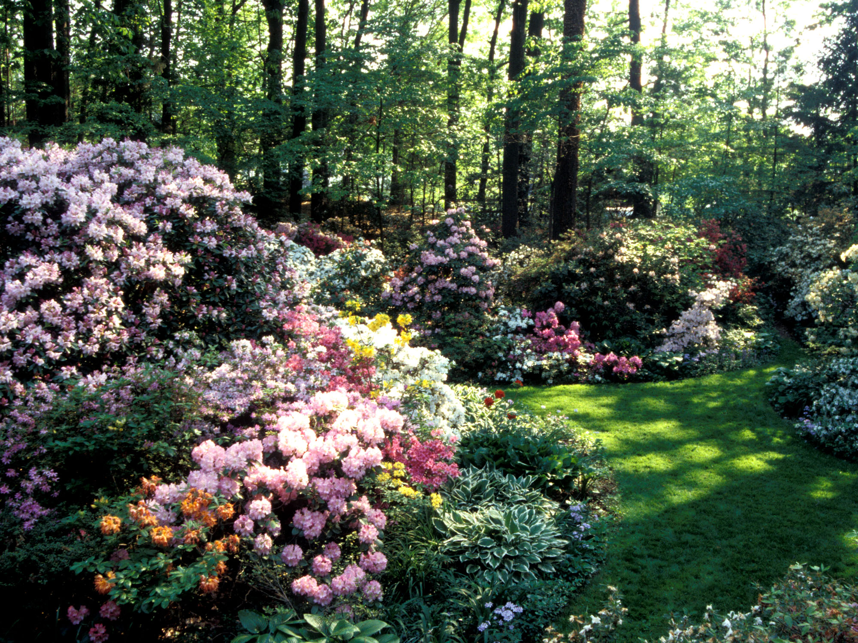
Propagation
Techniques for Propagating Rhododendrons and Azaleas
Raising Plants from Seed
by Donald W. Hyatt
Copyright © 2019 American Rhododendron Society

Slide 2
Propagation

Slide 3
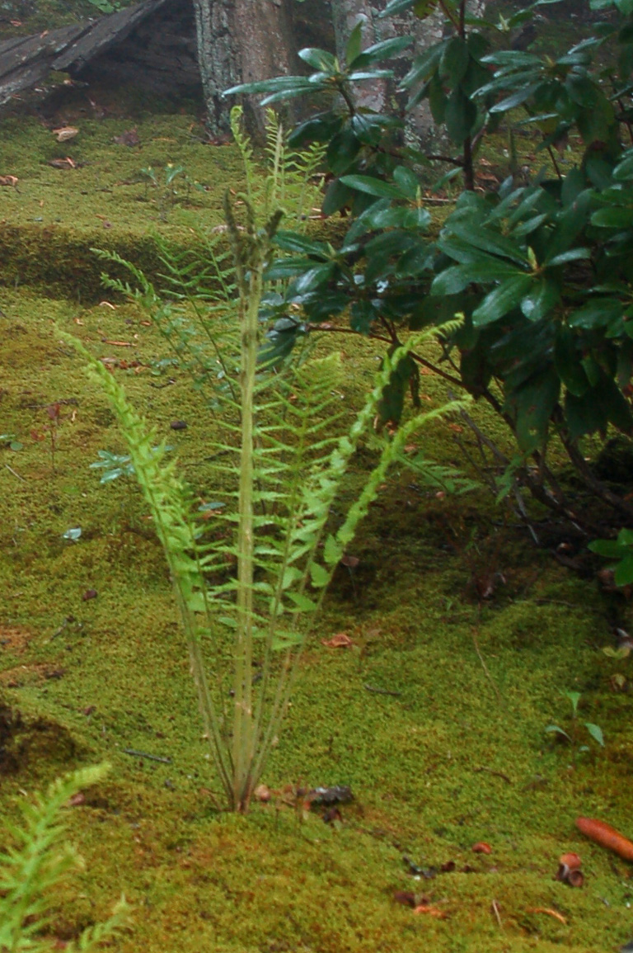
Raising Plants from Seed
Although some primitive plants like ferns and mosses reproduce by spores, most plants reproduce by seed. .

Slide 4
Raising Plants from Seed
Although some primitive plants like ferns and mosses reproduce by spores, most plants reproduce by seed. .
Coconut palms have very large seeds, coconuts.

Slide 5
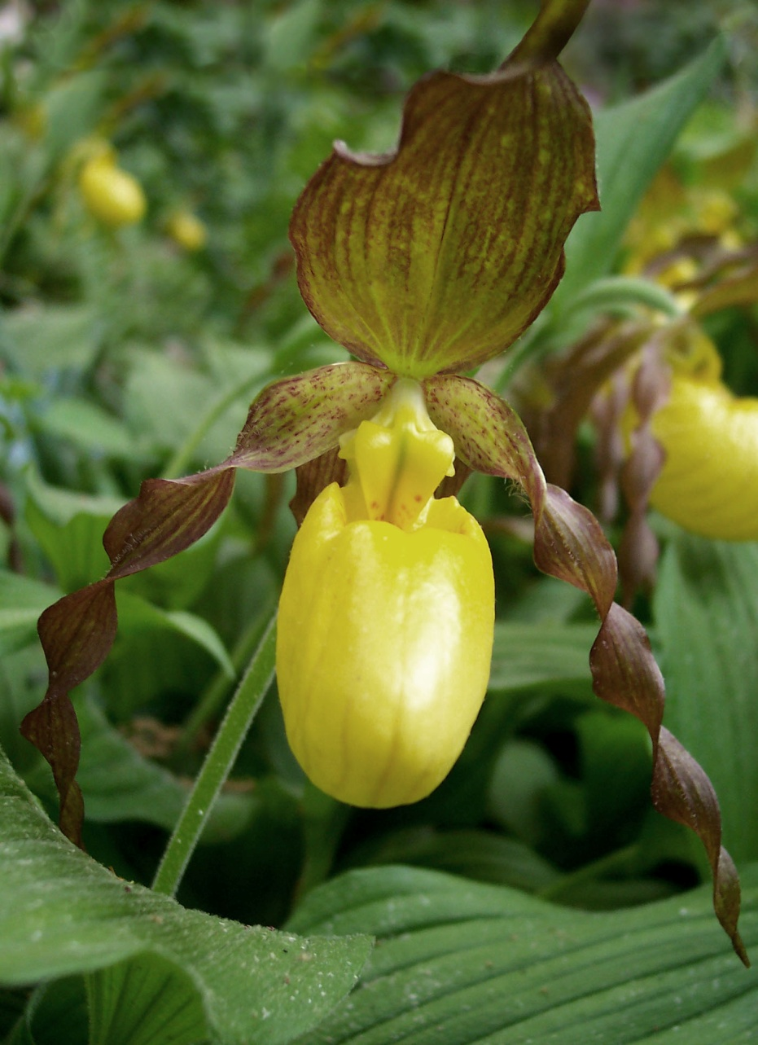
Raising Plants from Seed
Although some primitive plants like ferns and mosses reproduce by spores, most plants reproduce by seed. .
Coconut palms have very large seeds, coconuts.
Orchid seeds are tiny, almost like dust.

Slide 6
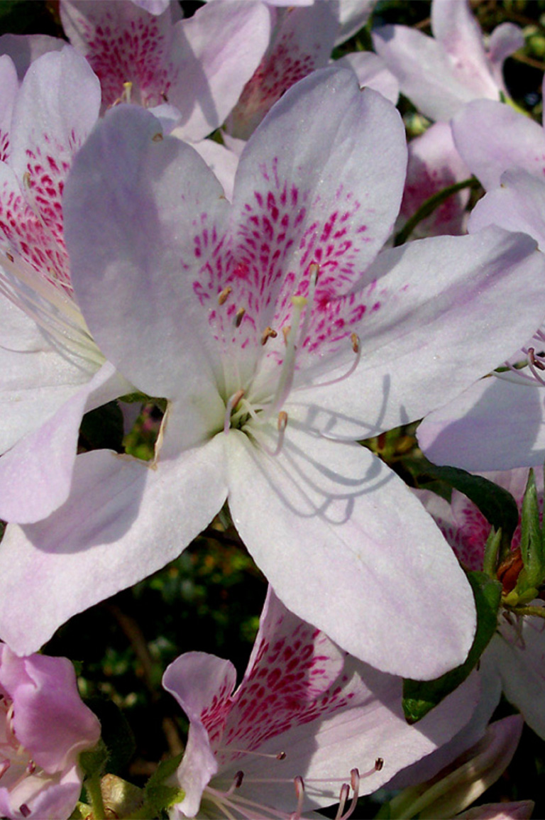
Raising Plants from Seed
Rhododendrons and azaleas can be easily propagated by seed. .

Slide 7
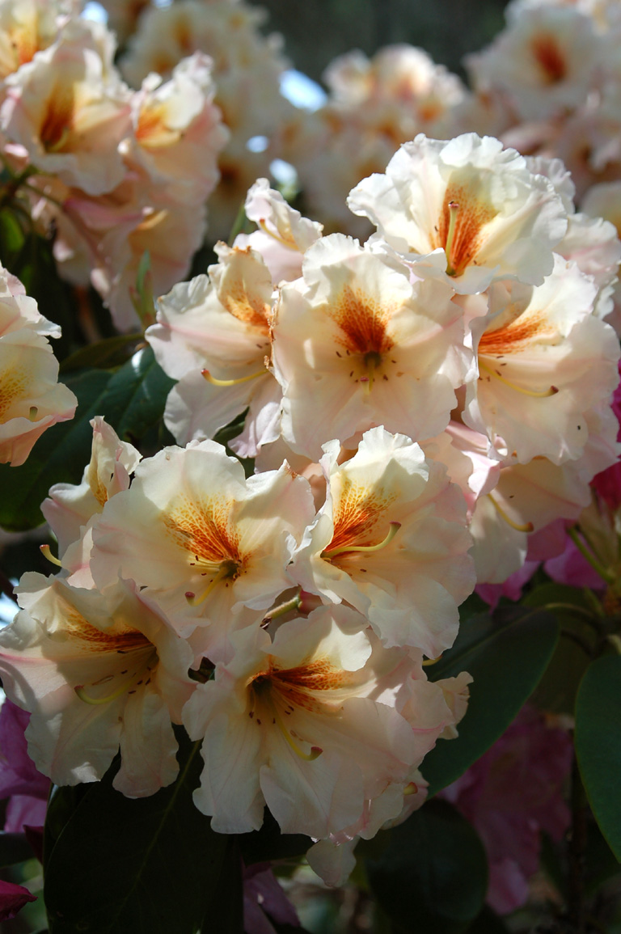
Raising Plants from Seed
Rhododendrons and azaleas can be easily propagated by seed. .
Their seeds are small and will require some care at first, but this presentation will show how and why to raise them from seed.

Slide 8
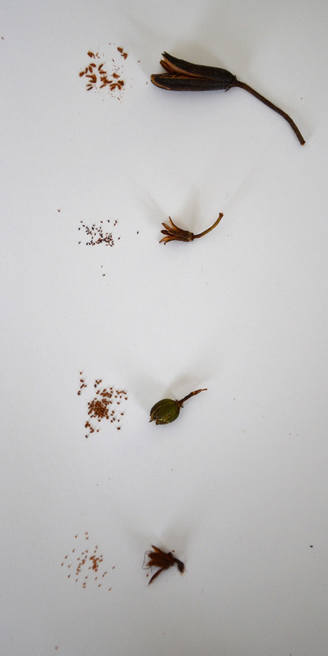
Seed Variations
The size and shape of seedpods and seeds will vary depending upon the species. Here are some example rhododendron and azalea seed types.
Seeds
Pods

Slide 9
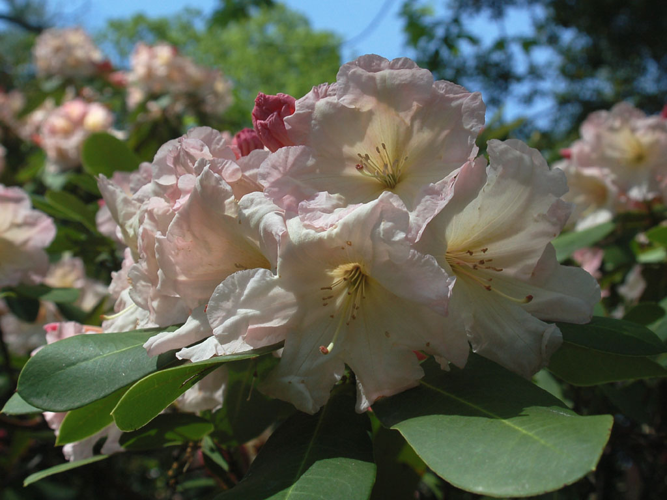
Seed Variations
R. fortunei
R. fortunei – Large Elepidote
Rhododendron

Slide 10
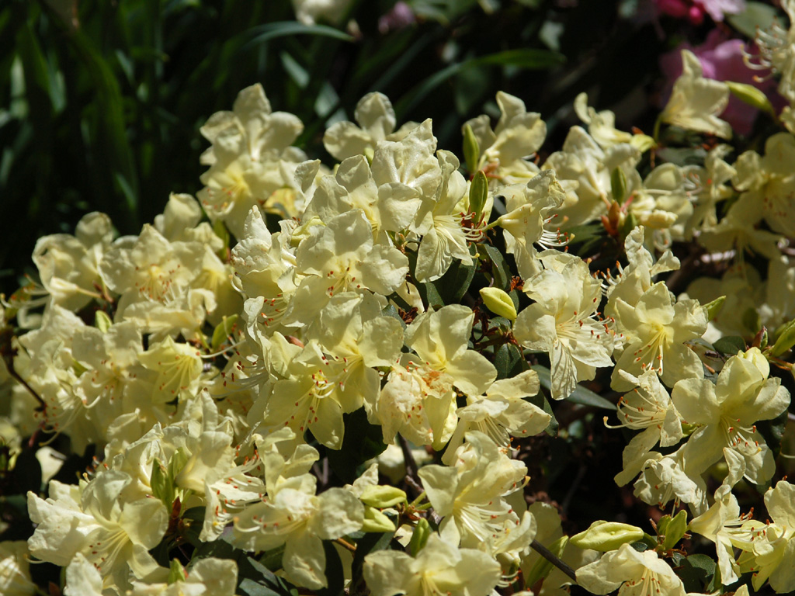
Seed Variations
R. fortunei
R. keiskei
R. keiskei – Dwarf Lepidote
Rhododendron

Slide 11
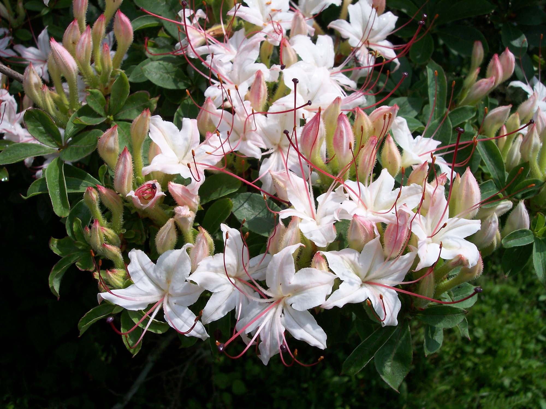
Seed Variations
R. fortunei
R. keiskei
R. arborescens
R. arborescens – Native Azalea

Slide 12
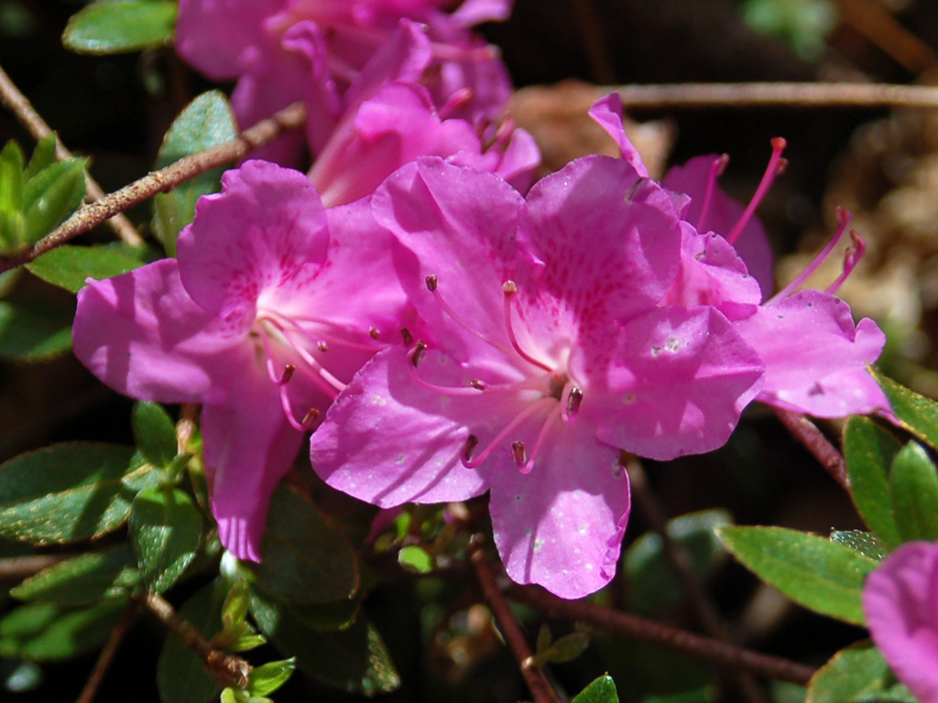
Seed Variations
R. fortunei
R. keiskei
R. arborescens
R. kiusianum – Evergreen Azalea
All Azaleas are Rhododendrons!
R. kiusianum

Slide 13
Where to Get Seed
Sources
1. Plants in
the Wild

Slide 14
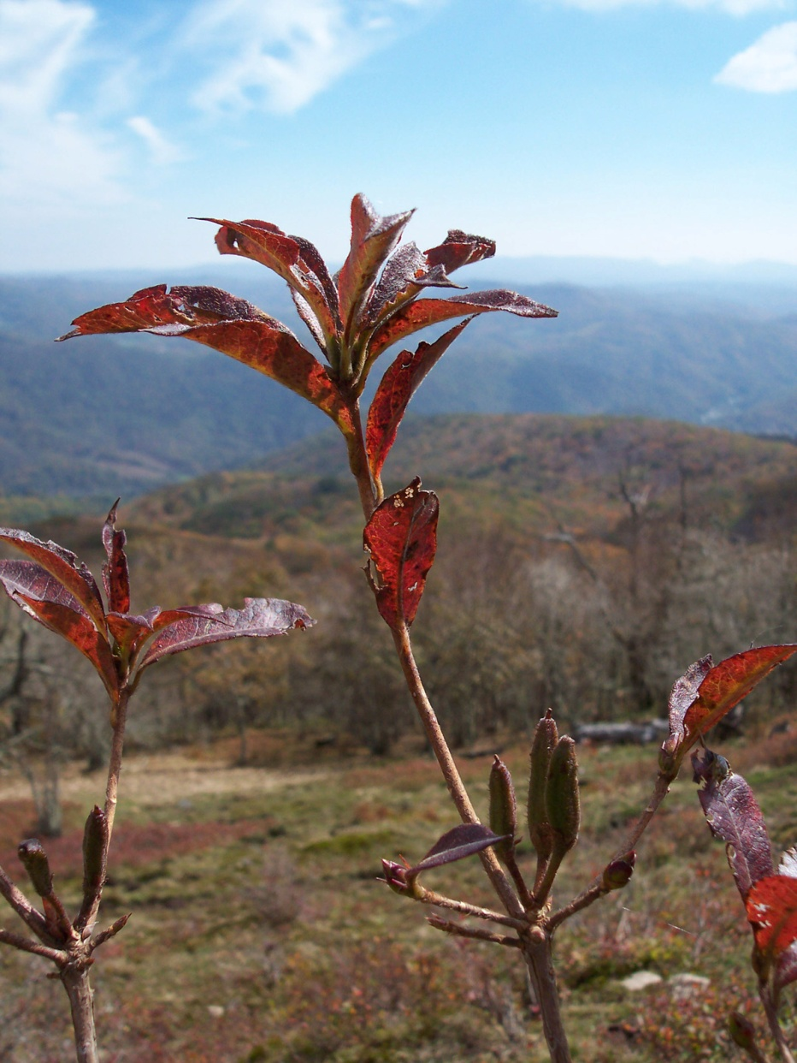
Where to Get Seed
Sources
1. Plants in
the Wild

Slide 15
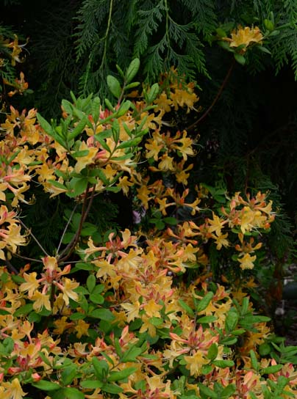
Where to Get Seed
Sources
1. Plants in
the Wild
2. Open Pollinated
Garden Sources

Slide 16
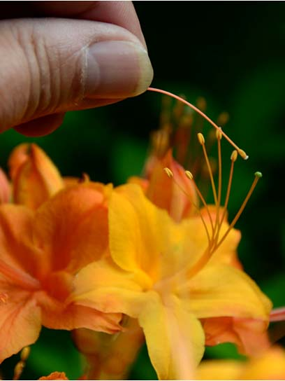
Where to Get Seed
Sources
1. Plants in
the Wild
2. Open Pollinated
Garden Sources
3. Controlled
Crosses

Slide 17
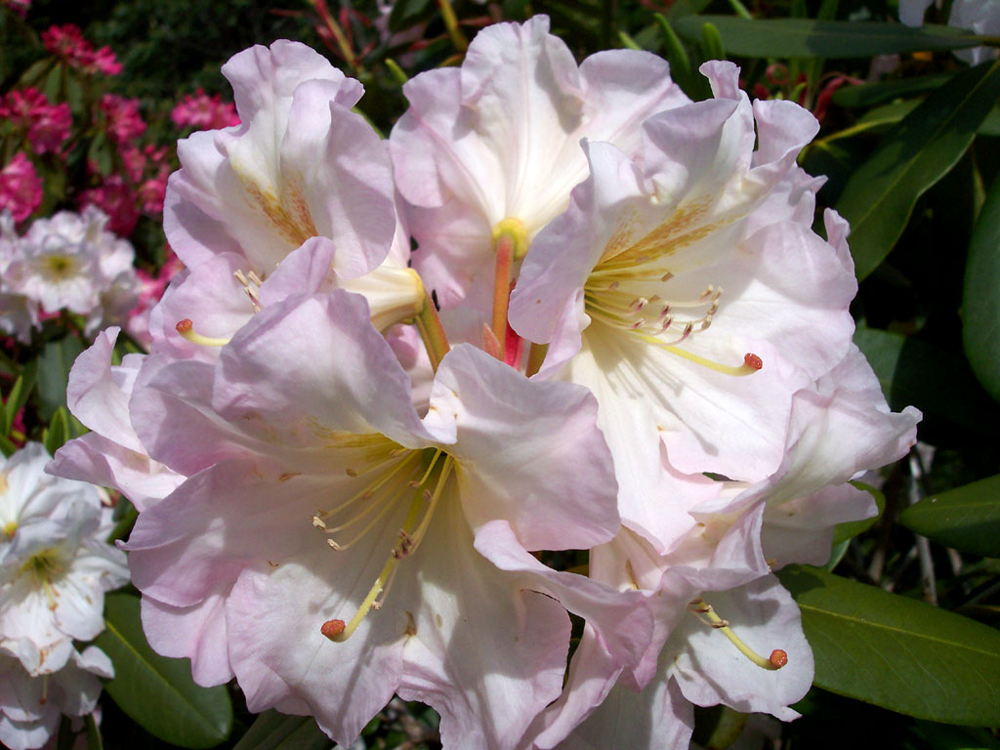
How to Make a Cross
Flower Parts
Corolla

Slide 18
How to Make a Cross
Flower Parts
Corolla
Stamens

Slide 19
How to Make a Cross
Flower Parts
Corolla
Stamens
Pistil

Slide 20
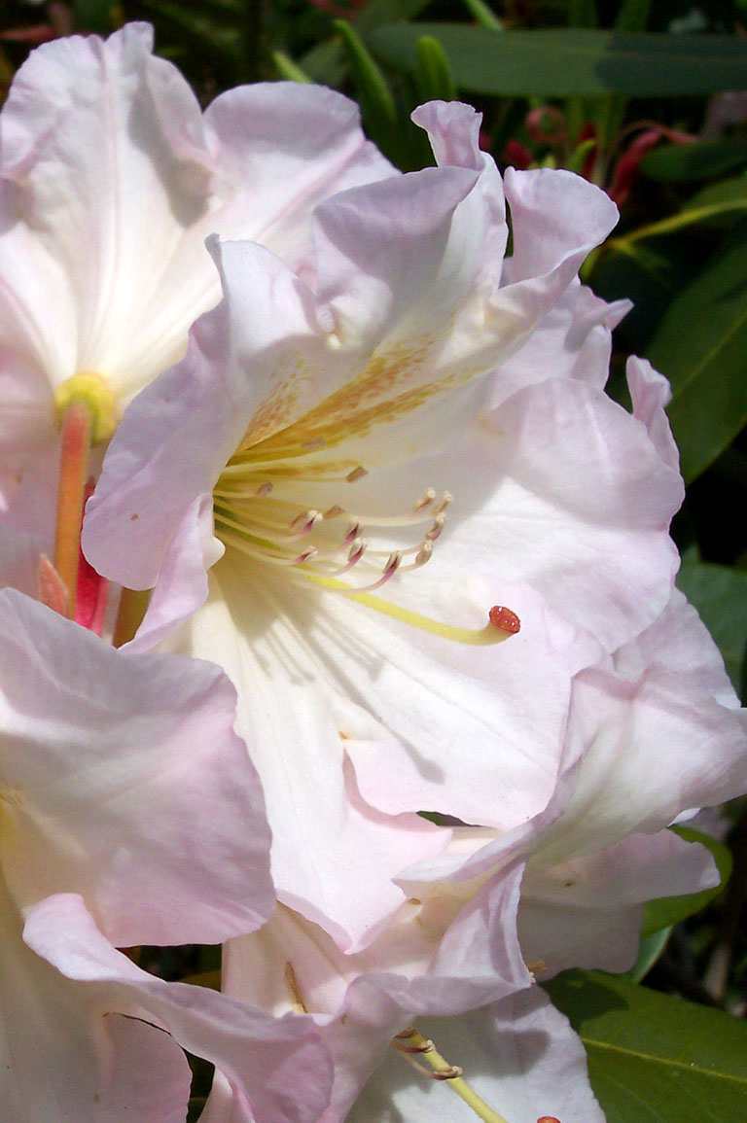
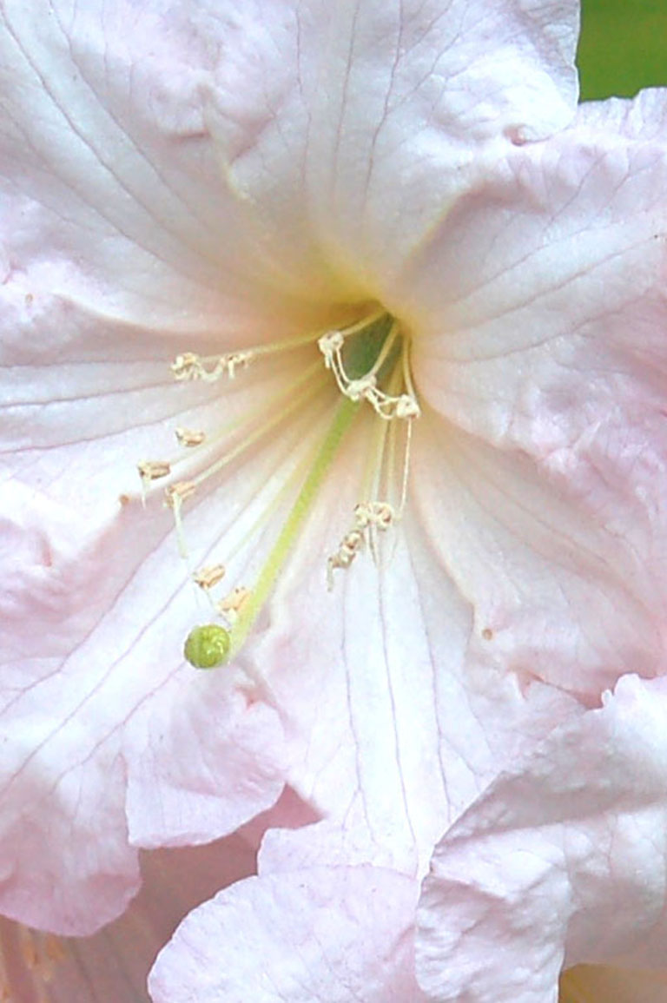
How to Make a Cross
Pollen
Put pollen from
one flower on the
pistil of another
‘Pastel Perfume’
The cross is done!
Record the Parentage.
‘Apritan’
‘Pastel Perfume’ x ‘Apritan’
Female Parent
Listed First
Pistil
Pollen Parent
Listed Second

Slide 21
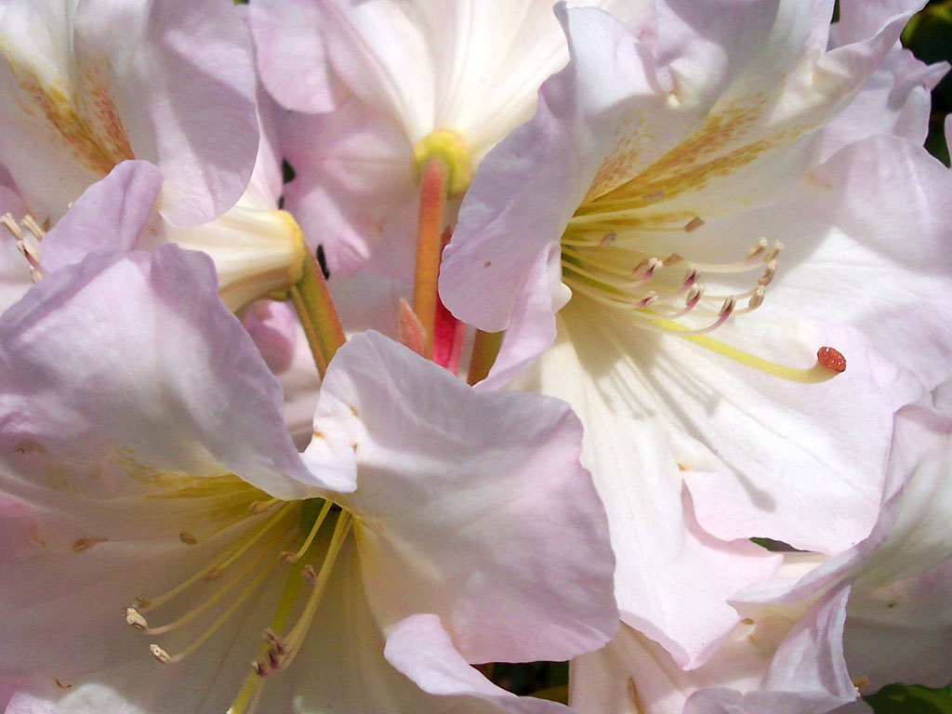
Emasculation
Keeping Bees Away
Bees may bring in unwanted
pollen from other sources

Slide 22
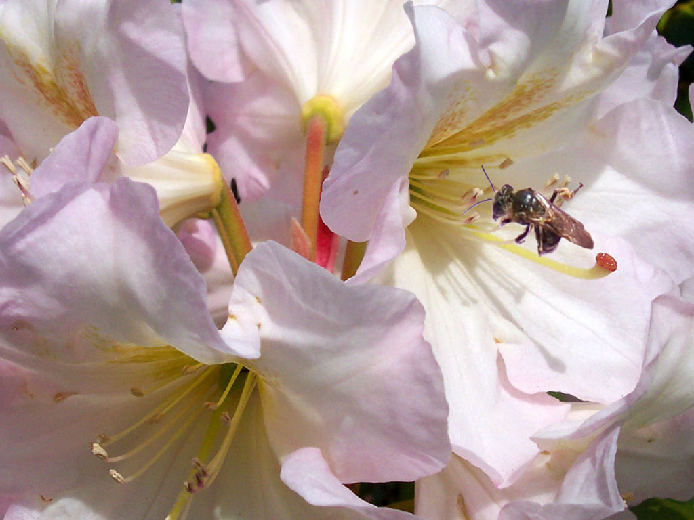
Emasculation
Keeping Bees Away
Emasculate
the Flower

Slide 23
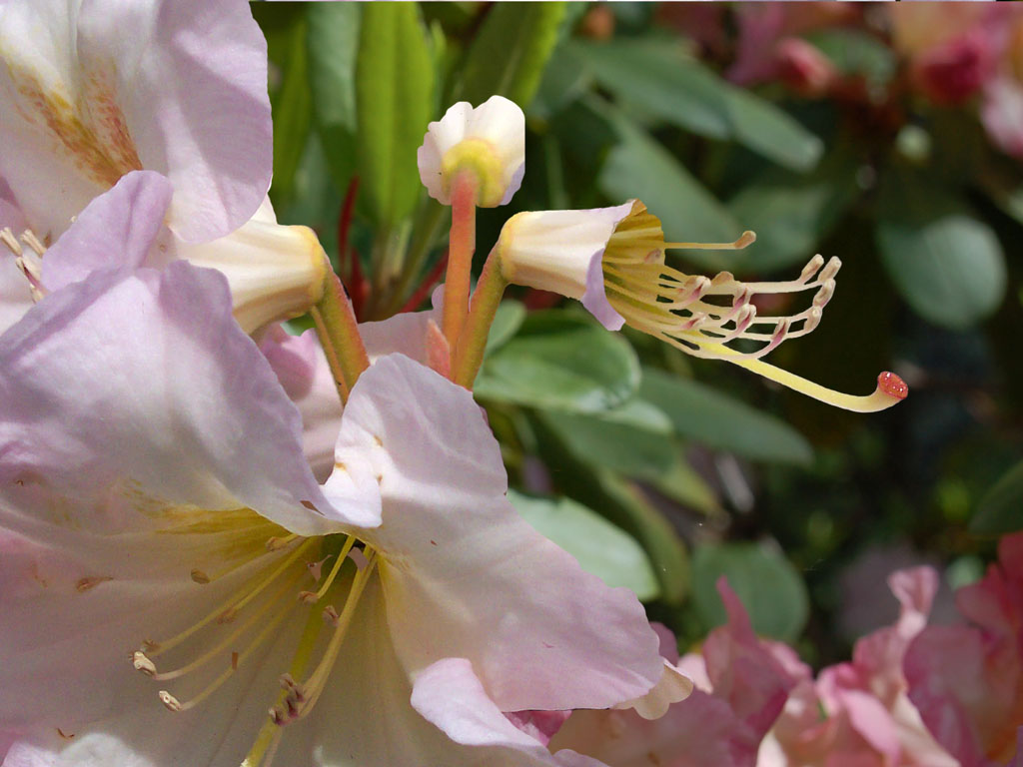
Emasculation
Keeping Bees Away
Remove the Corolla
Emasculate
the Flower

Slide 24
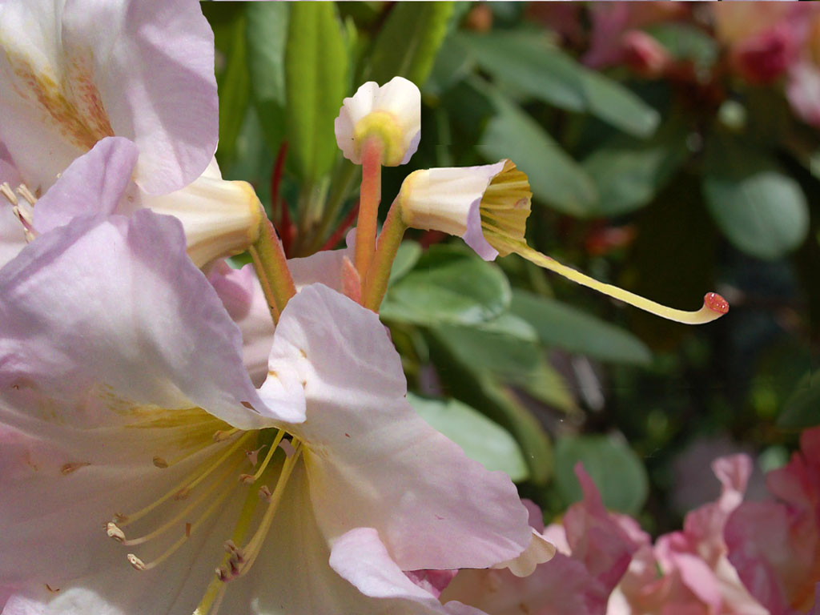
Emasculation
Remove the Corolla
Remove the Stamens
Emasculate
the Flower

Slide 25
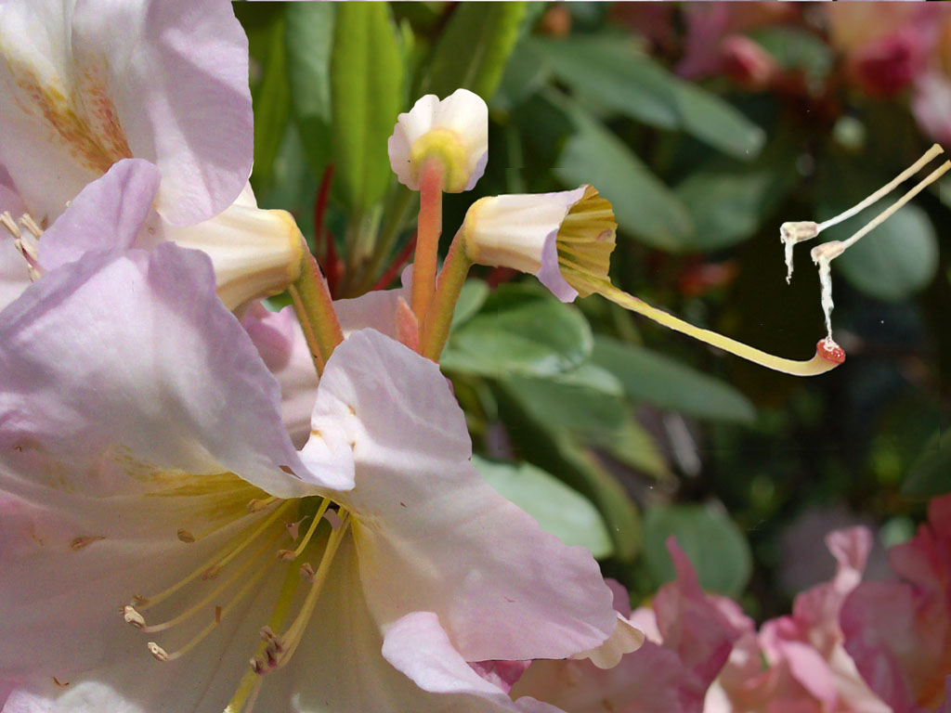
Emasculation
Make the Cross
Emasculate
the Flower

Slide 26
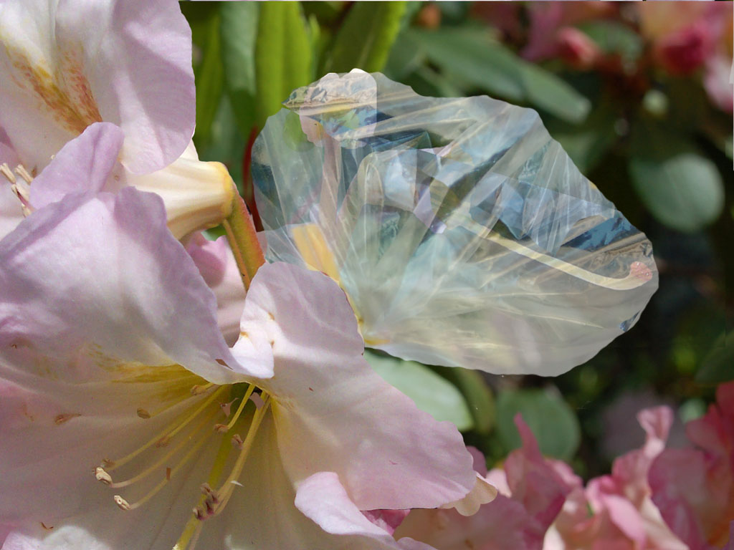
Emasculation
Cover with Plastic Bag
Emasculate
the Flower

Slide 27
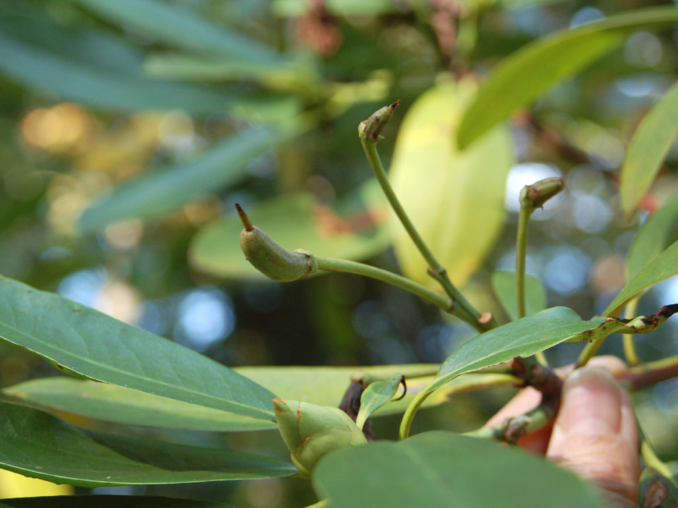
Seed Pods
Seed Pod Development
No Seeds
Successful

Slide 28
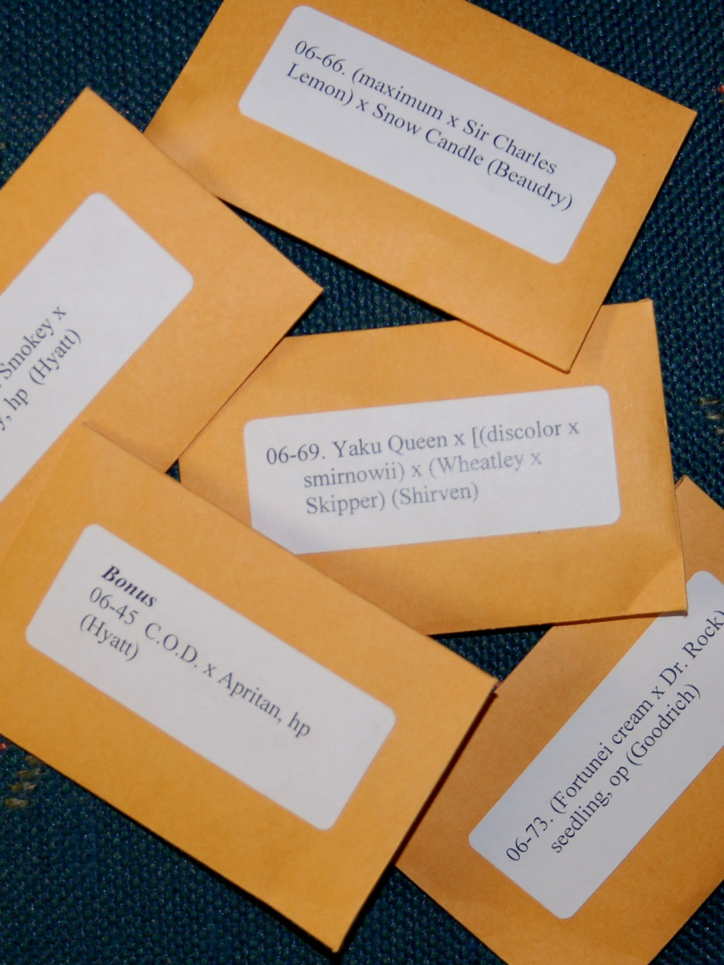
Where to Get Seed
Sources
1. Plants in
the Wild
2. Open Pollinated
Garden Sources
3. Controlled
Crosses
4. ARS & ASA
Seed Exchanges

Slide 29
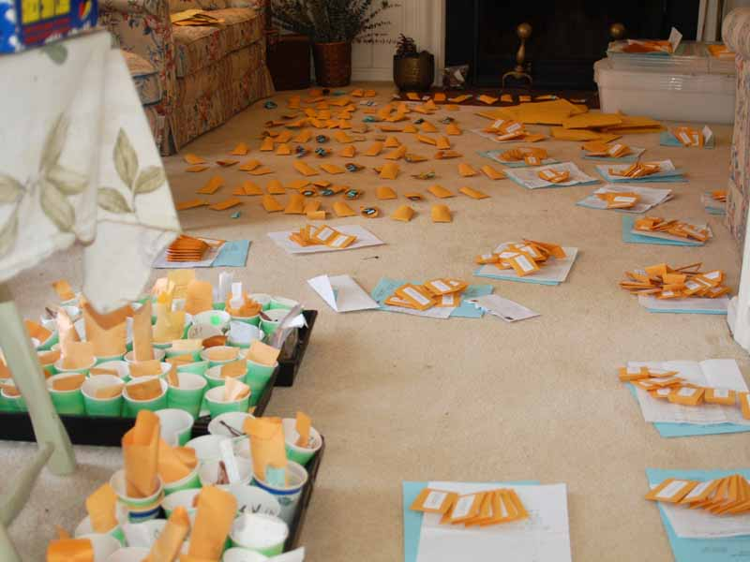
Where to Get Seed
Potomac Valley Chapter
Seed Exchange

Slide 30
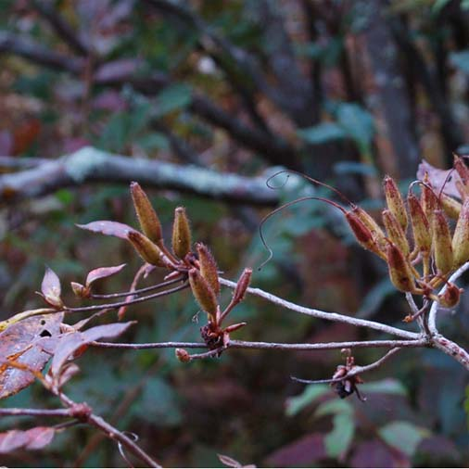
Seed Preparation
Procedure
Collect capsules
in late fall

Slide 31
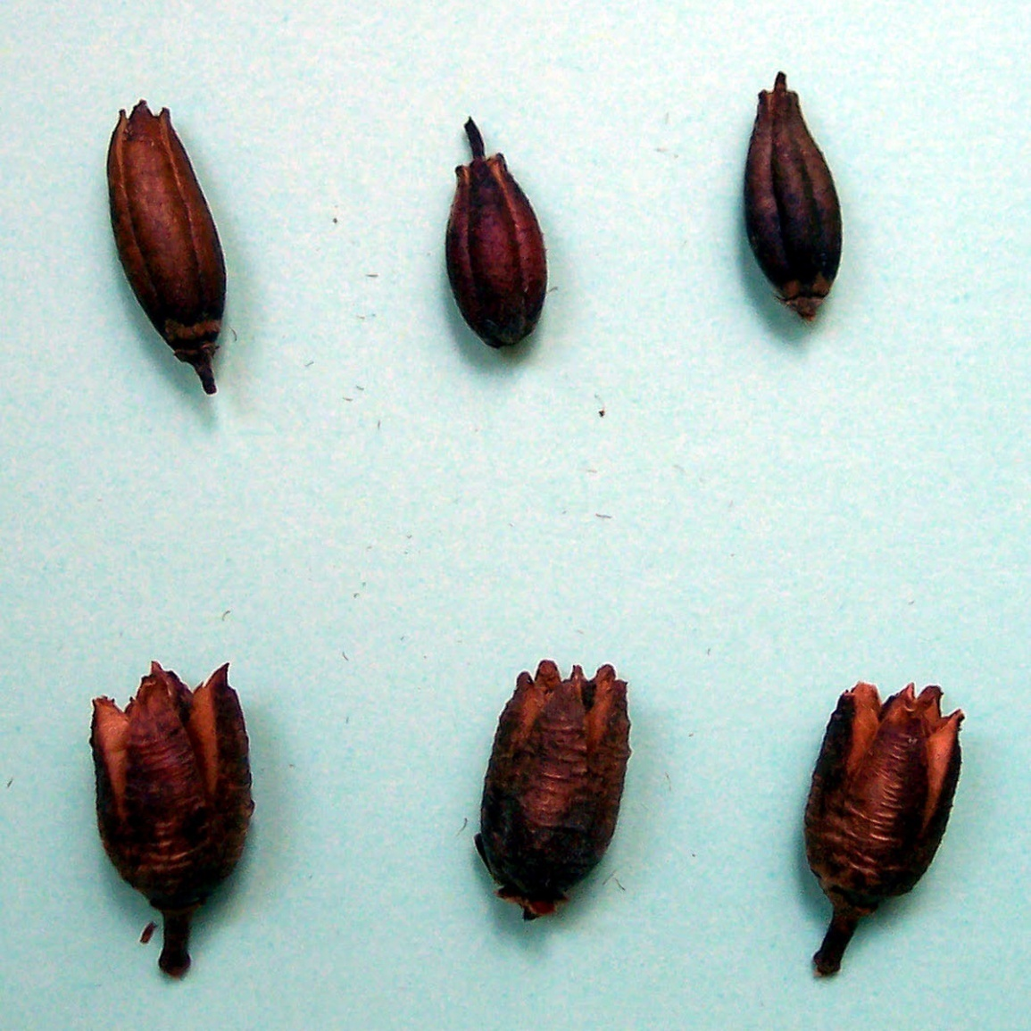
Seed Preparation
Procedure
Collect capsules
in late fall
2. When dry, crack
open capsules

Slide 32
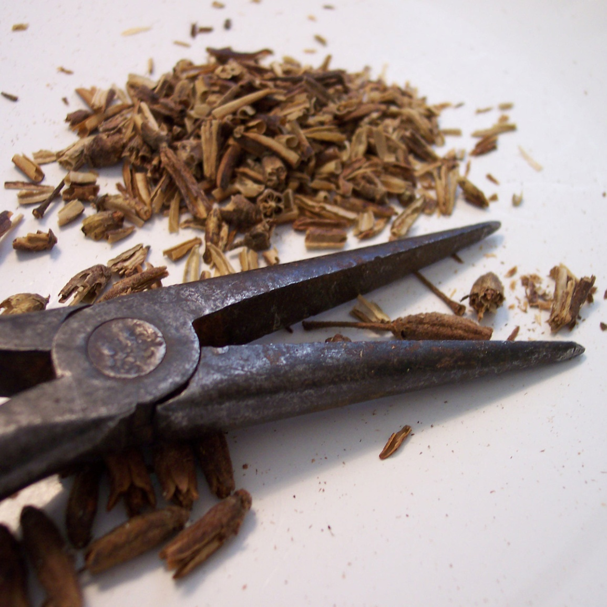
Seed Preparation
Procedure
Collect capsules
in late fall
2. When dry, crack
open capsules

Slide 33
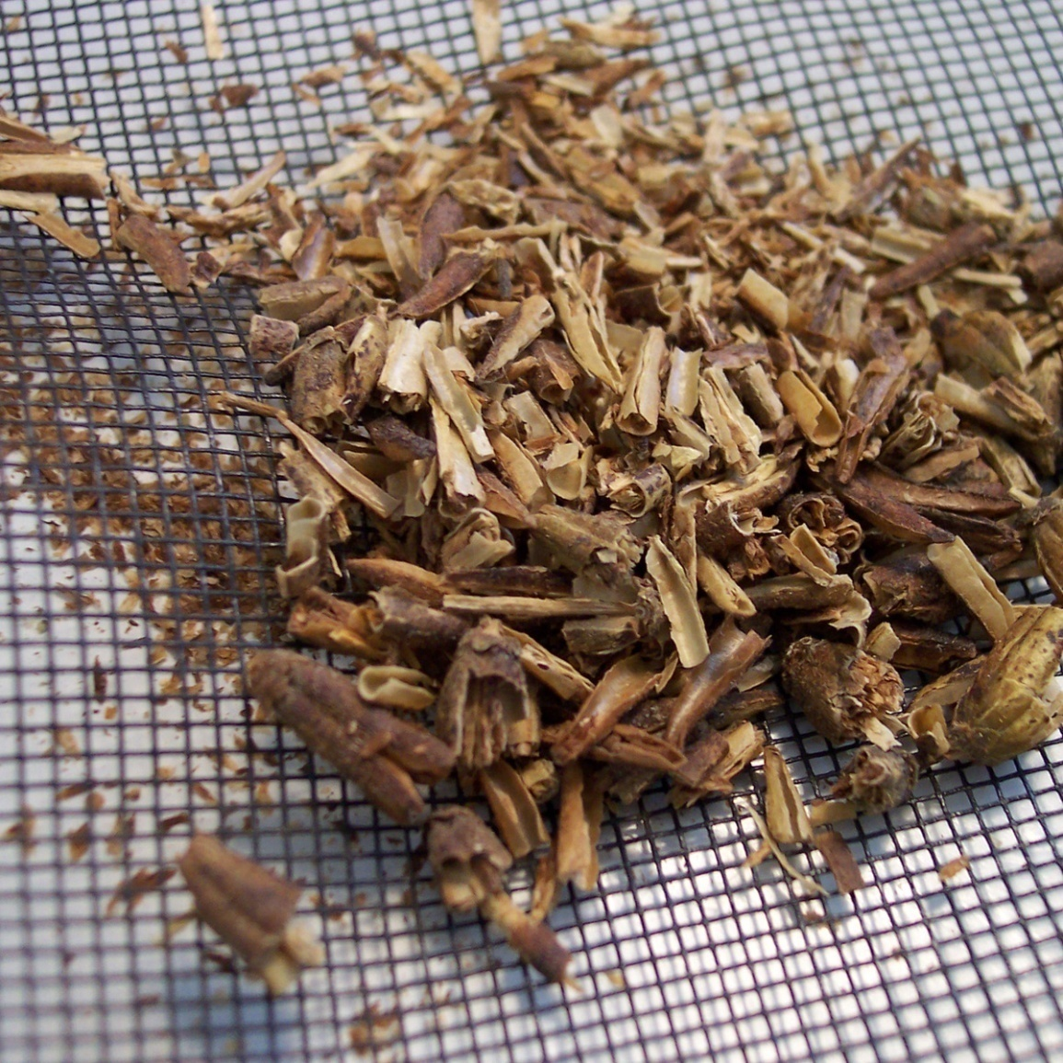
Seed Preparation
Procedure
Collect capsules
in late fall
2. When dry, crack
open capsules
3. Separate seed
from chaff
Note: This approach does
create a lot of chaff . The
debris is hard to remove
and may become moldy, spreading to the seedlings.

Slide 34
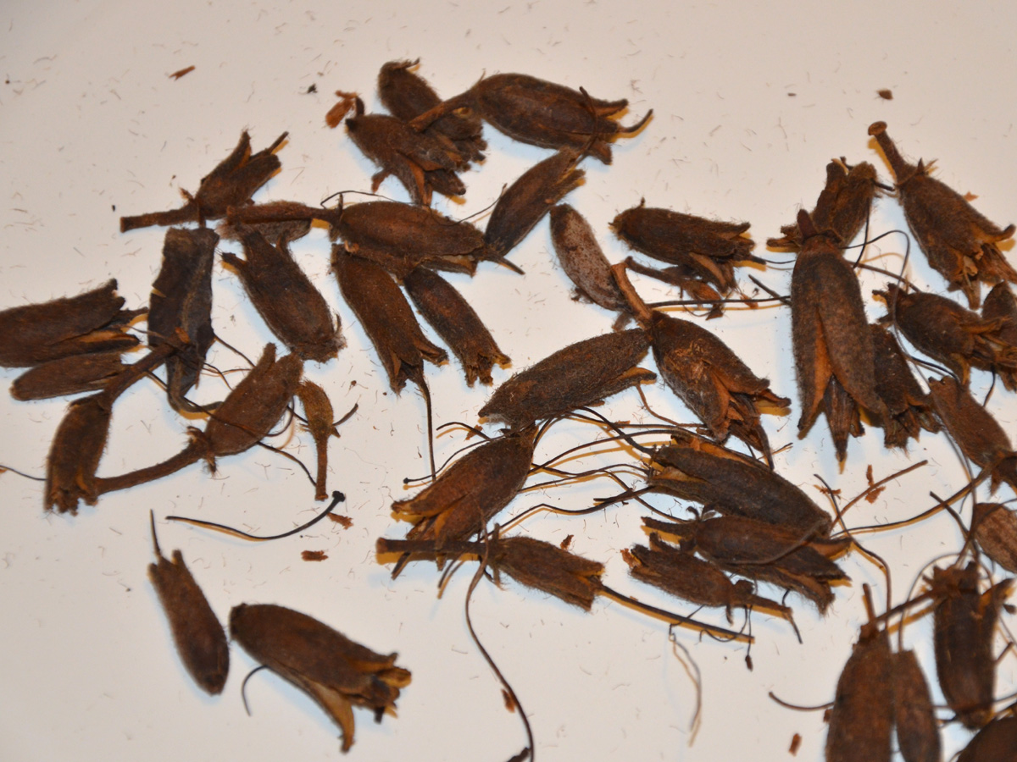
Alternative Seed Cleaning Method
Clean one pod
at a time!

Slide 35
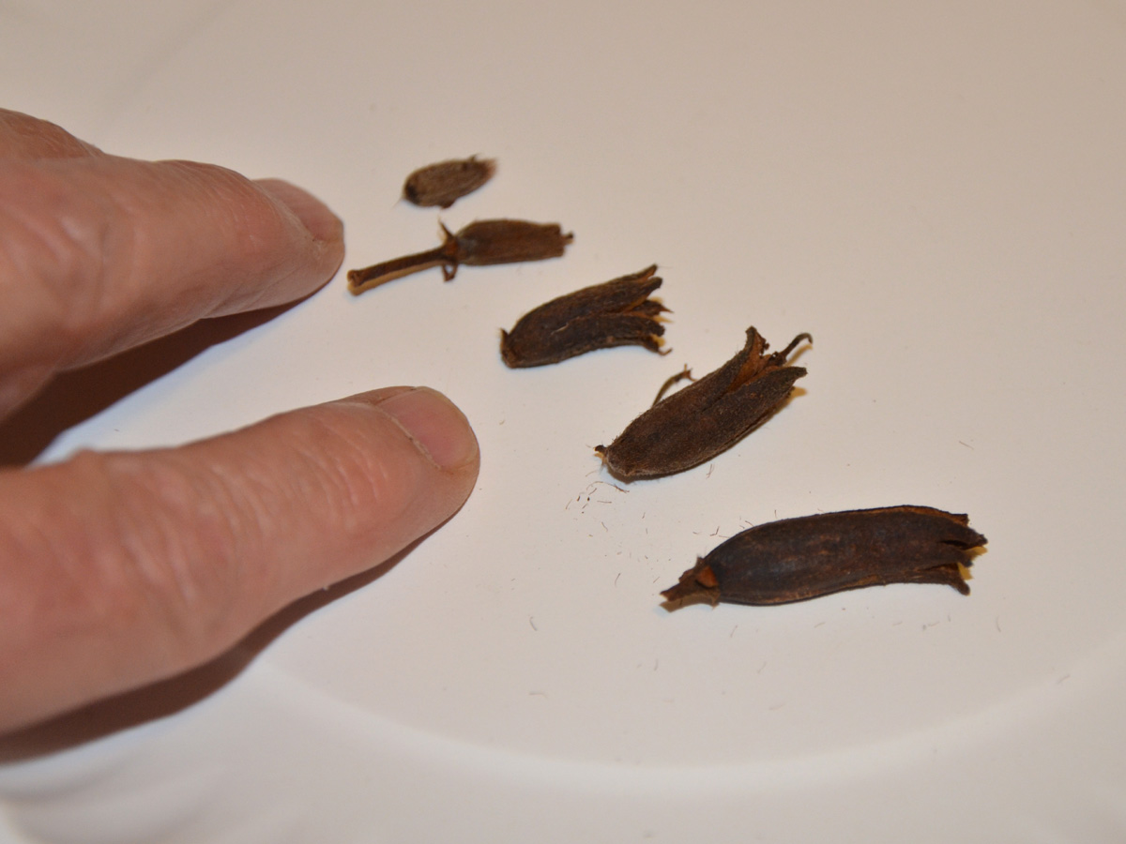
Alternative Seed Cleaning Method
Clean one pod
at a time!
R. calendulaceum

Slide 36
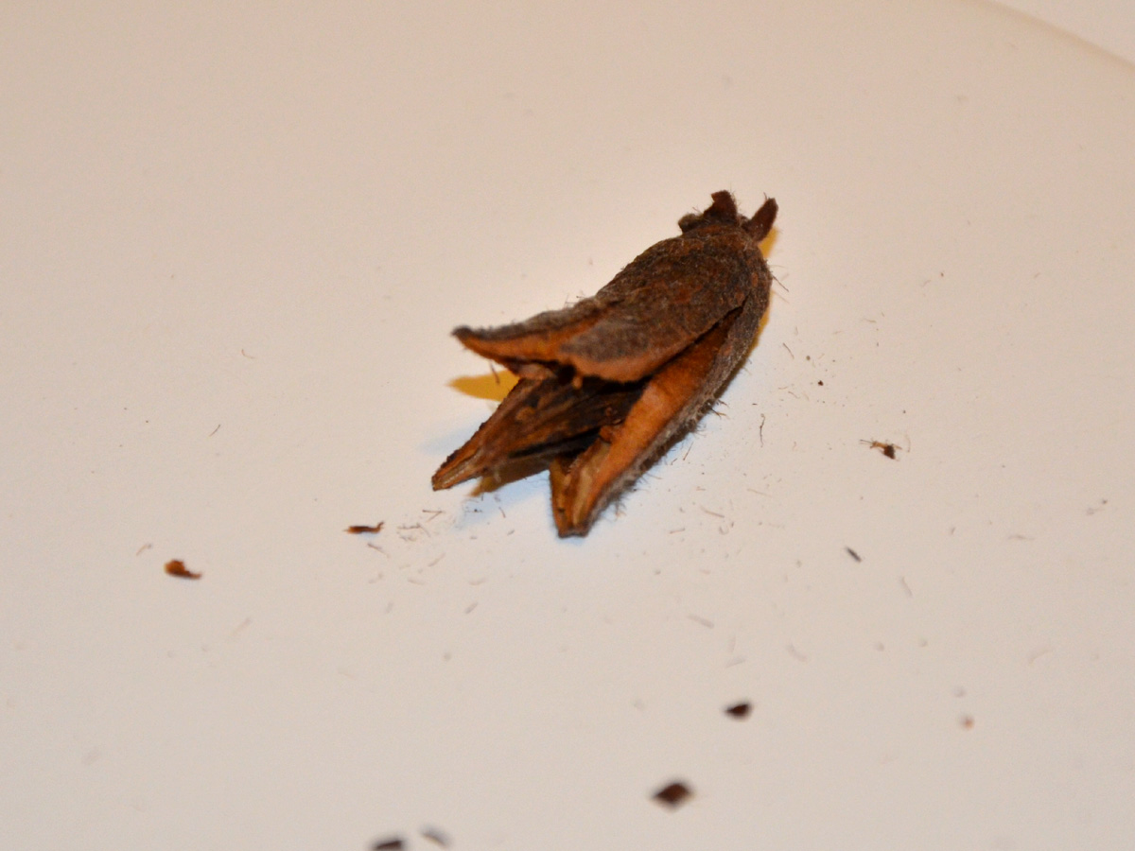
Most seedpods have multiple channels
surrounding a central shaft.
Shaft
Channel

Slide 37
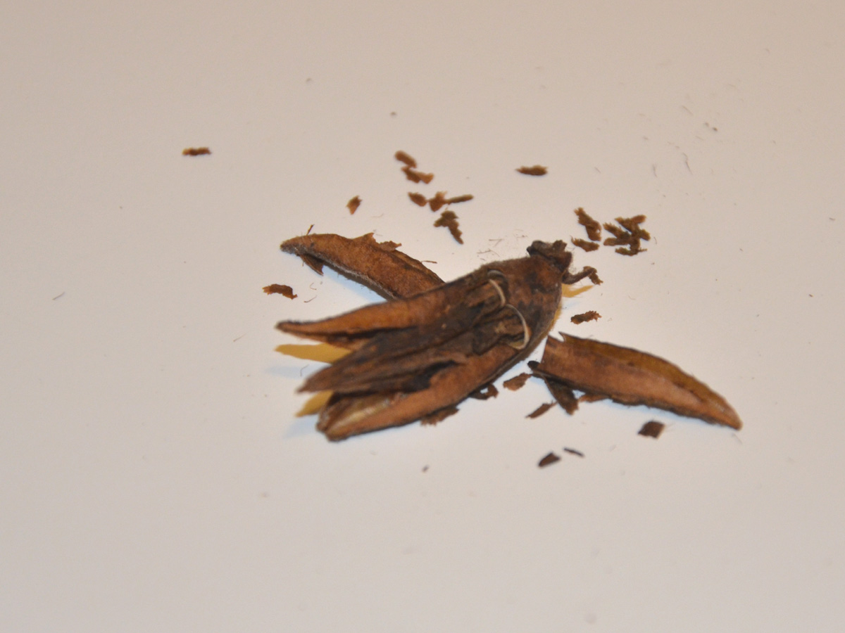
Seeds attach to the shaft are in the channels.
Seeds
Shaft
Channel

Slide 38
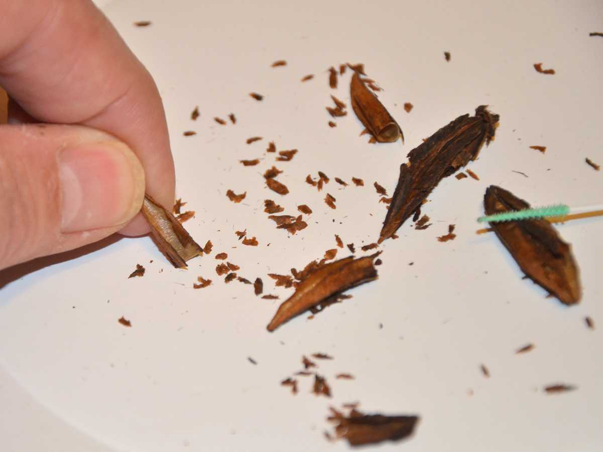
Remove seeds from the shaft and channels.

Slide 39
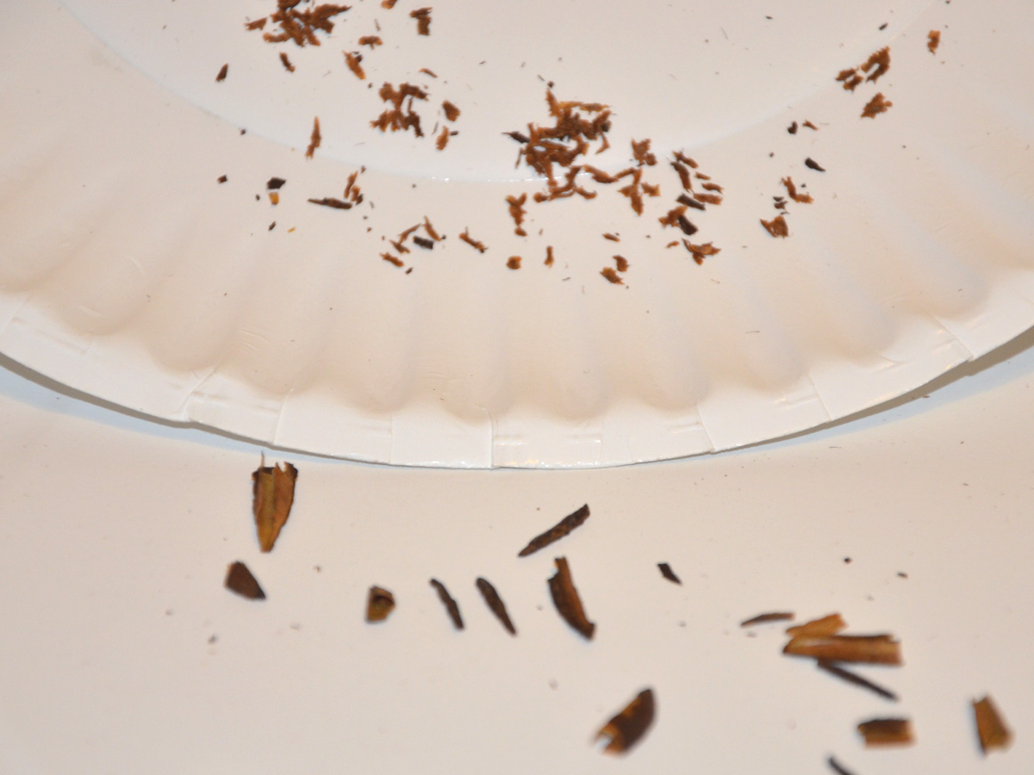
Seeds
Debris
Separate seeds and the debris.

Slide 40
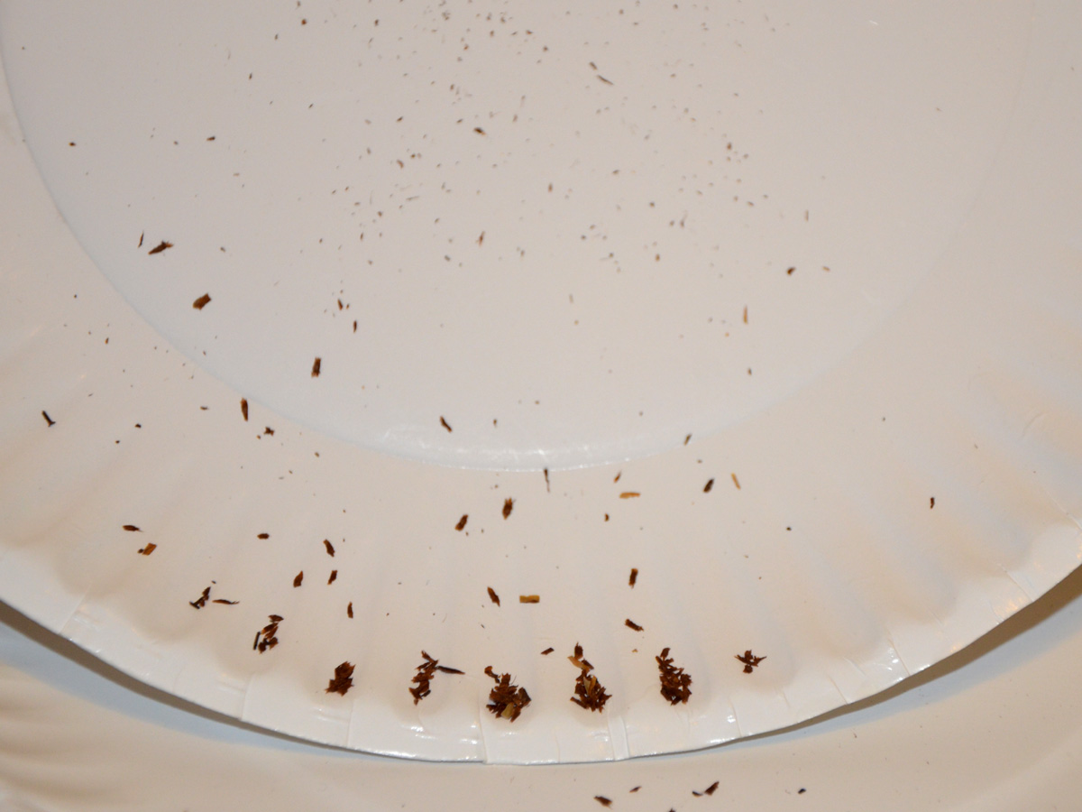
Separate seeds from dust.
Dust
Seeds

Slide 41
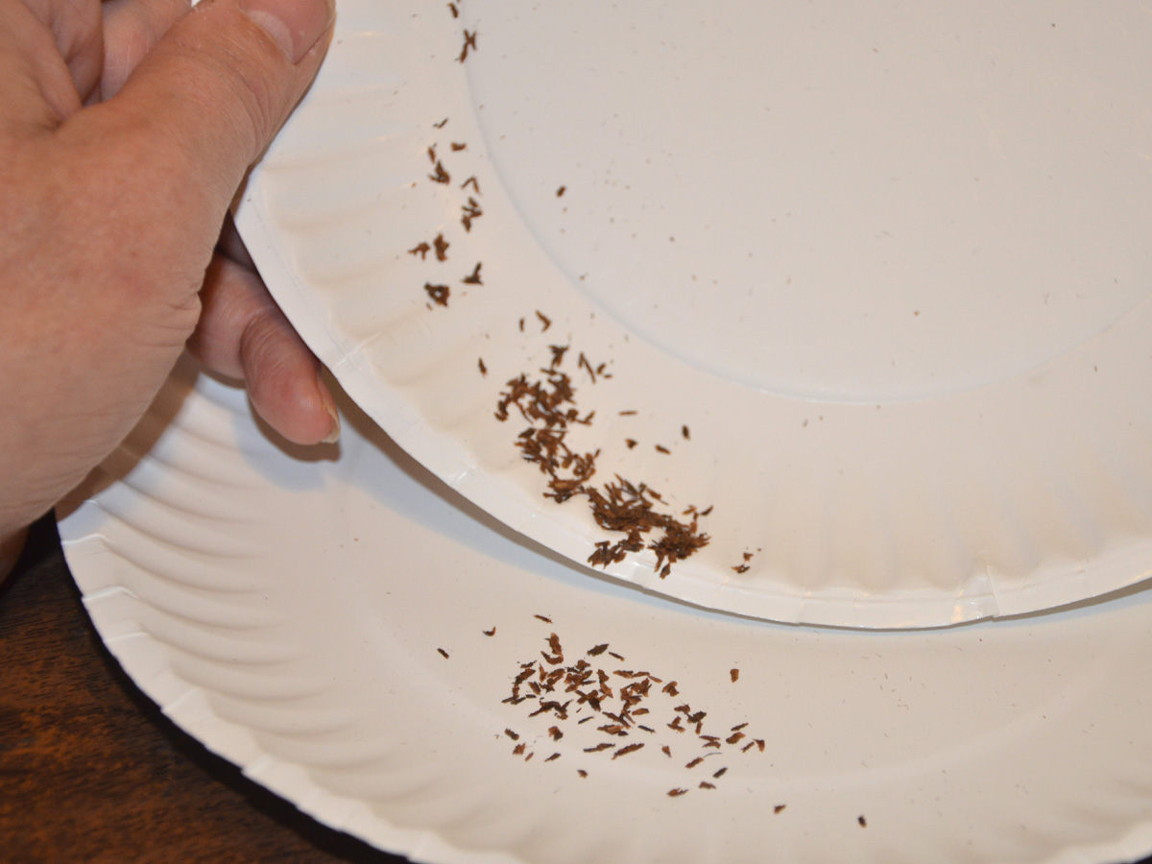
Separate seeds from dust.
It is a technique similar
to panning for gold.
Paper Plates are Great!

Slide 42
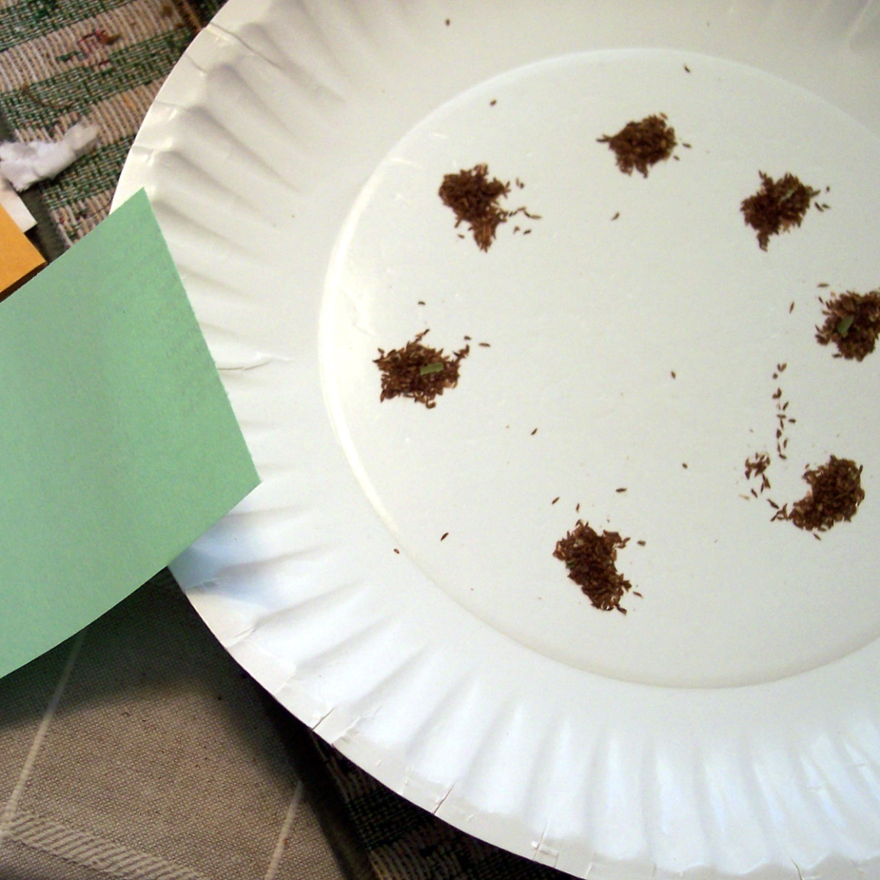
How Much Seed?
Seedpods may
have no seeds
to hundreds.
Share seeds
with others.

Slide 43
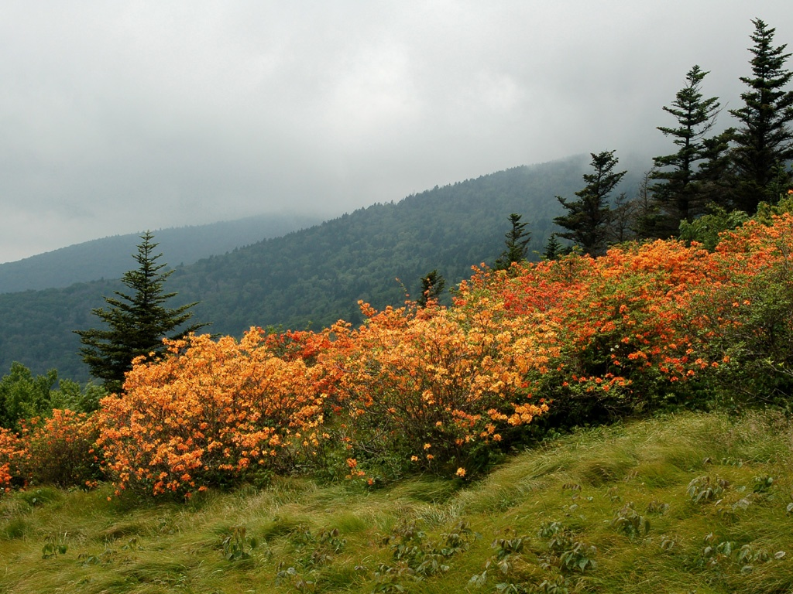
Plants in the wild produce millions of seeds, but due to competition and early seedling mortality, very few will reach maturity.

Slide 44
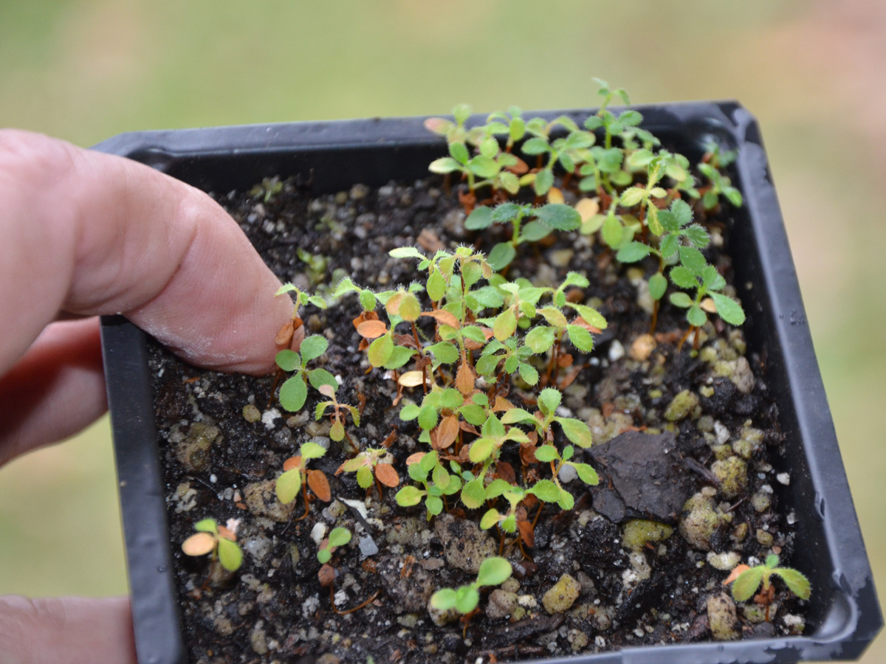
If we can get seedlings past the vulnerable stage, they can make it on their own.

Slide 45
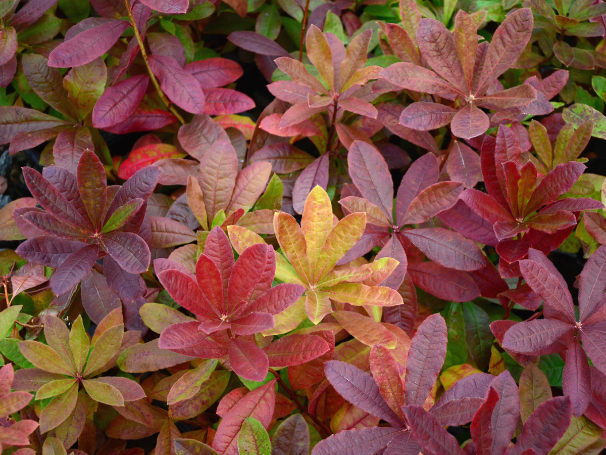

Slide 46
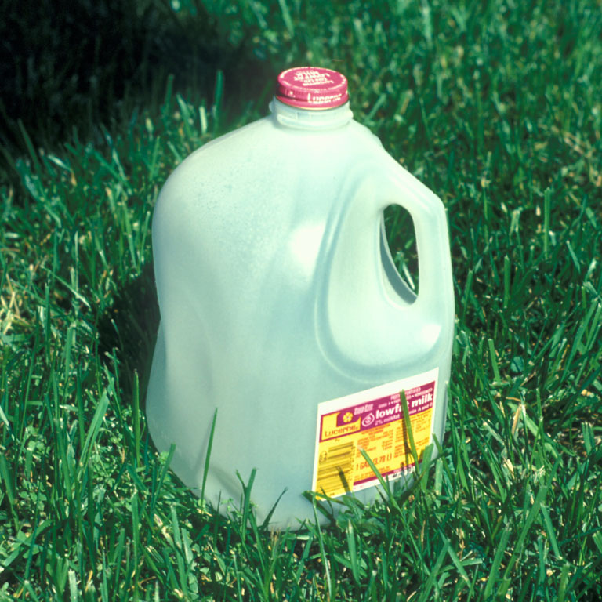
Planting the Seed
Procedure
Cut-off Milk Jug
Find a suitable pot

Slide 47
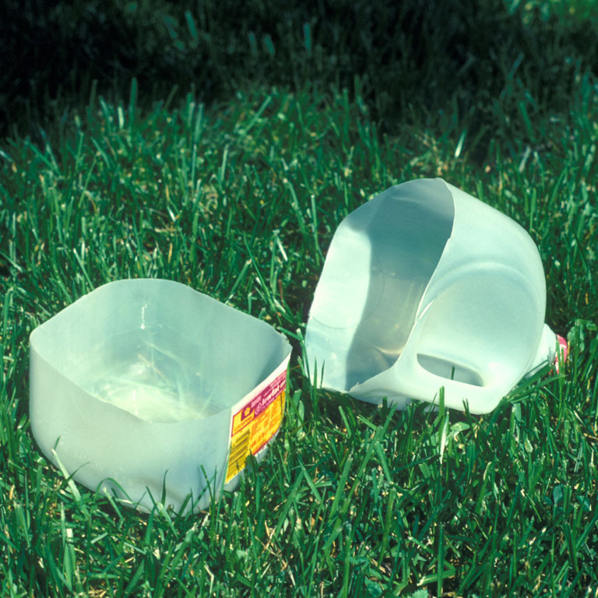
Planting the Seed
Procedure
Cut-off Milk Jug
Find a suitable pot
Make slits for drainage

Slide 48
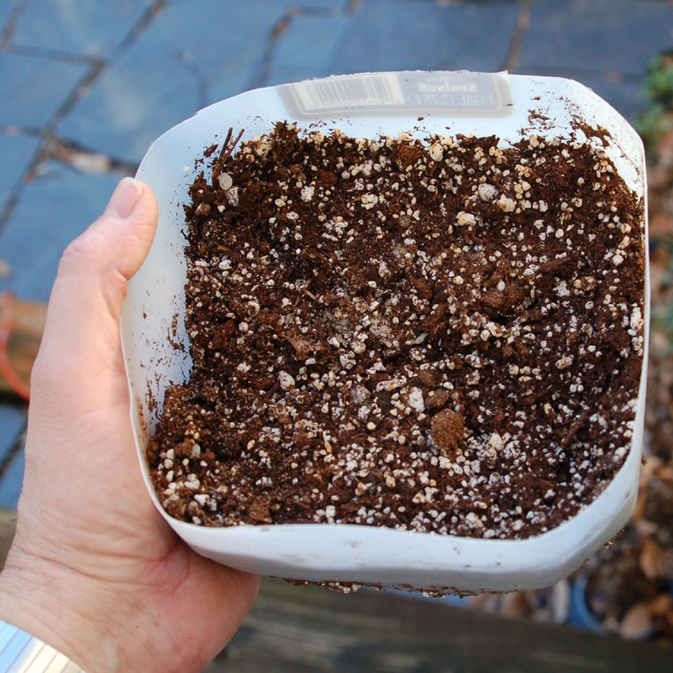
Planting the Seed
Procedure
Find a suitable pot
2. Prepare medium:
50% Peat
50% Perlite
Coarse Sand, Pine Fines

Slide 49
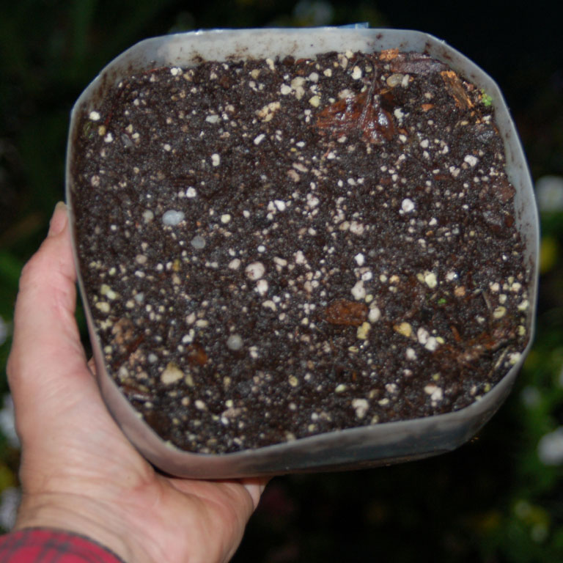
Planting the Seed
Procedure
Find a suitable pot
2. Prepare medium:
50% Peat
50% Perlite
Coarse Sand, Pine Fines
3. Plant on surface
Moisten but do not
make too wet!

Slide 50
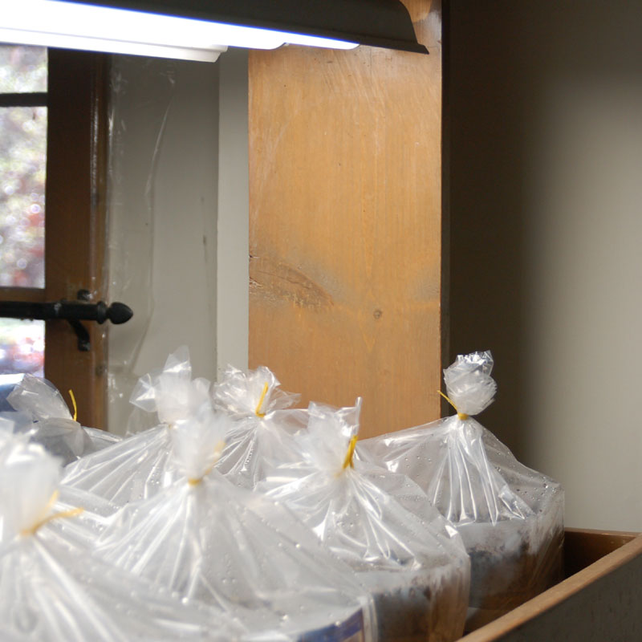
Germination
Process
Put pots in a clear
plastic bag to make
a mini-greenhouse.
2. Put containers in
a warm spot out of
direct sun or under
fluorescent lights.

Slide 51
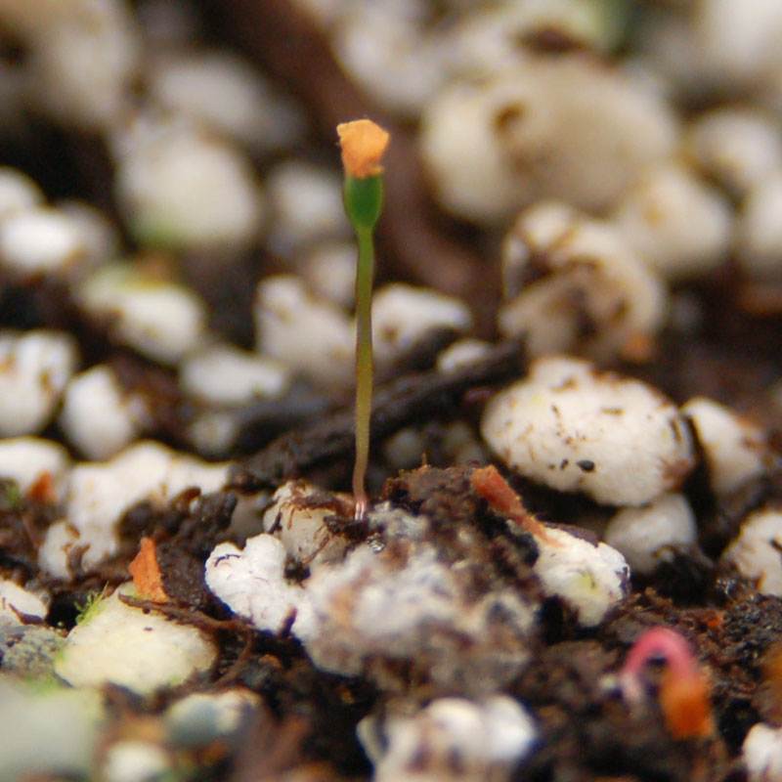
Germination
Process
Fluorescent lights
are best and they
should stay on 18
24 hours a day
2. Seed germinates
in 2 to 3 weeks

Slide 52
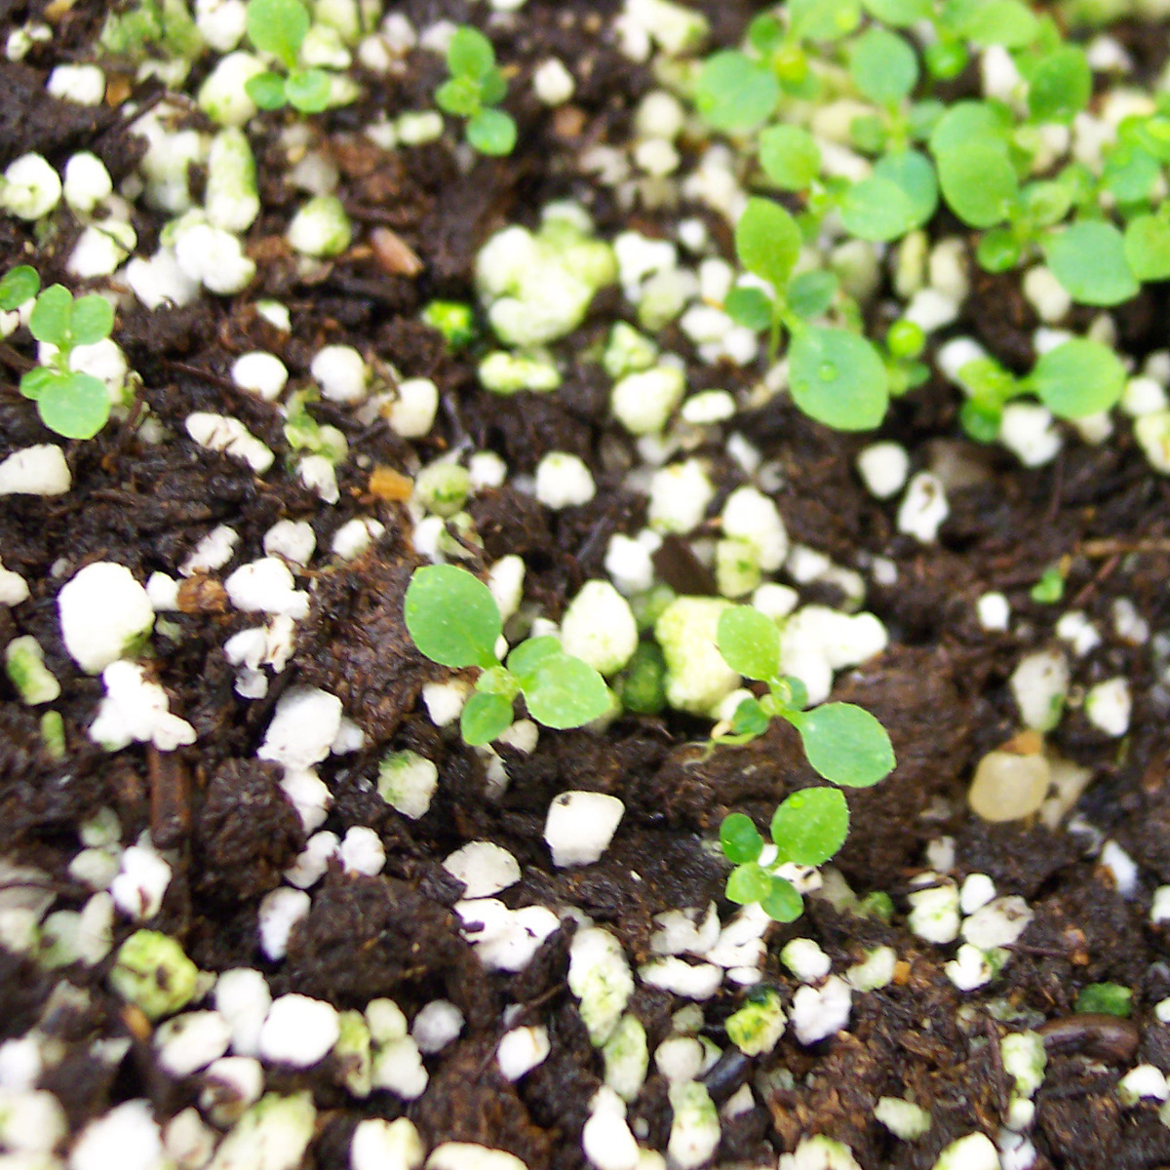
Germination
Process
1. Mini-greenhouses
need little care
2. The condensation
on the bag will drop
like rain on the soil
3. Plants in low light
don’t need much
fertilizer
Liquid Fertilizer (1/8 strength)
Weak fertilizer, once!
or Slow Release (a few grains)

Slide 53
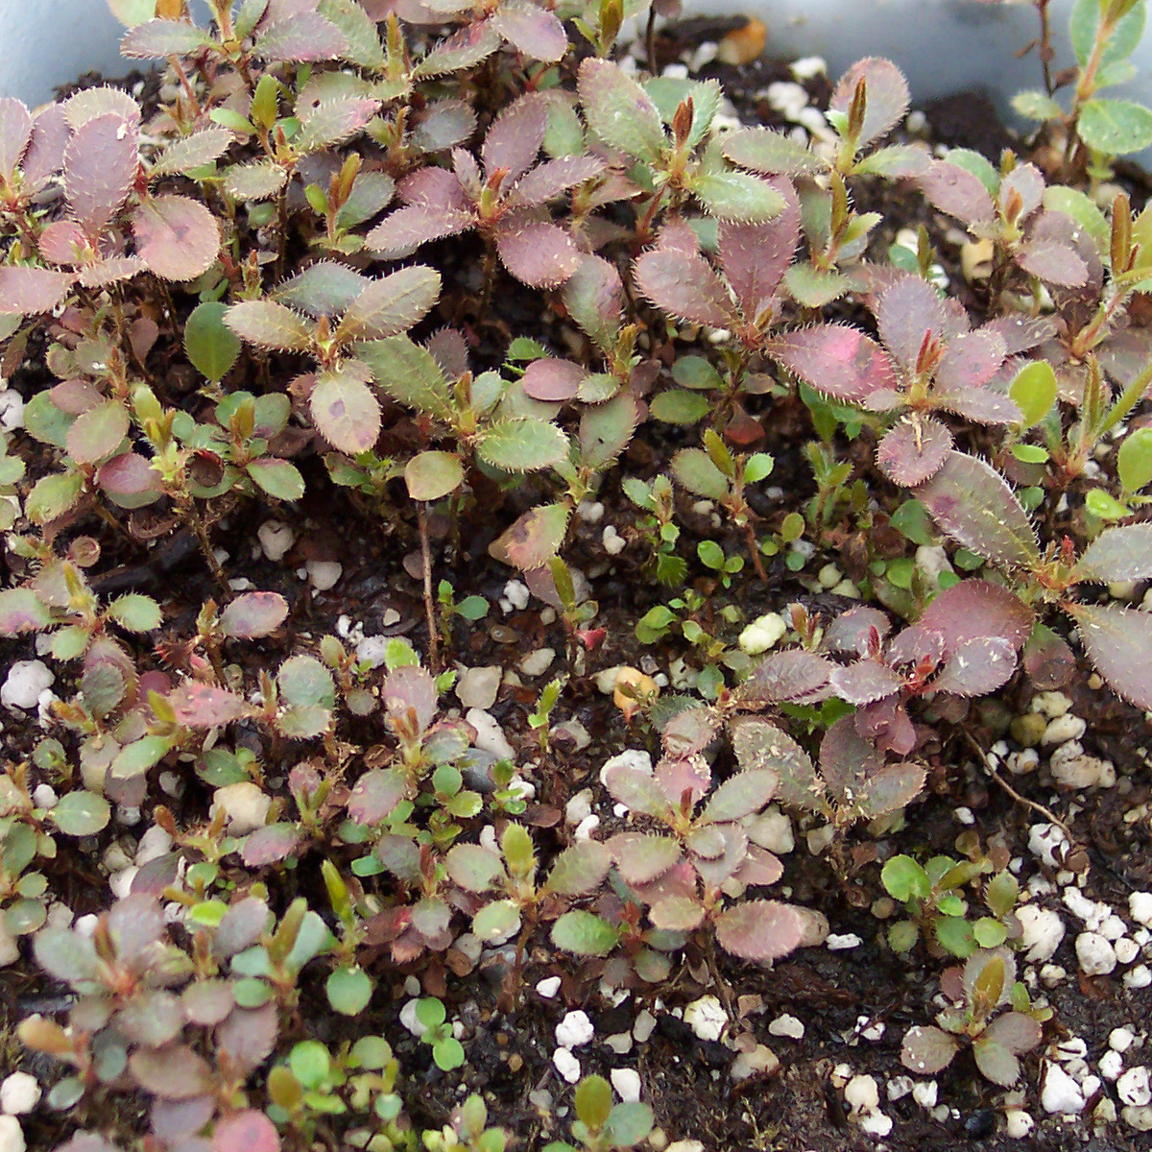
Germination
Process
1. Harden off before
transplanting
Hardening off means to
get plants used to lower
humidity levels. Those seedlings are used to 100% humidity so open
the bags slowly over
several days so they get
adjusted to normal conditions.

Slide 54
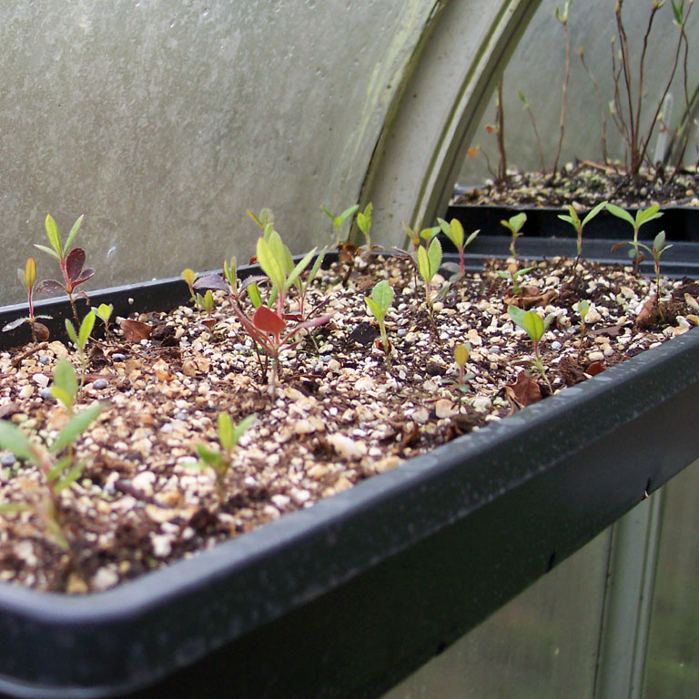
Germination
Process
1. Harden off before
transplanting
2. Transplant to flats
or small pots

Slide 56
Growing On
Transplant to flats or
small pots
2. Give more light
Increase fertilizer

Slide 57
Growing On
Transplant to flats or
small pots
2. Give more light
Increase fertilizer
3. Transplant to larger
pots when ready

Slide 58
Growing On
Transplant to flats or
small pots
2. Give more light
Increase fertilizer
3. Transplant to larger
pots when ready
4. Pinch to encourage
better branching

Slide 59
Growing On
Transplant to flats or
small pots
2. Give more light
Increase fertilizer
3. Transplant to larger
pots when ready
4. Pinch to encourage
better branching
5. Stop fertilizing by fall
so plants go dormant

Slide 60
Growing On
Transplant to flats or
small pots
2. Give more light
Increase fertilizer
3. Transplant to larger
pots when ready
4. Pinch to encourage
better branching
5. Stop fertilizing by fall
so plants go dormant
6. Move into larger pots
Grow in strong sun for better bud set

Slide 61
Growing On
Transplant to flats or
small pots
2. Give more light
Increase fertilizer
3. Transplant to larger
pots when ready
4. Pinch to encourage
better branching
5. Stop fertilizing by fall
so plants go dormant
6. Move into larger pots
Grow in strong sun for better bud set

Slide 62
Growing On
Transplant to flats or
small pots
2. Give more light
Increase fertilizer
3. Transplant to larger
pots when ready
4. Pinch to encourage
better branching
5. Stop fertilizing by fall
so plants go dormant
6. Move into larger pots
Grow in strong sun for better bud set

Slide 63
Planting
Site Selection
Rhododendrons
Rich Woodland Border
Dappled Sun and Shade
Wind Protection

Slide 64
Planting
Site Selection
Native Azaleas
At Least a Half Day of Full Sun
Afternoon Shade Best in Hot Climates

Slide 65
Soil
SOIL
Rich Humus Soil
Good Drainage

Slide 66
Reality – Bad soil
SOIL
Heavy Clay Soils are Bad

Slide 67
Poor Drainage
Poor Drainage Can Kill

Slide 68
Summer – Heat & Drought
Poor Drainage Can Kill

Slide 69
Summer – Heat & Drought
Do not plant deeply.
Poor Drainage Can Kill

Slide 70
Don’t Plant Too Deep
Do not plant deeply.
Set the plant high.

Slide 71
Don’t Plant Too Deep
Mulch well!
Set the plant high.

Slide 72
Don’t Plant Too Deep
Mulch well!
But not too well.

Slide 73
Fertilizer
Fertilizer can kill!
FERTILIZER

Slide 74
Fertilizer
Use ½ to ¼ of recommended
strength.
FERTILIZER
Never fertilize rhododendrons or azaleas after mid July since
plants may not
go dormant in the fall. They
will be prone
to winter kill.

Slide 75
Container Plants
Container Plants

Slide 76
Break Up The Roots
Pull apart the roots to help them get established in the new soil.
Container Plants

Slide 77
Break Up The Roots
Pot Bound Plants

Slide 78
Break Up The Roots
Pot Bound Plants

Slide 79
Break Up The Roots
Pot Bound Plants

Slide 80
Break Up The Roots
Pot Bound Plants
They may be better moved
to a larger pot so the roots
can get adjusted before
trying to plant out.

Slide 81
Blizzard
R. prunifolium
Buds: -15º F
Roots: +20º F
Root systems are not
necessarily as hardy
as buds or branches.

Slide 82
Blizzard
Protect containers over winter.
Cluster pots together
Mulch pots to insulate

Slide 83
Blizzard
Protect containers over winter.
Snow can insulate, too!

Slide 84
Enjoy!
Enjoy!

Slide 85
Enjoy!
For More Information:
American Rhododendron Society
www.rhododendron.org
Azalea Society of America
www.azaleas.org
Potomac Valley Chapter ARS
www.arspvc.org
Donald W. Hyatt (author)
www.donaldhyatt.com
don@donaldhyatt.com

Slide 86
The End

