Slide 1
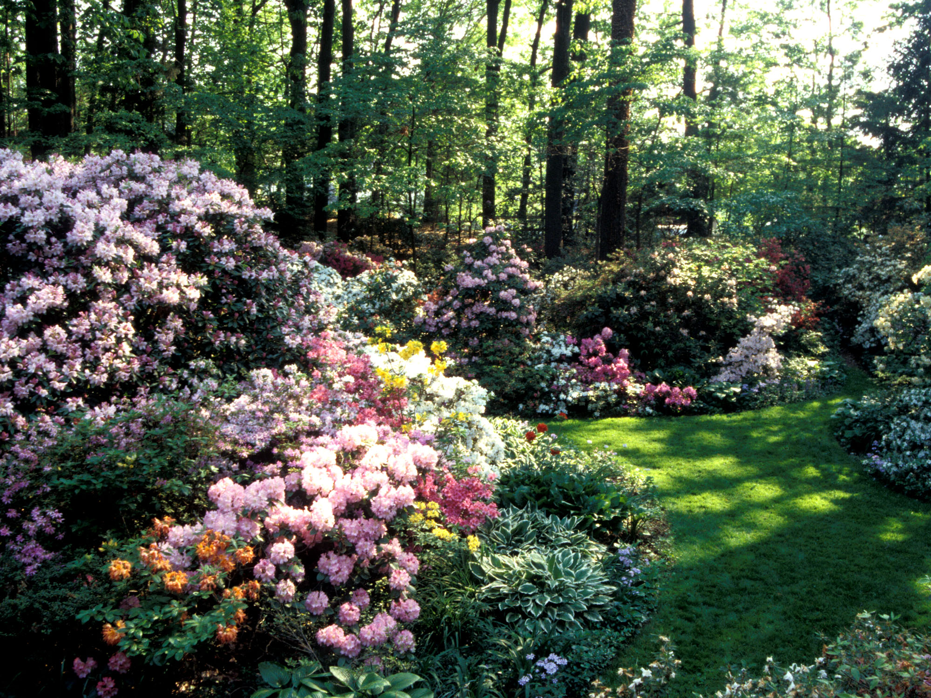
Propagation
Techniques for Propagating Rhododendrons and Azaleas
Rooting Cuttings
by Donald W. Hyatt
Copyright © 2019 American Rhododendron Society

Slide 2
Propagation

Slide 3
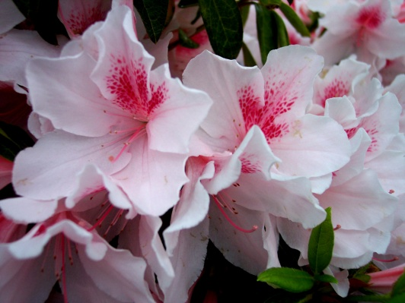
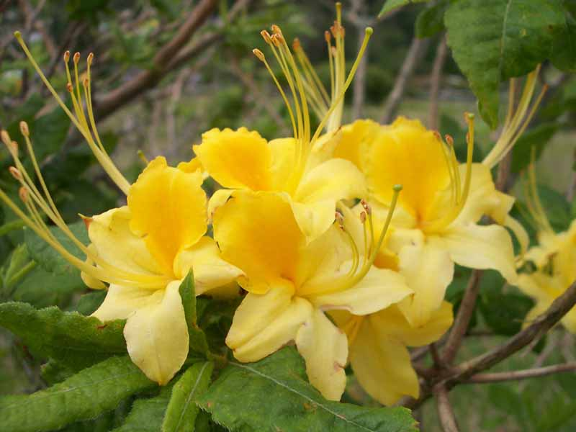
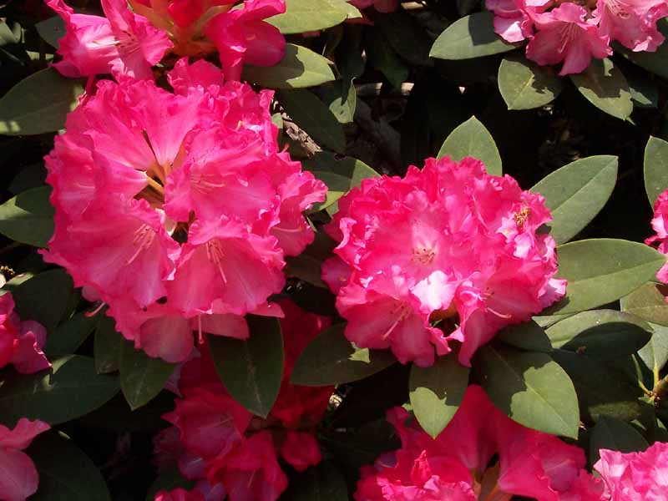
Propagation by Cuttings
Evergreen Azaleas
Usually Easy
Deciduous Azaleas
Usually Difficult
Rhododendrons
Some are Easy
Some are Difficult

Slide 4
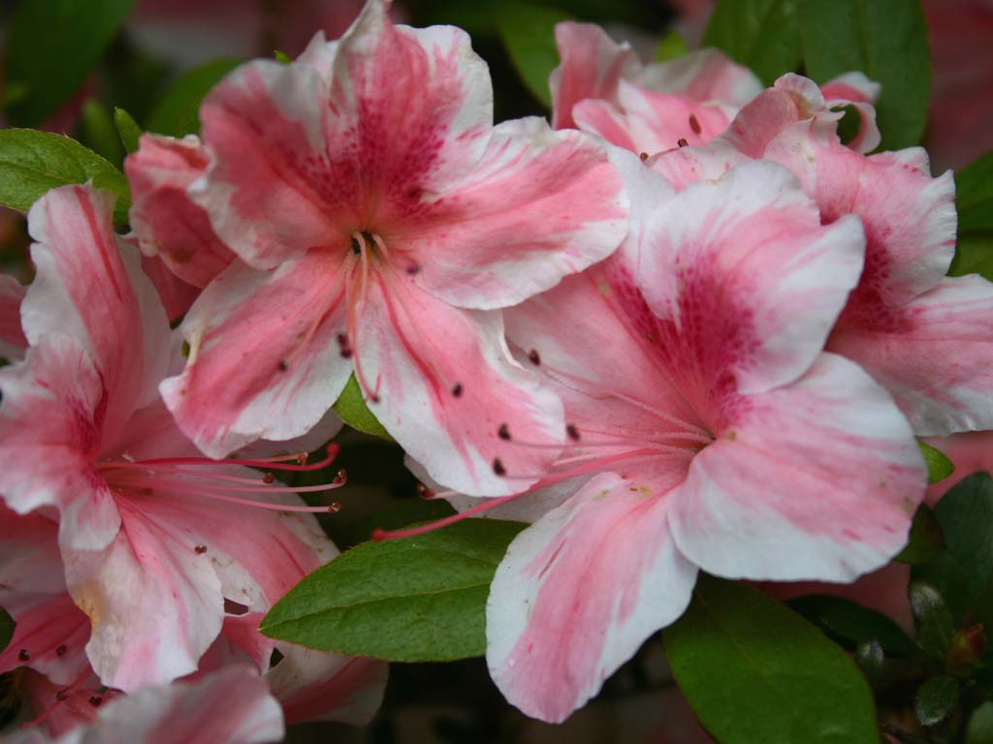
Evergreen Azalea Cuttings
Considerations
Timing
Selection
Preparation
Sterilization
Hormone
Rooting
Growing

Slide 5
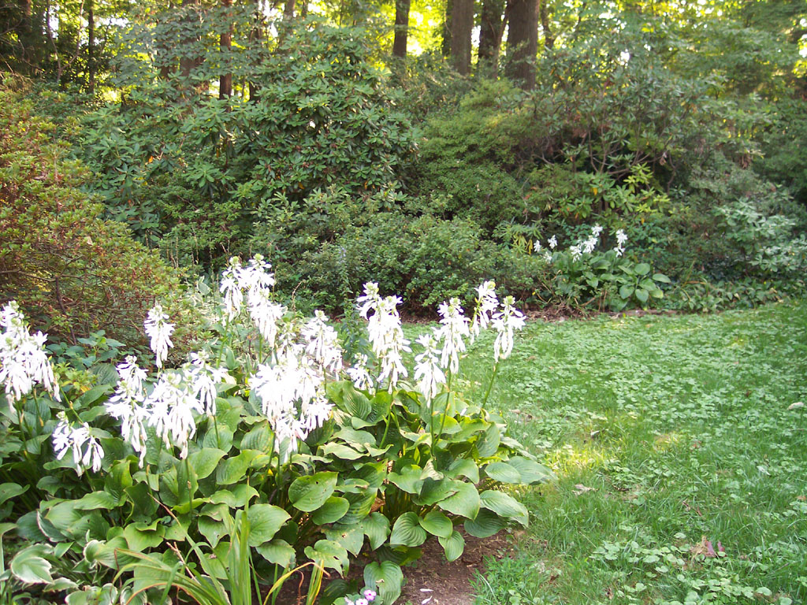
Timing and Selection
Usually take
in June or July.

Slide 6
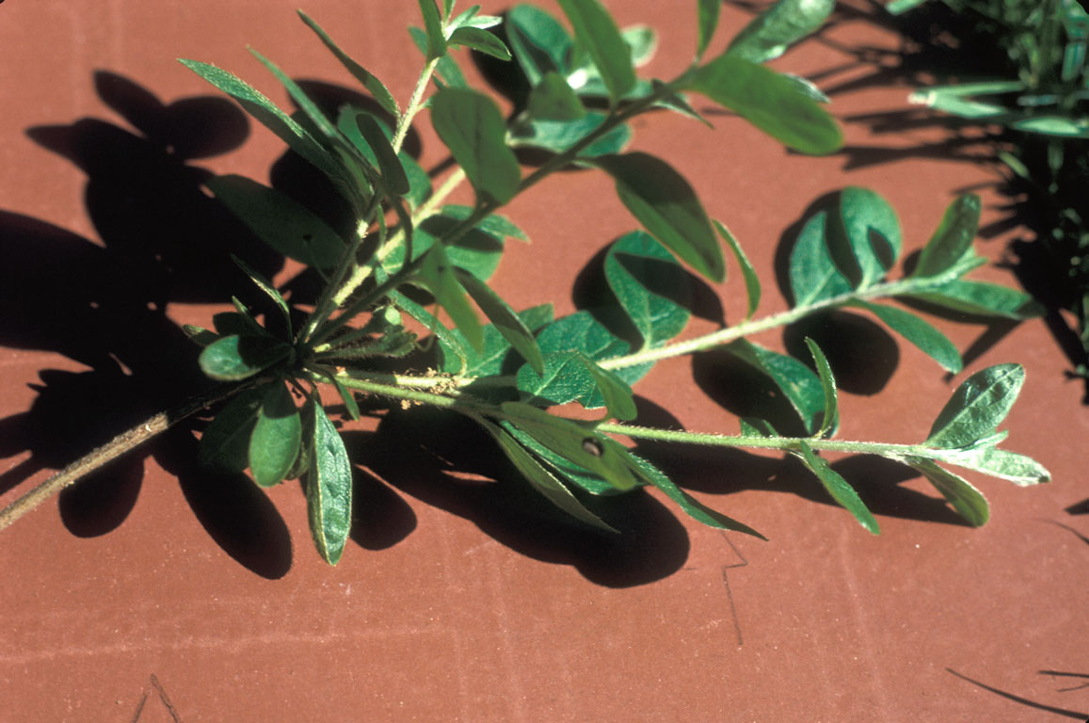
Timing and Selection
Usually take
in June or July.
2. Choose healthy
growth that is
getting firm.

Slide 7
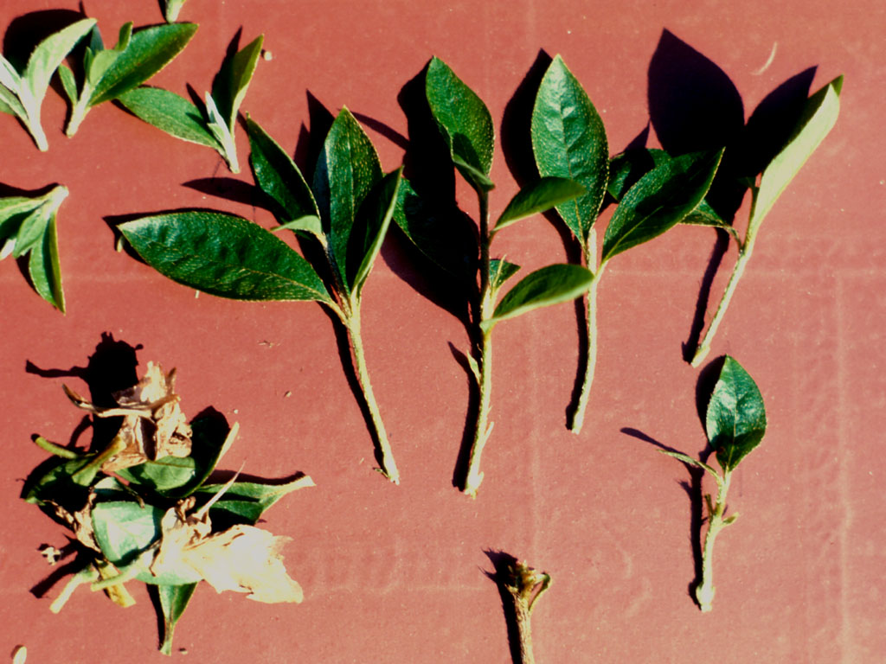
Timing and Selection
Usually take
in June or July.
2. Choose healthy
growth that is
getting firm.
3. Separate into single stems.
Pinch out the soft tips.
Remove lower
1eaves.

Slide 8
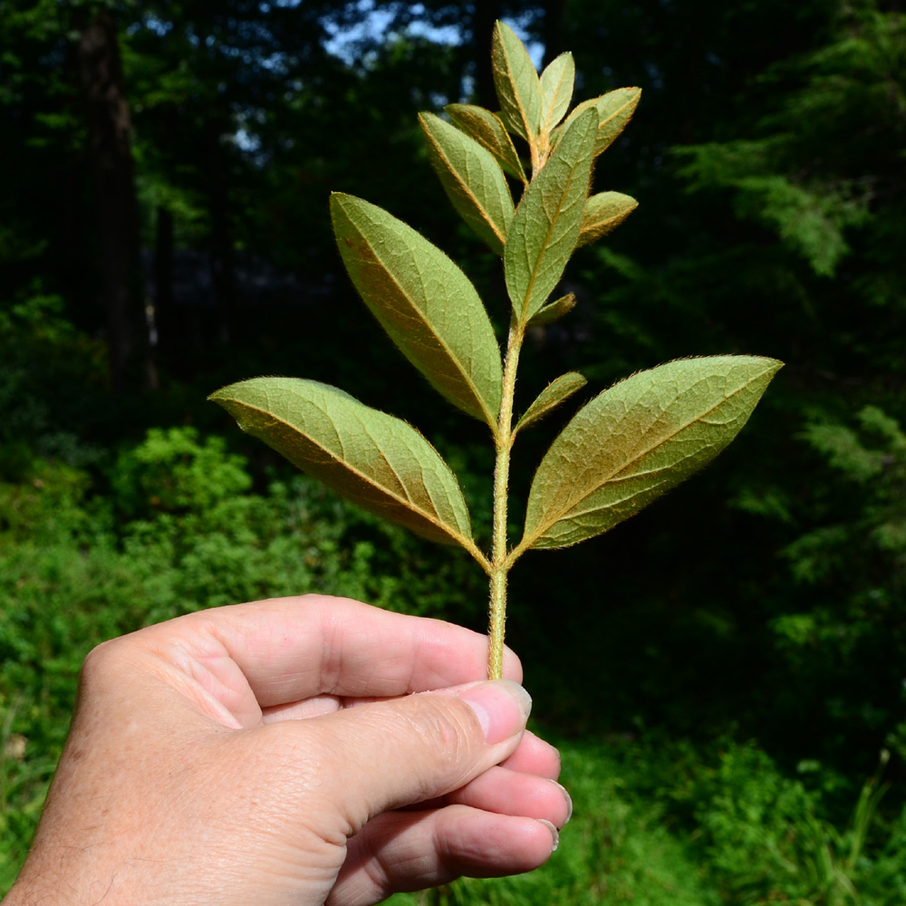
Timing and Selection
Be careful when removing lower leaves.

Slide 9
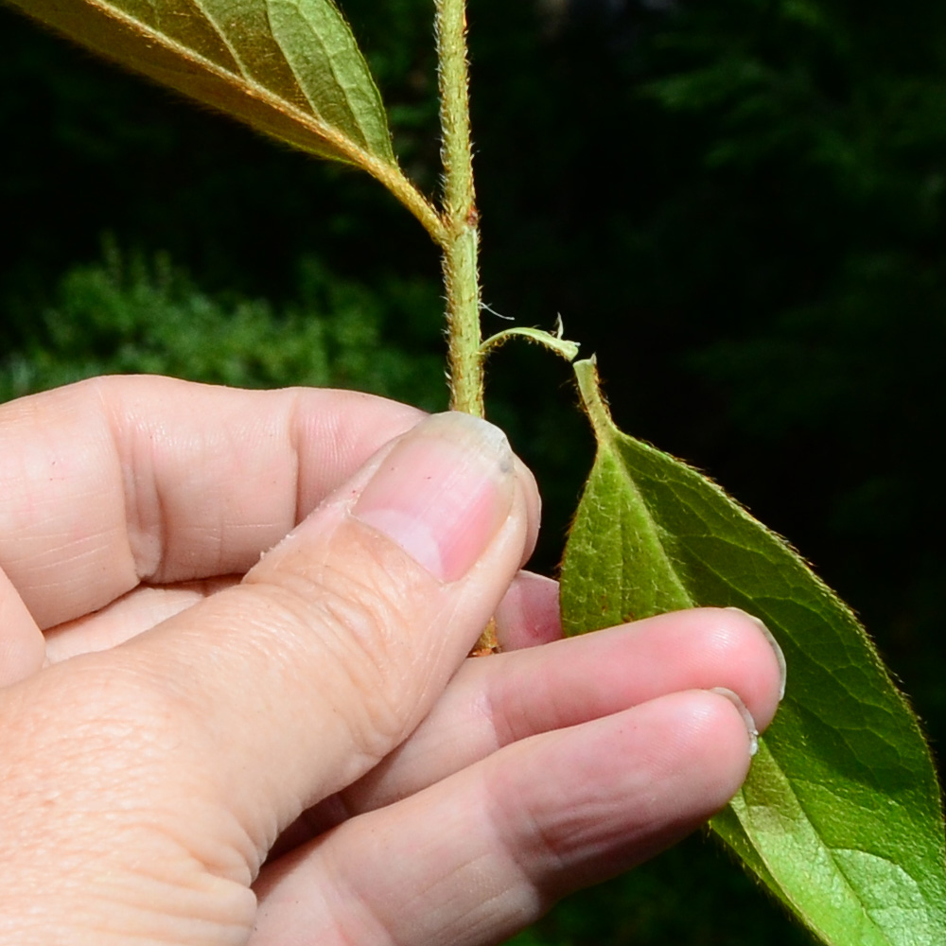
Timing and Selection
Be careful when removing lower leaves.
Bark Gets
Torn Away
Don’t pull down since it can tear the bark off the stem.

Slide 10
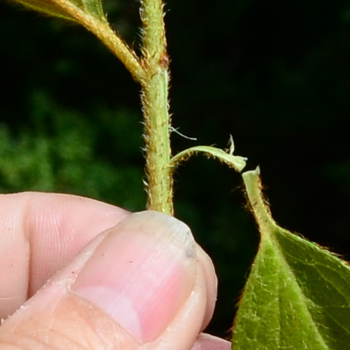
Timing and Selection
Be careful when removing lower leaves.
Bark Gets
Torn Away
Don’t pull down since it can tear the bark off the stem.

Slide 11
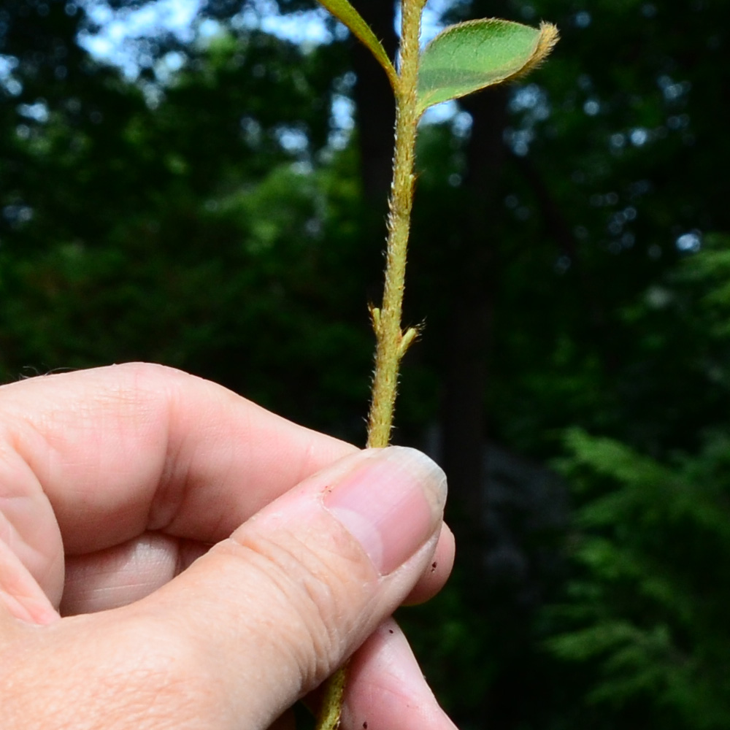
Timing and Selection
Be careful when removing lower leaves.
Don’t pull down since it can tear the bark off the stem.
Pinch off leaves or pull upwards so that the bark is not harmed.

Slide 12
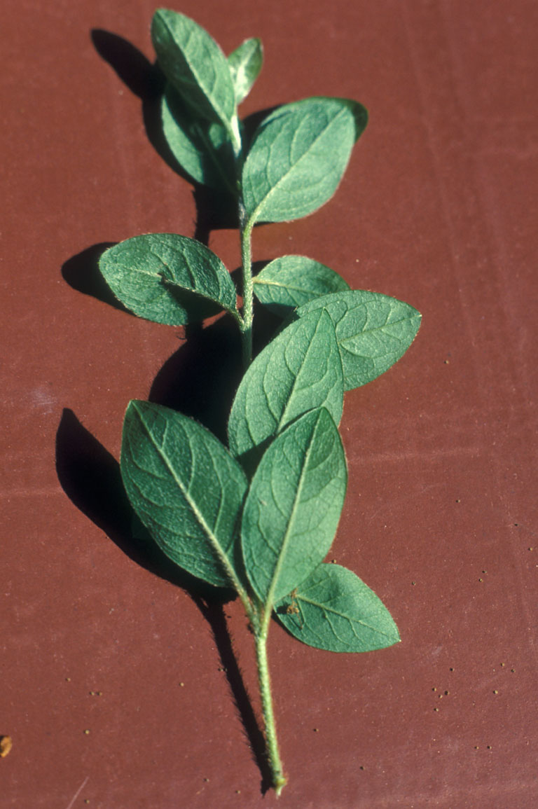
Cutting Length
Short cuttings are preferred.

Slide 13
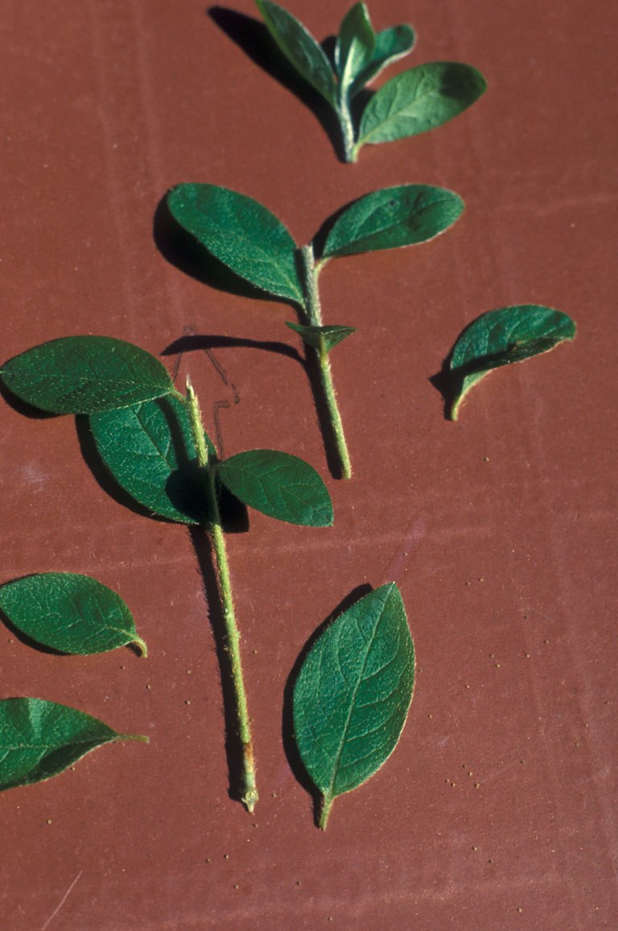
Cutting Length
Short cuttings are preferred.
Long shoots
can be cut in
shorter pieces.

Slide 14
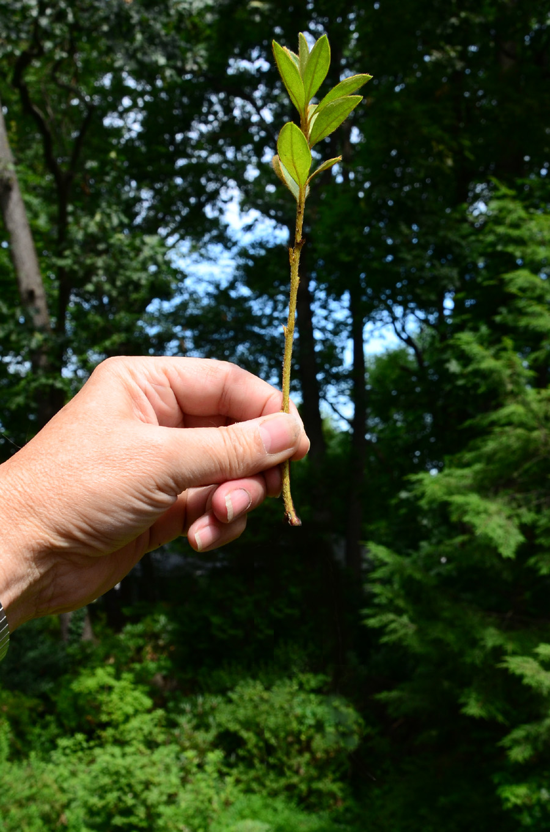
Why Short
Cuttings?
Rhododendrons and azaleas are shallow rooted plants.
Long cuttings will root but those roots usually
form at the end of the cutting.

Slide 15
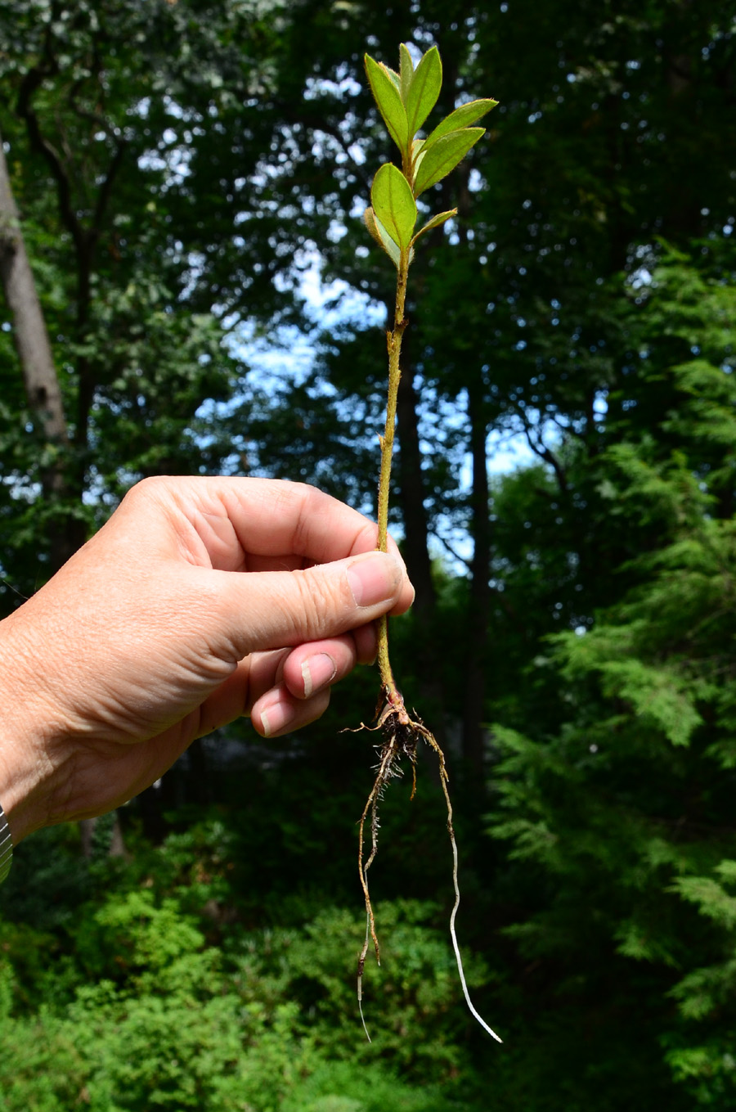
Why Short
Cuttings?
Rhododendrons and azaleas are shallow rooted plants.
Long cuttings will root but those roots usually
form at the end of the cutting.

Slide 16
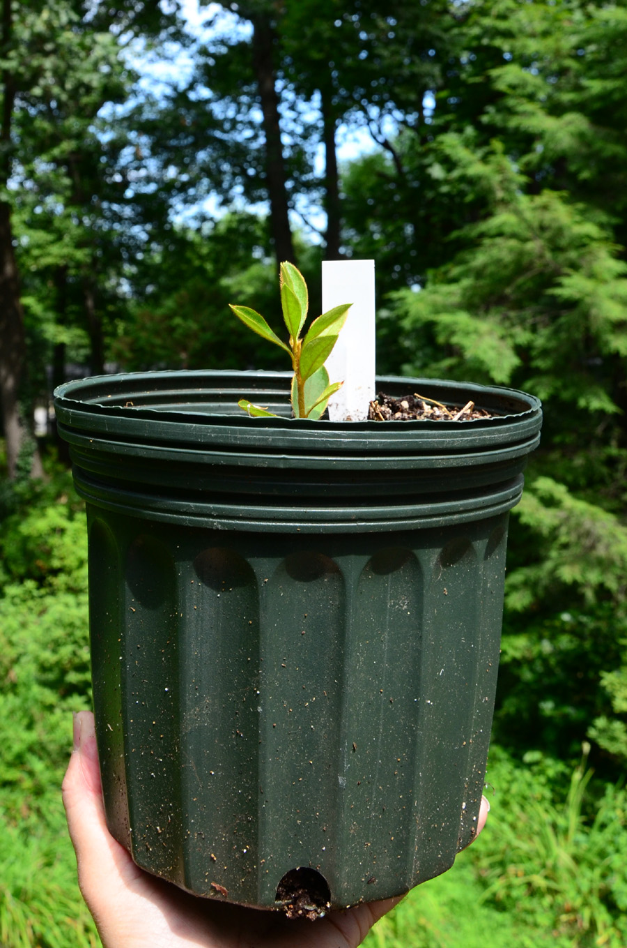
Why Short
Cuttings?
Rhododendrons and azaleas are shallow rooted plants.
Long cuttings will root but those roots usually
form at the end of the cutting.
It is easy to set the plant too deeply in the soil and that will cause problems.

Slide 17
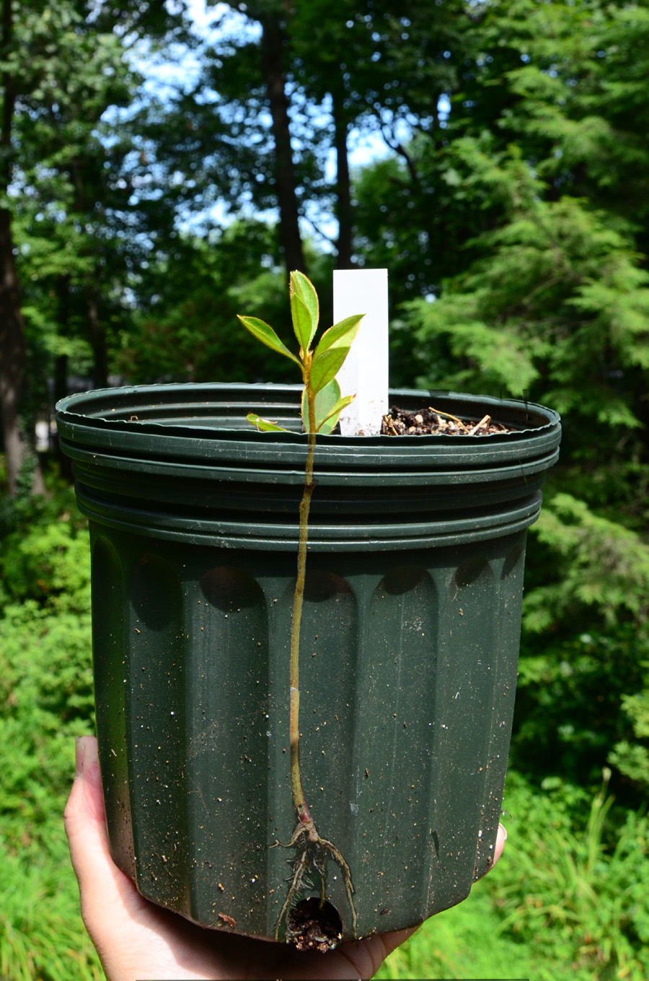
Why Short
Cuttings?
Rhododendrons and azaleas are shallow rooted plants.
Long cuttings will root but those roots usually
form at the end of the cutting.
It is easy to set the plant too deeply in the soil and that will cause problems.

Slide 18
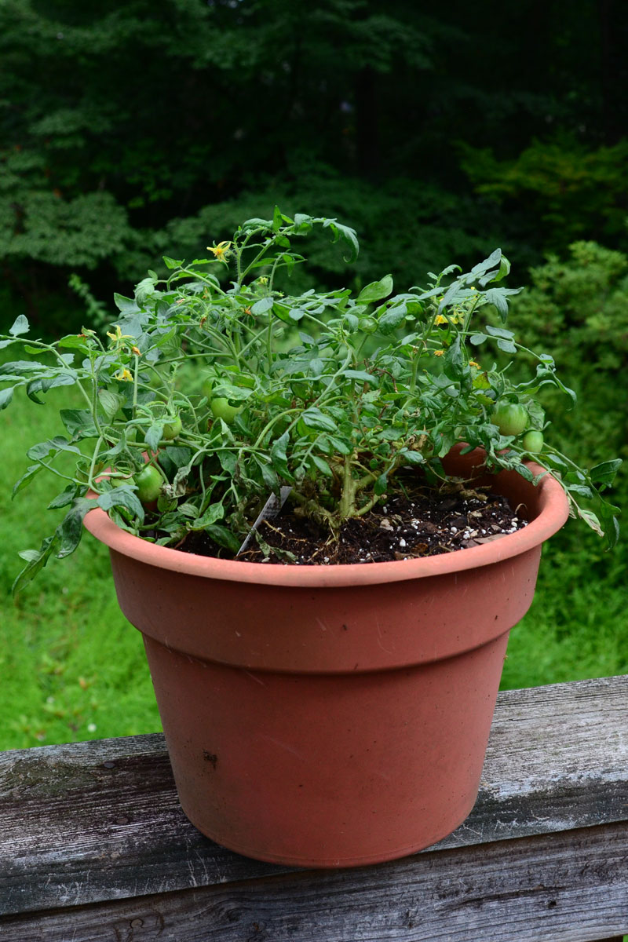
Why Short
Cuttings?
Some herbaceous plants like tomatoes enjoy being planted deeply since new roots form all along the stem. That can make a bushy, stronger plant.

Slide 19
Why Short
Cuttings?
Some herbaceous plants like tomatoes enjoy being planted deeply since new roots form all along the stem. That can make a bushy, stronger plant.
Woody plants like azaleas and rhododendrons do not and their root systems tend to smother and die if planted too deeply.

Slide 20
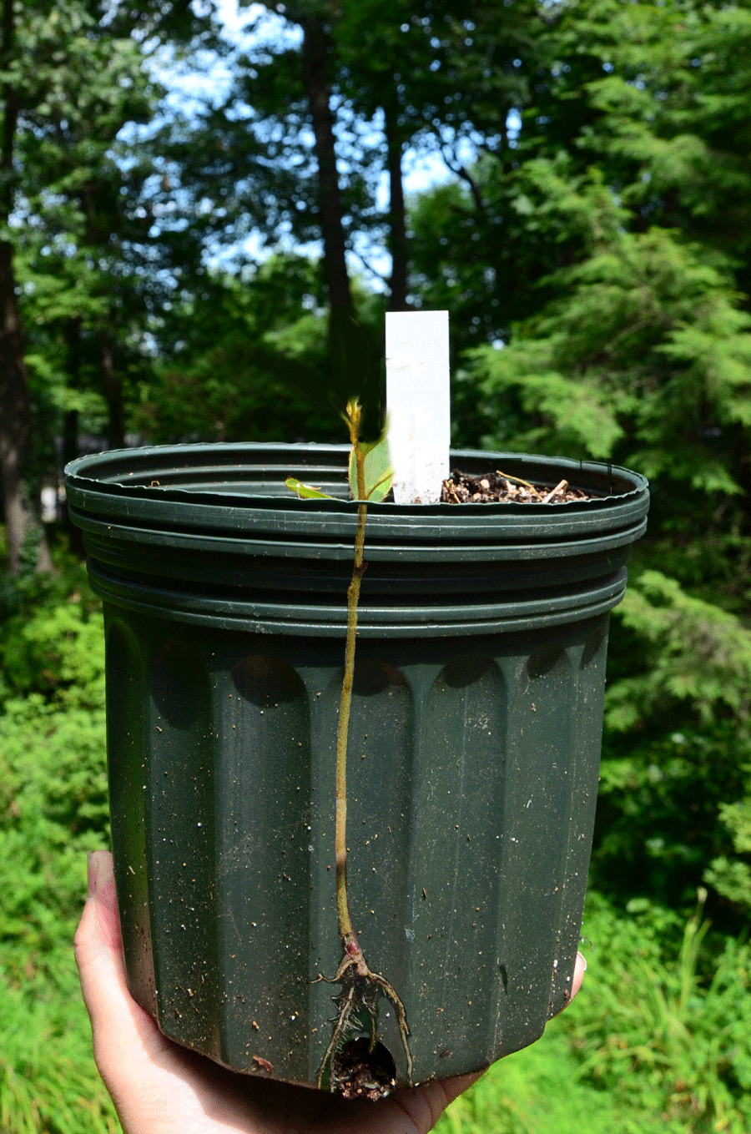
Why Short
Cuttings?
Some herbaceous plants like tomatoes enjoy being planted deeply since new roots form all along the stem. That can make a bushy, stronger plant.
Woody plants like azaleas and rhododendrons do not and their root systems tend to smother and die if planted too deeply.

Slide 21
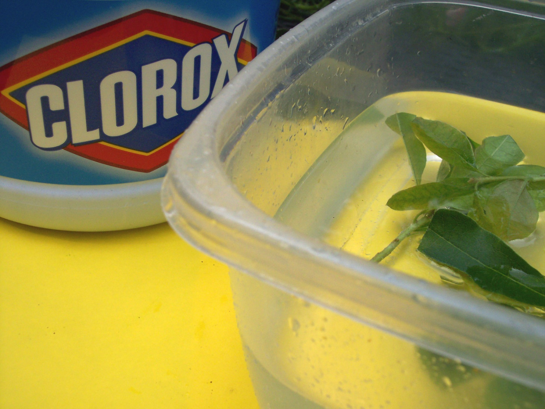
Sterilization
Avoiding potential insect and disease problems
1. Soak cuttings in dilute (5%)
Clorox water
for 5 minutes.
This step is
optional

Slide 22

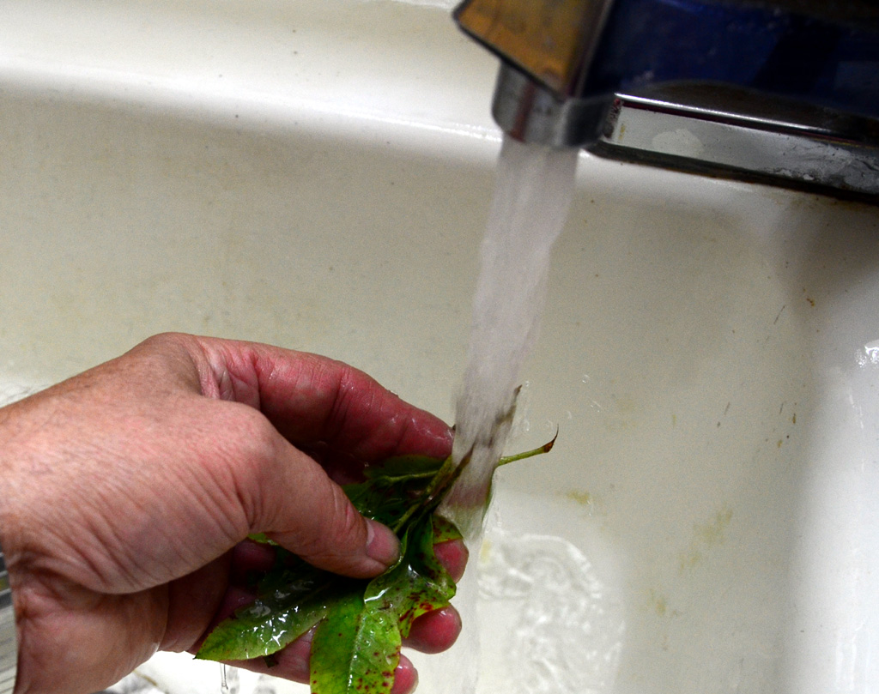
Sterilization
Avoiding potential insect and disease problems
1. Soak cuttings in dilute (5%)
Clorox water
for 5 minutes.
2. Rinse well in
clean water.

Slide 23
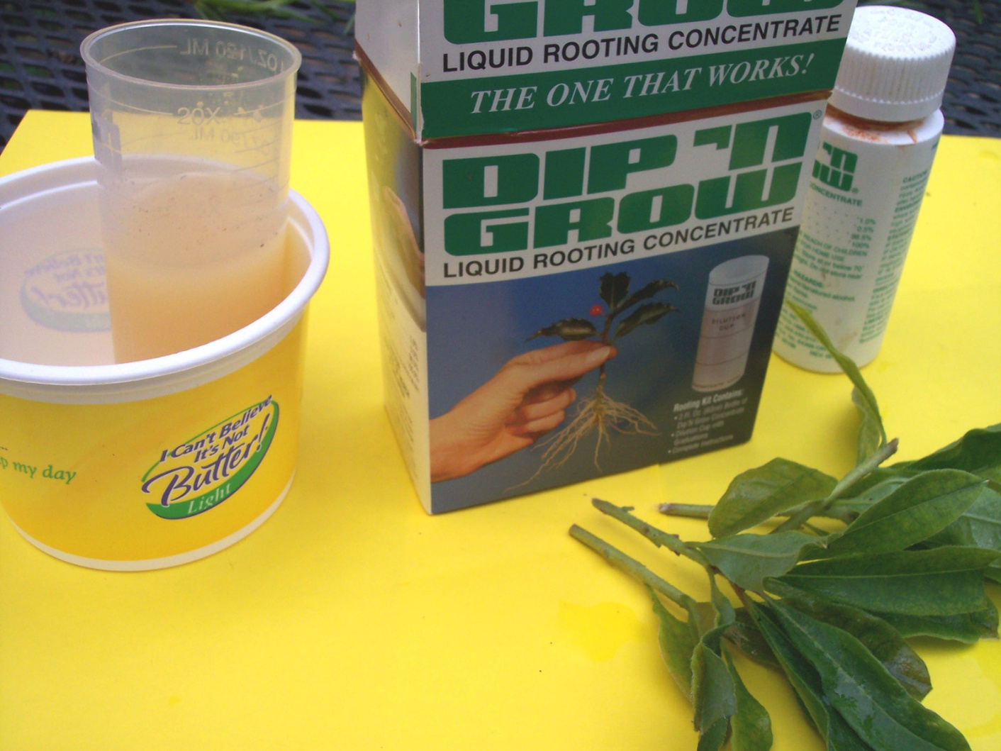
Rooting Hormone
If using a liquid
hormone like
Dip ‘n Grow, use a weak solution at a 10 to 1 ratio.

Slide 24
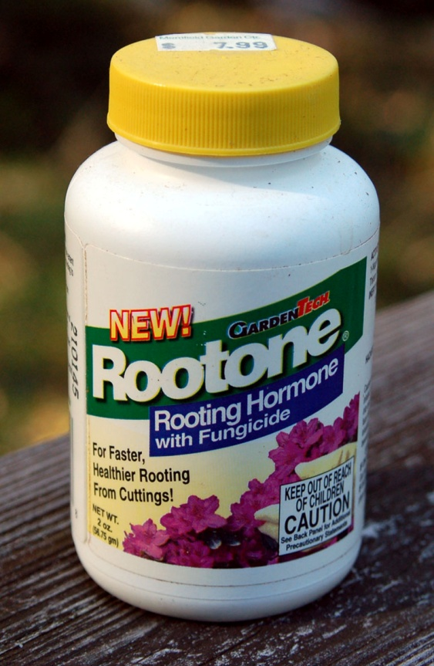
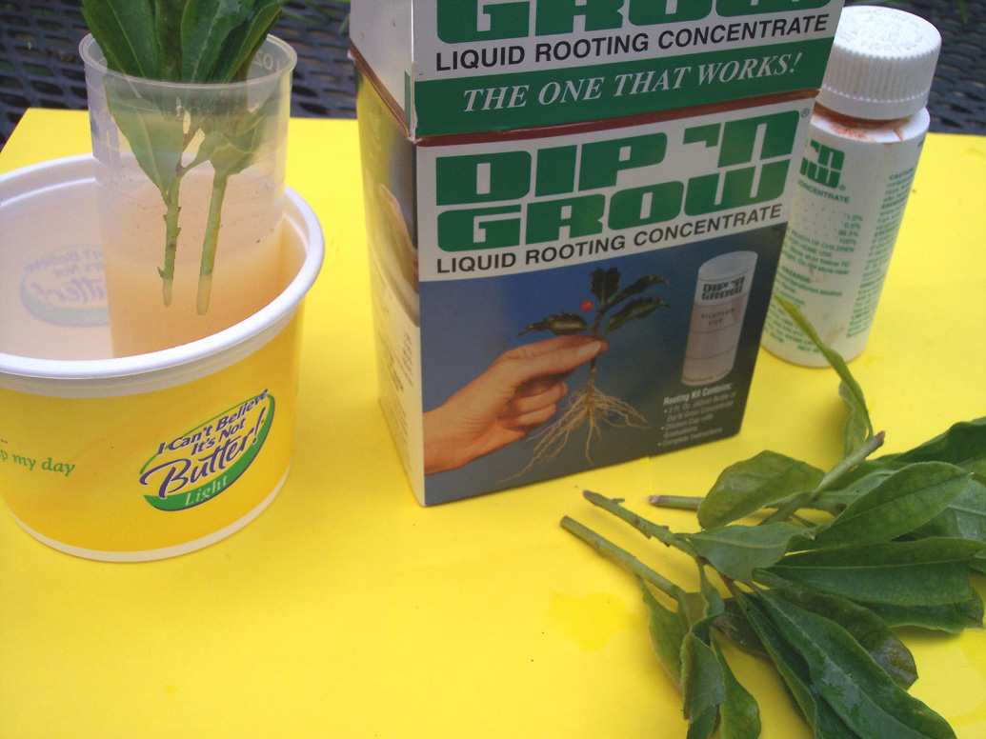
Rooting Hormone
If using a liquid
hormone like
Dip ‘n Grow, use a weak solution at a 10 to 1 ratio.
2. Dip the cutting base in hormone
for about 3 to 5 seconds.
Rootone works, too!

Slide 25
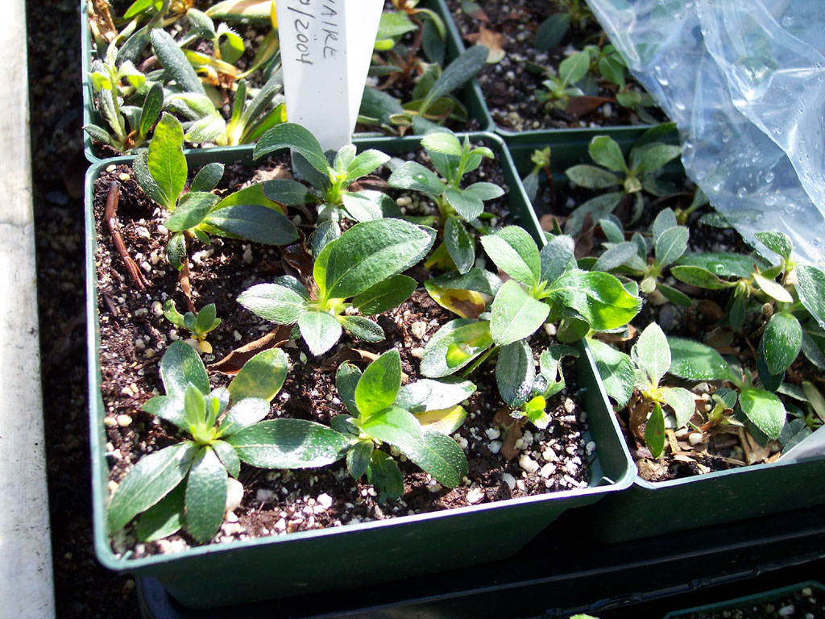
Rooting Environment
Insert cuttings
in rooting
medium.
It is a good idea to
wet the medium in
advance and let it
drain overnight.
It should be damp
but not too wet.

Slide 26
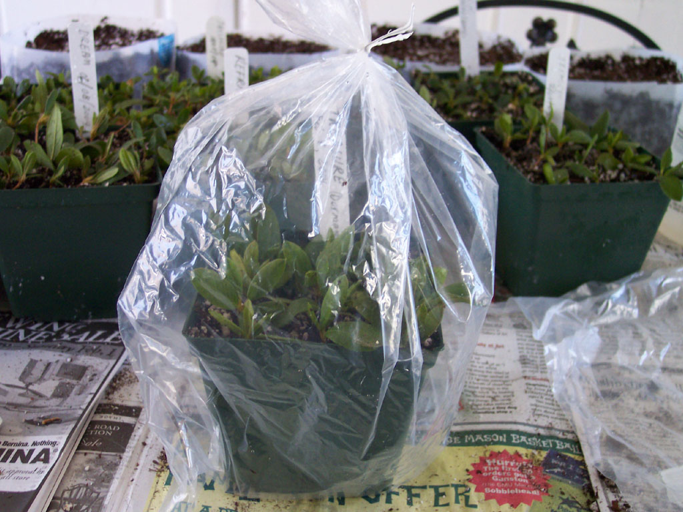
Rooting Environment
Insert cuttings
in rooting
medium.
2. Enclose pots
in plastic bags.

Slide 27
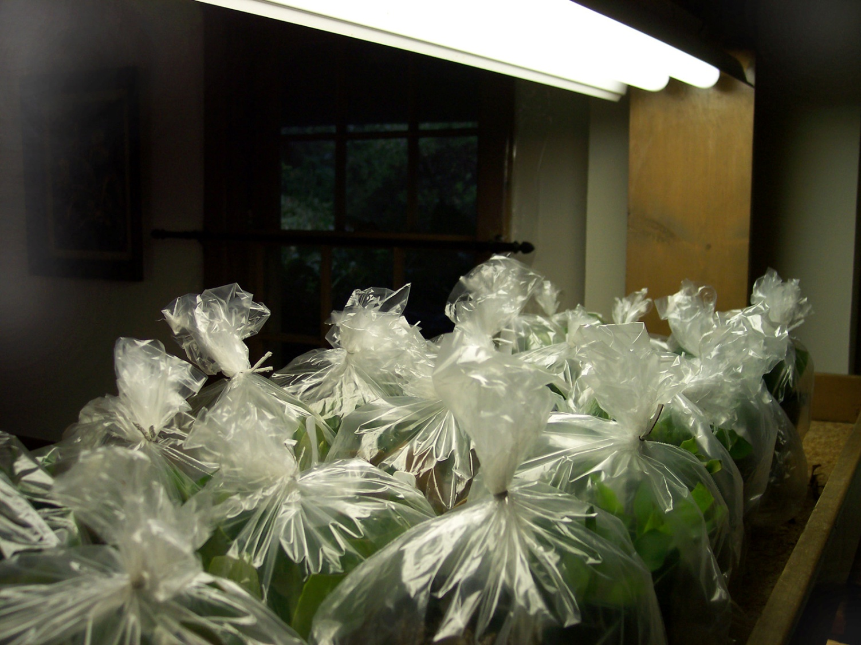
Rooting Environment
Insert cuttings
in rooting
medium.
2. Enclose pots
in plastic bags.
3. Keep under
fluorescent
lights while
cuttings root.

Slide 28
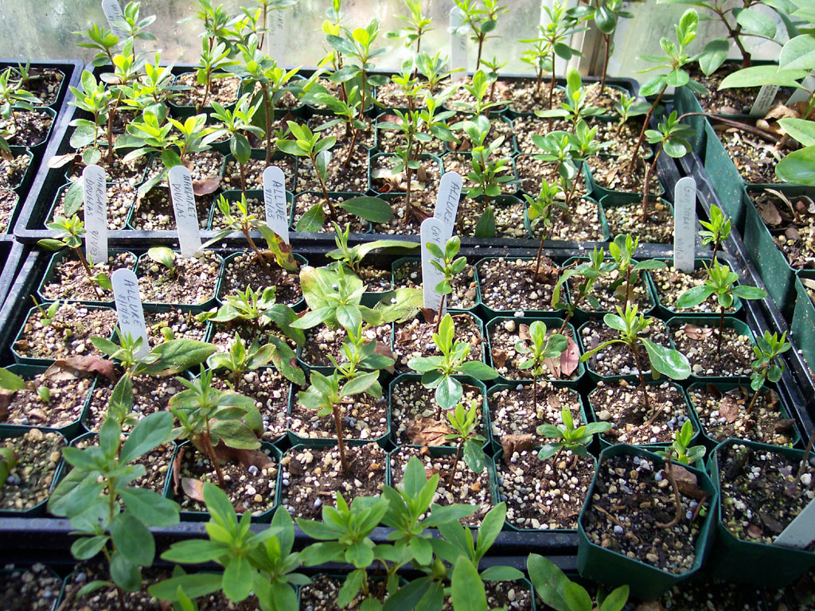
Growing On
Transfer to
individual pots.

Slide 29
Growing On
Transfer to
individual pots.
2. Plants may be
kept under lights
or moved to a
cold frame.

Slide 30
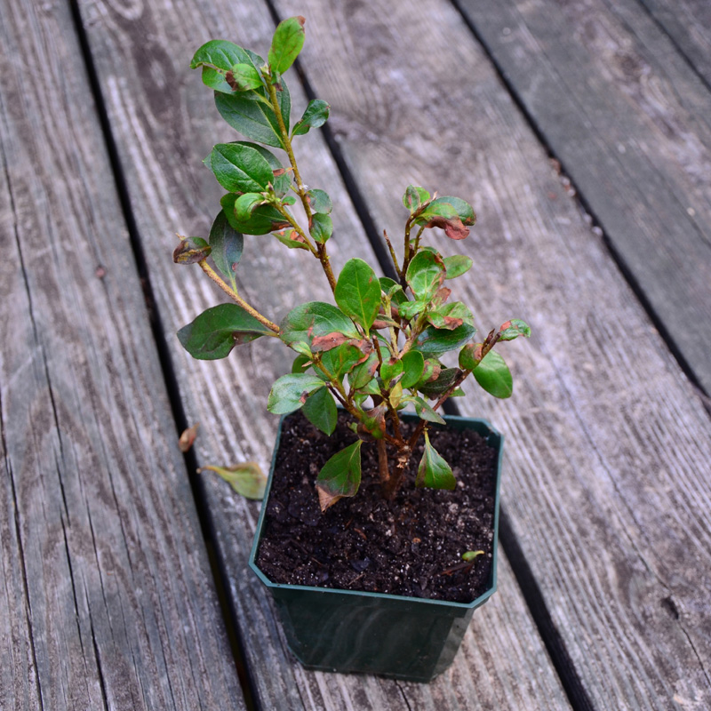
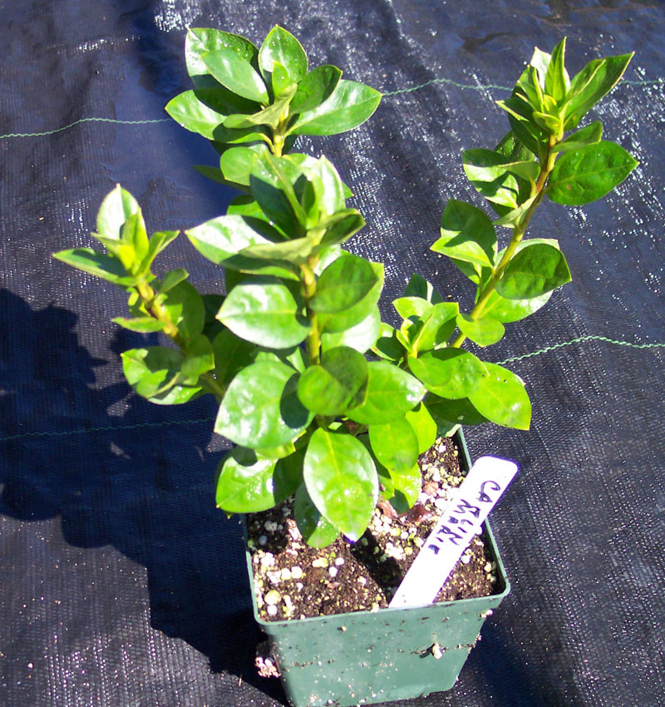
Growing On
Transplant to larger
pots as cuttings grow.

Slide 31
Growing On
Transplant to larger
pots as cuttings grow.
2. Provide more light,
increase fertilizer,
and prune plants to
improve shape.
3. It is better to use
several applications
of dilute fertilizer
than heavy doses.
WARNING!
Fertilizer can kill.

Slide 32
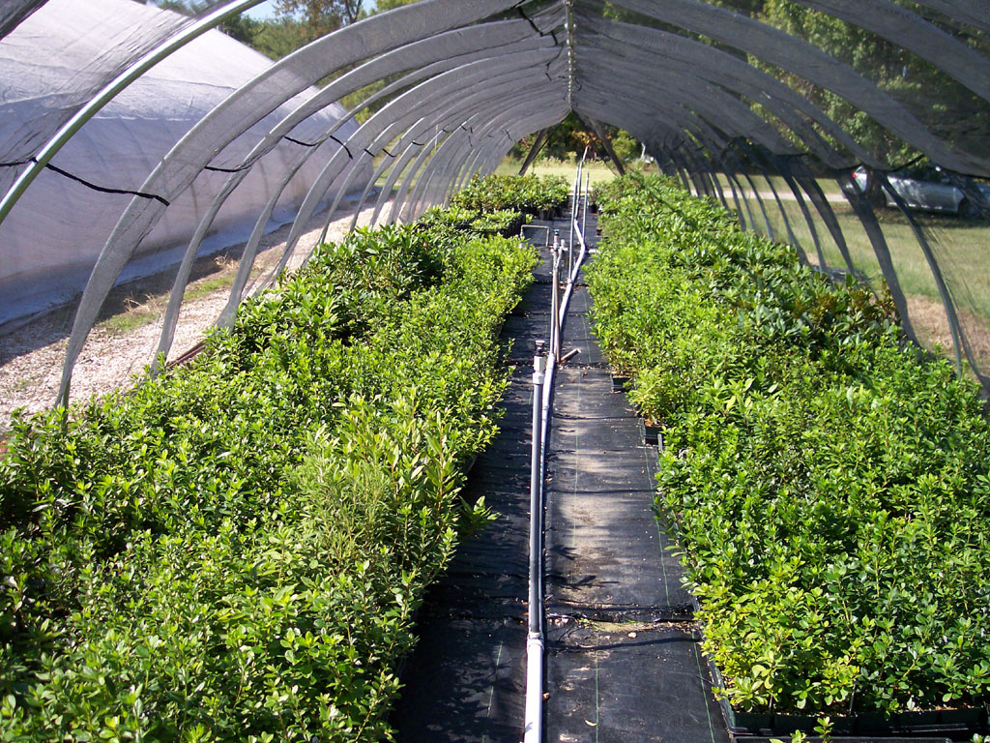
Growing On
Stop fertilizing
by midsummer
so cuttings will
go dormant as
autumn arrives.

Slide 33
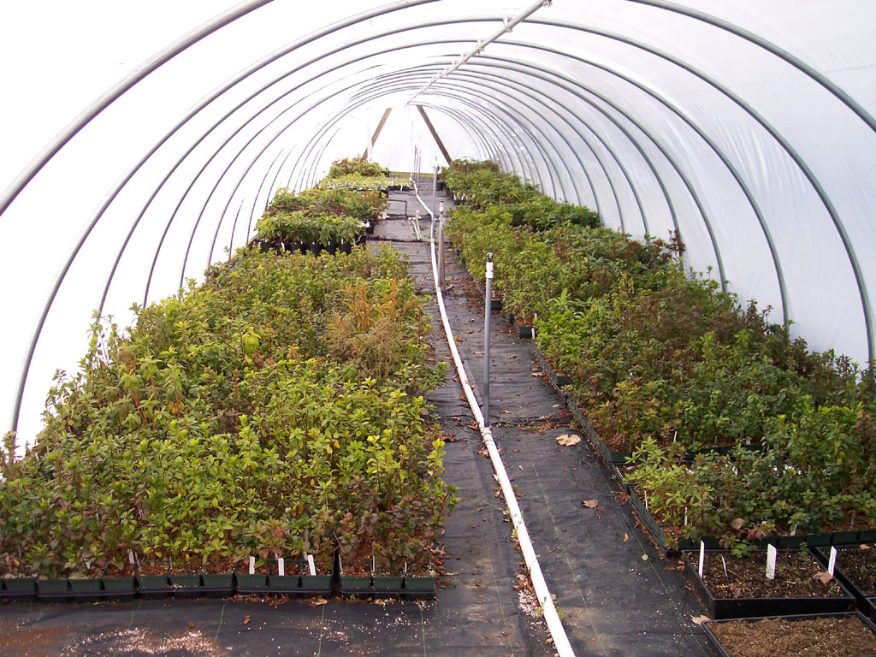
Growing On
Stop fertilizing
by midsummer
so cuttings will
go dormant as
autumn arrives.
2. Young plants
usually need
some winter
protection.
Options include a cool greenhouse, a
cold frame, or a shady sheltered spot.

Slide 34
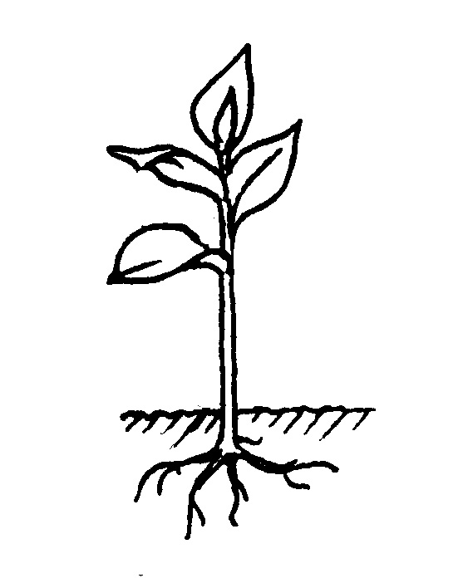
Why do cuttings need protection?
1. Cuttings and young
plants that spend the
winter outside will
need protection from
harsh winter cold.
2. If they have not gone
dormant before frost
arrives, they will be
prone to bark split.
What causes Bark Split?

Slide 35
Why do cuttings need protection?
1. Cuttings and young
plants that spend the
winter outside will
need protection from
harsh winter cold.
Warm
2. If they have not gone
dormant before frost
arrives, they will be
prone to bark split.
Plant is still
Growing
Moisture is
Pushed Up
from Roots

Slide 36
Why do cuttings need protection?
1. Cuttings and young
plants that spend the
winter outside will
need protection from
harsh winter cold.
Cold
Freezing
Weather
Arrives
2. If they have not gone
dormant before frost
arrives, they will be
prone to bark split.
Moisture is
Pushed Up
from Roots

Slide 37
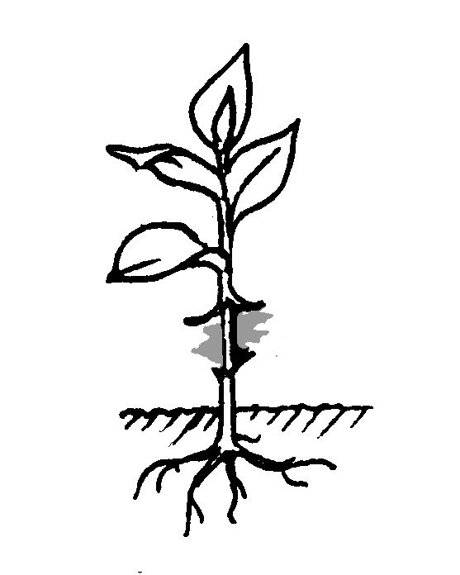
Why do cuttings need protection?
1. Cuttings and young
plants that spend the
winter outside will
need protection from
harsh winter cold.
Cold
Freezing
Weather
Arrives
2. If they have not gone
dormant before frost
arrives, they will be
prone to bark split.
Ice Freezes
Under Bark

Slide 38
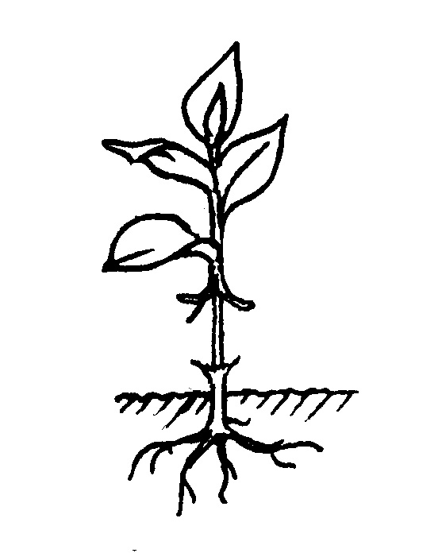
Why do cuttings need protection?
1. Cuttings and young
plants that spend the
winter outside will
need protection from
harsh winter cold.
Ice Melts
But Bark
is Damaged
2. If they have not gone
dormant before frost
arrives, they will be
prone to bark split.

Slide 39
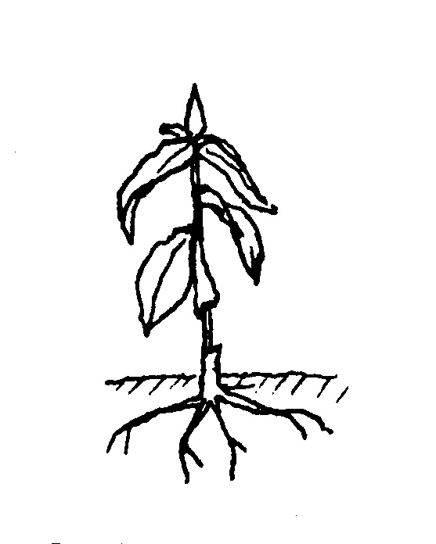
Why do cuttings need protection?
1. Cuttings and young
plants that spend the
winter outside will
need protection from
harsh winter cold.
2. If they have not gone
dormant before frost
arrives, they will be
prone to bark split.
Cutting is
Girdled
and Dies

Slide 40
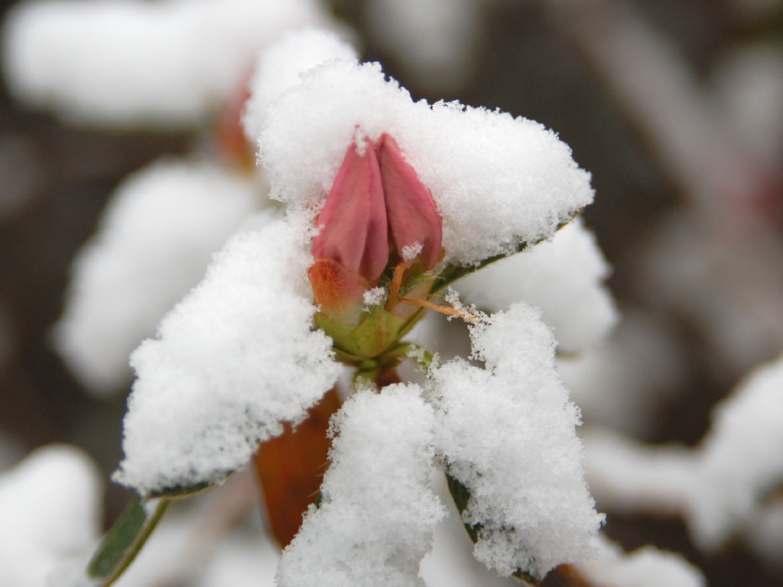
Winter Problems!
Even large plants
and trees can be
susceptible to
bark split if they
are not dormant
and there is a late
spring freeze or
an early fall frost.

Slide 41
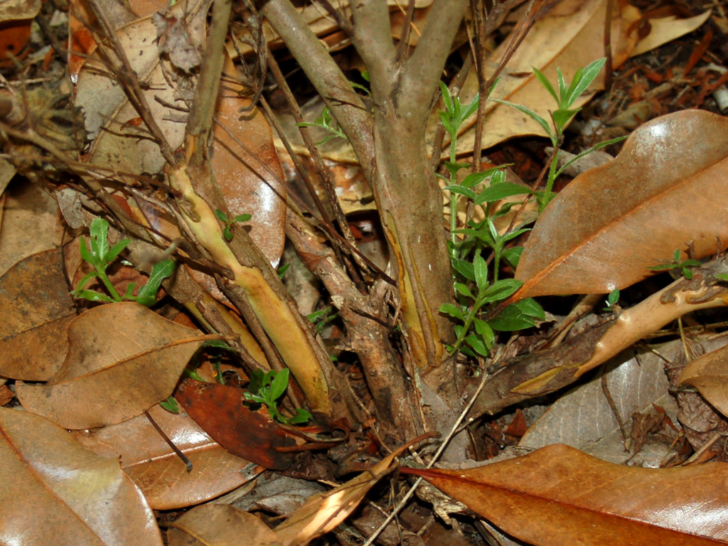
Winter Problems!
The damage may
not show up until
summer when a
plant that seemed
healthy suddenly
dies.
Check the base
of the plant for
bark split.

Slide 42
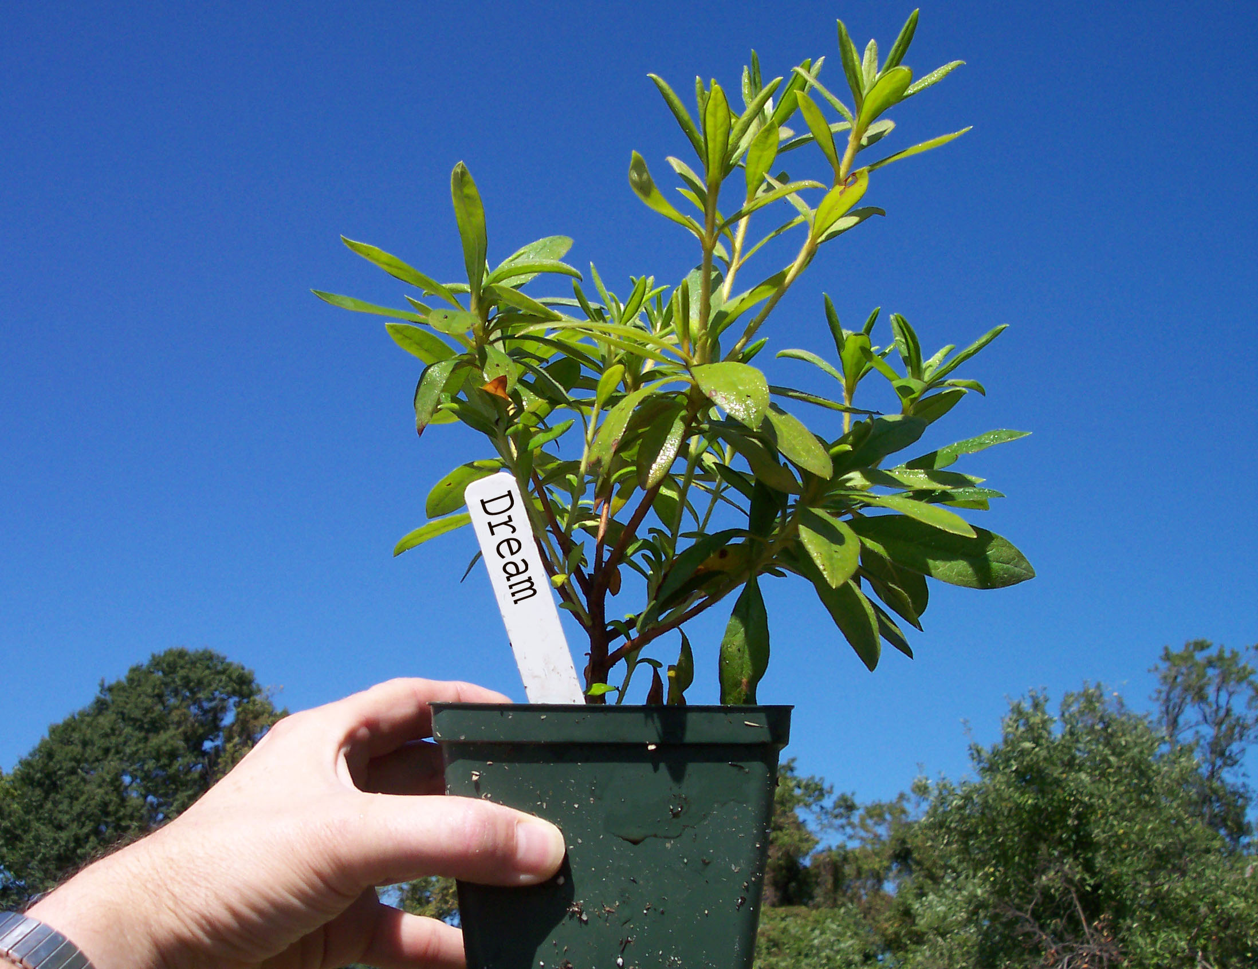
Growing On
Try rooting some azalea cuttings.
One Year
Liner
A small plant
can make a big
statement in
the landscape
in a few years.

Slide 43
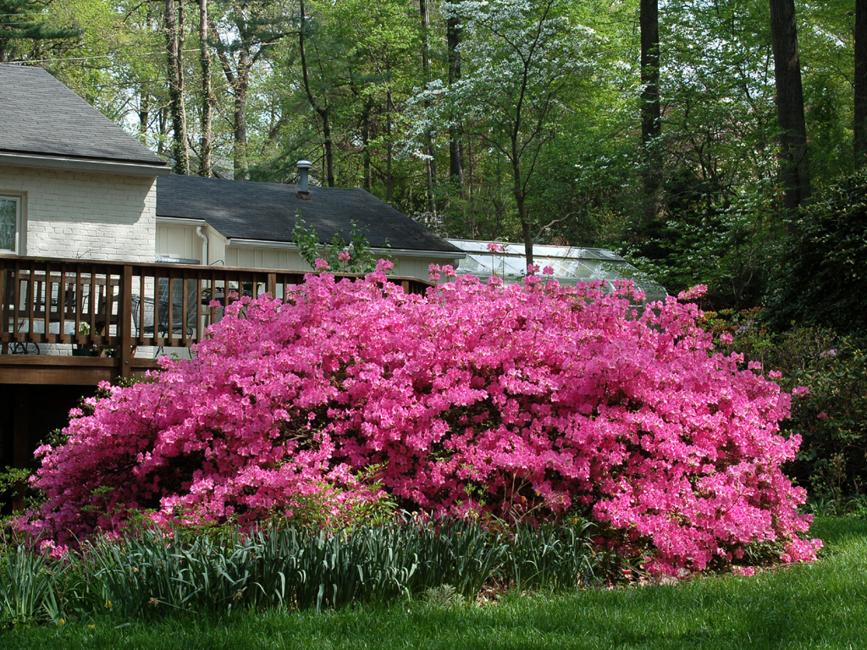
Growing On
40 Years
Later

Slide 44
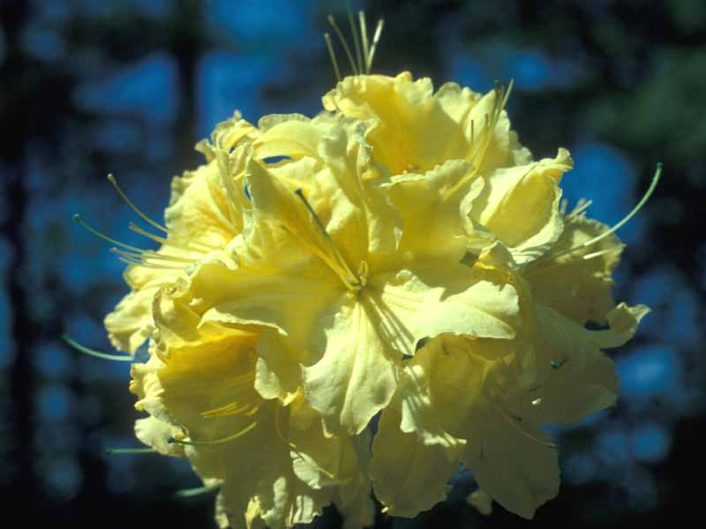
Deciduous Azalea Cuttings
Considerations
Timing
Selection
Preparation
Sterilization
Hormone
Rooting
Dormancy!

Slide 45
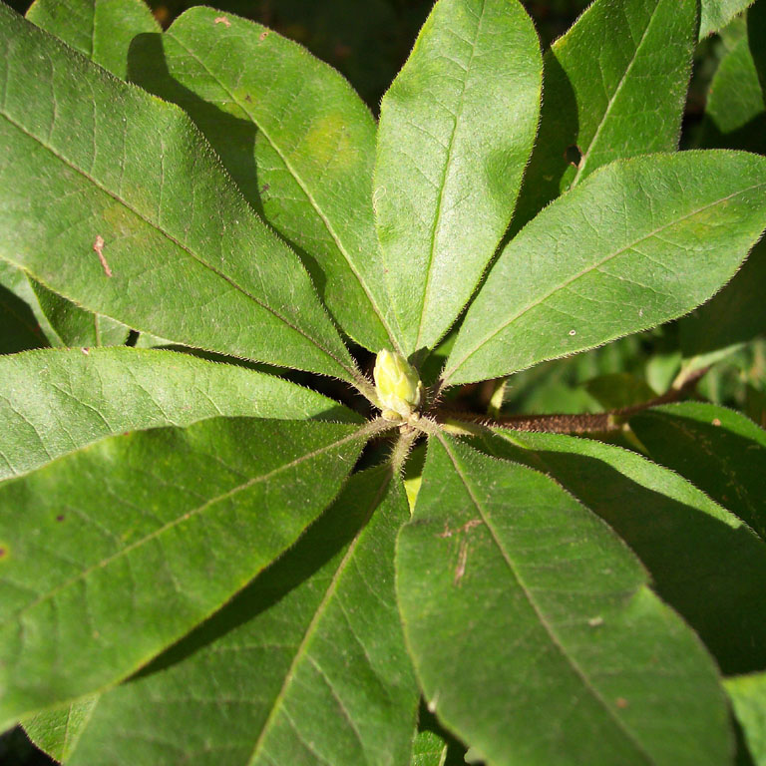
Why is Dormancy a Problem?
Deciduous azaleas drop their leaves in autumn and must go through a winter dormancy period.

Slide 46
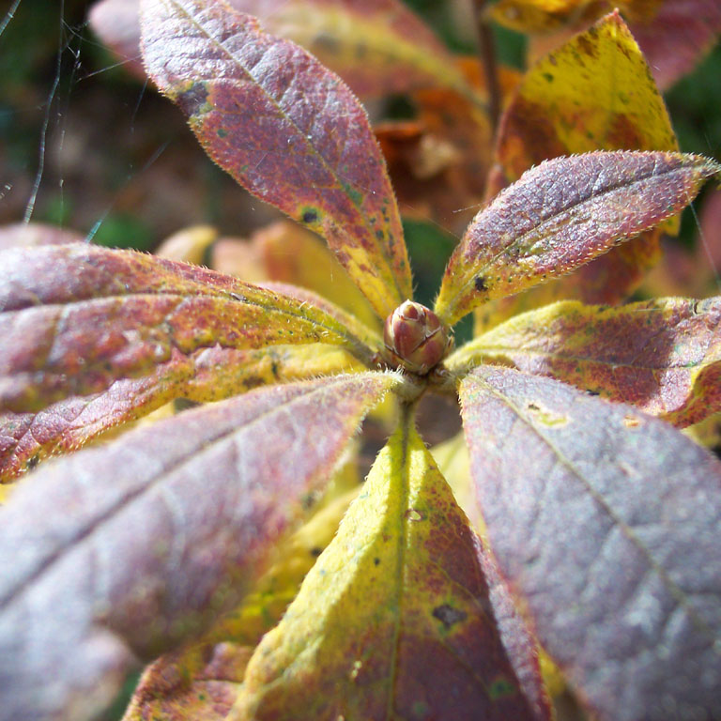
Why is Dormancy a Problem?
Deciduous azaleas drop their leaves in autumn and must go through a winter dormancy period.

Slide 47
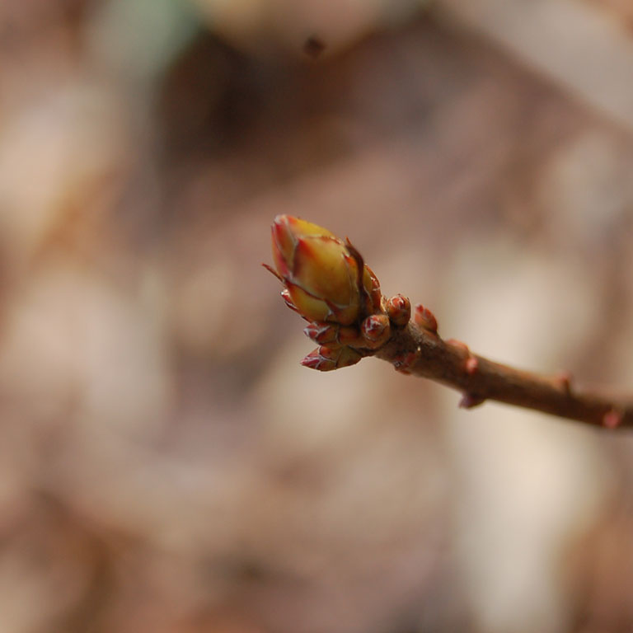
Why is Dormancy a Problem?
Deciduous azaleas drop their leaves in autumn and must go through a winter dormancy period.

Slide 48
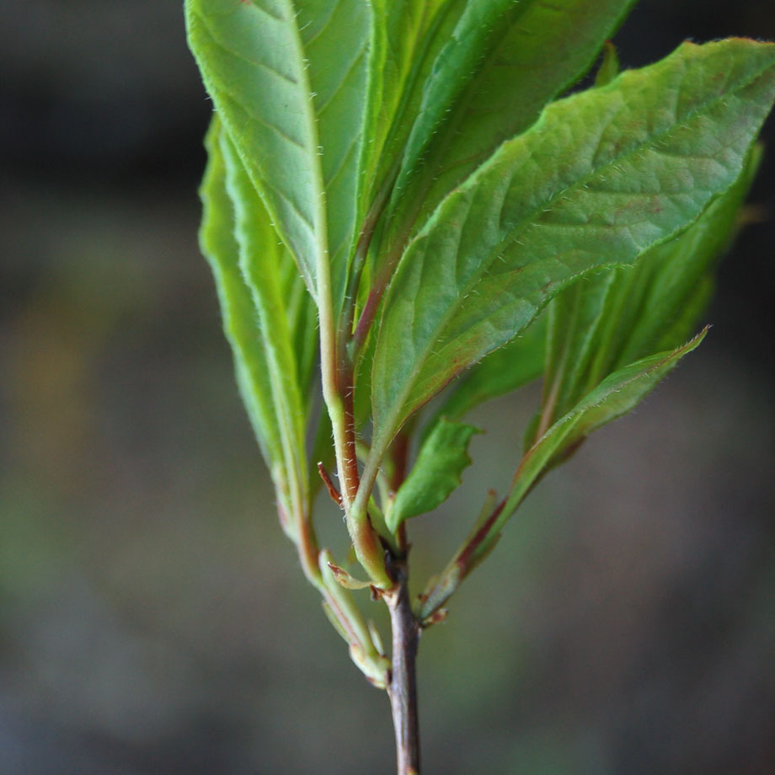
Why is Dormancy a Problem?
Deciduous azaleas drop their leaves in autumn and must go through a winter dormancy period.
Then they send out new growth in the spring.

Slide 49

Why is Dormancy a Problem?
Cuttings of deciduous azaleas usually root
easily but dormancy requirements will often get messed up.

Slide 50
Why is Dormancy a Problem?
Cuttings of deciduous azaleas usually root
easily but dormancy requirements will often get messed up.
Rooted cuttings can stay in a dormant state for the entire year may never grow. The plants will eventually die if they
do not have any leaves.

Slide 51
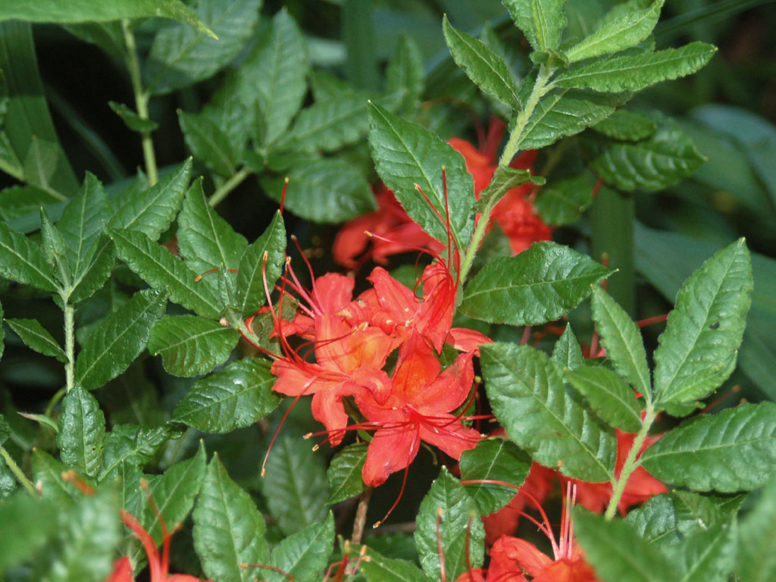
Why is Dormancy a Problem?
By rooting deciduous azaleas when the days are long and then maintaining summer like conditions until they send out a second flush of growth, the cuttings seem to avoid dormancy problems.

Slide 52
Timing and Selection
Take cuttings
early: late May to early June.

Slide 53
Timing and Selection
Take cuttings
early: late May to early June.
2. Choose strong
new growth.

Slide 54
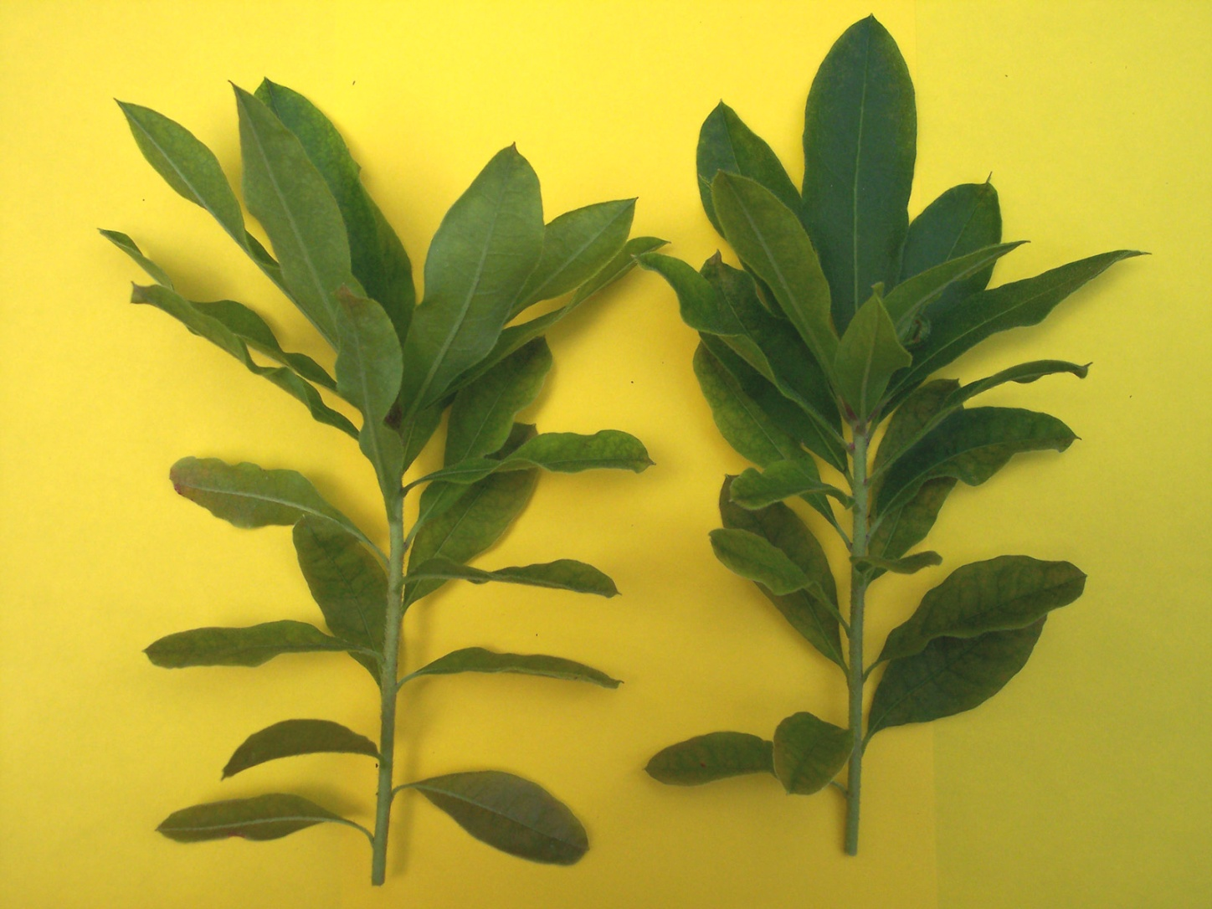
Timing and Selection
Take cuttings
early: late May to early June.
2. Choose strong
new growth.
3. Stems should
be starting to
harden off.

Slide 55
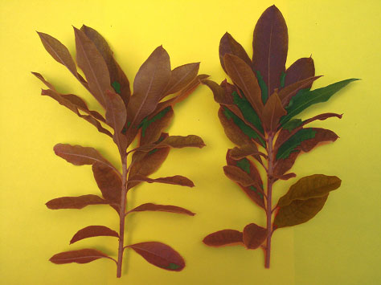
Timing and Selection
Take cuttings
early: late May to early June.
2. Choose strong
new growth.
3. Stems should
be starting to
harden off.
4. Never allow
cuttings to dry
out or wilt.

Slide 56


Timing and Selection
Take cuttings
early: late May to early June
Deciduous Azaleas tend to drop
their leaves if cuttings become wilted.
2. Choose strong
new growth
3. Stems should
be starting to
harden off
4. Never allow
cuttings to dry
out or wilt

Slide 57
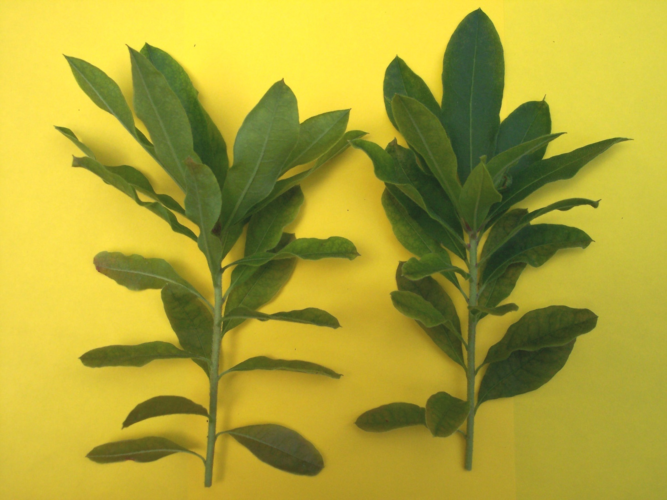
Cutting Preparation
Cut long stems
into pieces

Slide 58

Cutting Preparation
Cut long stems
into pieces

Slide 59

Cutting Preparation
Cut long stems
into pieces
2. Remove the
lower leaves

Slide 60

Cutting Preparation
Cut long stems
into pieces
2. Remove the
lower leaves
3. Pinch out
soft center or
flower bud

Slide 61


Cutting Preparation
Cut long stems
into pieces.
2. Remove the
lower leaves.
3. Pinch out
soft center or
flower bud.
4. Trim longer
leaf ends.

Slide 62

Sterilization
Avoiding potential insect and disease problems
Soak cuttings
in 5% Clorox
solution for
five minutes

Slide 63

Sterilization
Avoiding potential insect and disease problems
Soak cuttings
in 5% Clorox
solution for
five minutes
2. Rinse well
in clear water

Slide 64
Rooting Hormone
Weak dilution:
Dip ‘N Grow
at 10 to 1 ratio

Slide 65
Rooting Hormone
Weak dilution:
Dip ‘N Grow
at 10 to 1 ratio
2. Dip cuttings
in rooting
hormone for
3 to 5 seconds
Note:
Some people say
higher hormone
concentrations
may keep deciduous azaleas from breaking dormancy properly.

Slide 66

Rooting Environment
Insert cuttings in
rooting medium
(peat-perlite).
2. Medium should
be damp, not wet.

Slide 67

Rooting Environment
Insert cuttings in
rooting medium
(peat-perlite).
2. Medium should
be damp, not wet.
Excess moisture can encourage
rotting and fungus diseases.

Slide 68

Rooting Environment
Insert cuttings in
rooting medium
(peat-perlite).
2. Medium should
be damp, not wet.
3. Enclose pots in
clear plastic bags.

Slide 69

Rooting Environment
Insert cuttings in
rooting medium
(peat-perlite).
2. Medium should
be damp, not wet.
3. Enclose pots in
clear plastic bags.
4. Keep bags under
fluorescent lights,
long day conditions
of 18 to 24 hours.

Slide 70

Rooting Environment
Insert cuttings in
rooting medium
(peat-perlite).
2. Medium should
be damp, not wet.
3. Enclose pots in
clear plastic bags.
If days are short and nights
are cool, deciduous azaleas think winter is coming and begin to go dormant. Long
days keep them growing.
4. Keep bags under
fluorescent lights,
long day conditions
of 18 to 24 hours.

Slide 71

Breaking Dormancy
Keep cuttings
under long-day
conditions until
they break into
new growth.

Slide 72

Breaking Dormancy
Keep cuttings
under long-day
conditions until
they break into
new growth.
They can even stay under lights until the following spring.

Slide 73

Breaking Dormancy
Keep cuttings
under long-day
conditions until
they break into
new growth.
2. If cuttings don’t
break, they often
fail to leaf out
the next year and
eventually perish.
Cuttings may have roots but with no leaves they starve.

Slide 74

Growing On
Transplant to larger
pots in spring.

Slide 75

Growing On
Transplant to larger
pots in spring.

Slide 76

Growing On
Transplant to larger
pots in spring.
2. Give more light and
increase fertilizer to
encourage new growth.

Slide 77

Growing On
Transplant to larger
pots in spring.
2. Give more light and
increase fertilizer to
encourage new growth.

Slide 78

Growing On
Transplant to larger
pots in spring.
2. Give more light and
increase fertilizer to
encourage new growth.
3. Pinch long shoots to
encourage branching.

Slide 79

Growing On
Transplant to larger
pots in spring.
2. Give more light and
increase fertilizer to
encourage new growth.
3. Pinch long shoots to
encourage branching.

Slide 80

Growing On
Transplant to larger
pots in spring.
2. Give more light and
increase fertilizer to
encourage new growth.
3. Pinch long shoots to
encourage branching.
4. Stop fertilizing in mid
summer so plants go
dormant by fall.

Slide 81

Blooming
Transplant to larger
pots as needed.

Slide 82

Blooming
Transplant to larger
pots as needed.
2. Grow to blooming
size. (2 to 4 years)

Slide 83

Blooming
Transplant to larger
pots as needed.
2. Grow to blooming
size. (2 to 4 years)
3. Set plants out in the
garden to enjoy!

Slide 84

Rhododendron Cuttings
Considerations
Timing
Selection
Preparation
Sterilization
Hormone
Rooting
Growing

Slide 85




Two Rhododendron Types
Lepidotes
Elepidotes
Small Leaf Rhododendrons
Large Leaf Rhododendrons
R. keiskei
‘Blue Ensign’

Slide 86

Lepidotes
Lepidote Rhododendrons usually have small leaves and look more like azaleas.

Slide 87

Keiskei
Follow the same procedure used to root azalea cuttings.

Slide 88
Elepidotes
Elepidote rhododendrons are the large leaf plants most people associate with the genus.

Slide 89
Elepidotes
We handle them differently.

Slide 90


These Common Natives are Elepidotes
R. maximum
R. catawbiense

Slide 91

Elepidotes: When to Take Cuttings
1. Some varieties
root better in July or August.
‘Wheatley’

Slide 92

Elepidotes: When to Take Cuttings
1. Some varieties
root better in July or August.
2. Some varieties root better in
late fall.
R. yakushimanum hybrids

Slide 93

Elepidotes: When to Take Cuttings
1. Some varieties
root better in July or August.
2. Some varieties root better in
late fall.
3. Some are hard
to root at any
time of year.
‘Caroline’

Slide 94

Elepidotes: When to Take Cuttings
1. Some varieties
root better in July or August.
2. Some varieties root better in
late fall.
3. Some are hard
to root at any
time of year.
Try Grafting!
4. Some are nearly
impossible!
‘Jack Cowles’

Slide 95

Cutting Selection
Take cuttings
in mid summer
to late autumn.

Slide 96

Cutting Selection
Take cuttings
in mid summer
to late autumn.
2. Stems should
be firm, not
soft.
3. Smaller shoots
without buds
seem to root
more easily.

Slide 97

Sterilization
Same as Before
Soak cuttings
in 5% Clorox
solution for
five minutes.

Slide 98

Sterilization
Same as Before
Soak cuttings
in 5% Clorox
solution for
five minutes.
2. Rinse well
in clear water.

Slide 99

Sterilization
Same as Before
Soak cuttings
in 5% Clorox
solution for
five minutes.
2. Rinse well
in clear water.
Alternative:
Spray with a
fungicide and
insecticide mix
after sticking.

Slide 100

Cutting Preparation
Make short
cuttings: 2” - 3”

Slide 101

Cutting Preparation
Make short
cuttings: 2” - 3”

Slide 102


Cutting Preparation
Make short
cuttings: 2” - 3”
2. Trim back
longer leaves.

Slide 103

Cutting Preparation
Make short
cuttings: 2” - 3”
2. Trim back
longer leaves.
3. Pinch out
flower buds.

Slide 104

Cutting Preparation
Make short
cuttings: 2” - 3”
2. Trim back
longer leaves.
Cut thin strip
of bark from
both sides.
3. Pinch out
flower buds.
4. Wound the
cutting base
on each side.

Slide 105

Cutting Preparation
Make short
cuttings: 2” - 3”
2. Trim back
longer leaves.
3. Pinch out
flower buds.
4. Wound the
cutting base
on each side.

Slide 106

Cutting Preparation
Make short
cuttings: 2” - 3”
Callus tissue will
first develop here
2. Trim back
longer leaves.
3. Pinch out
flower buds.
4. Wound the
cutting base
on each side.

Slide 107

Cutting Preparation
Make short
cuttings: 2” - 3”
Callus tissue will
first develop here
2. Trim back
longer leaves.
3. Pinch out
flower buds.
4. Wound the
cutting base
on each side.
Roots will emerge
from the callus

Slide 108


Rooting Hormone
Stronger dilution:
Dip ‘N Grow
5 to 1 ratio.
2. Dip cuttings
in rooting
hormone for
3 to 5 seconds.

Slide 109

Many propagators now
recommend a purple
gel called CLONEX
for rhododendrons.
It sticks to the cutting
and protects the wound
as it is forming roots.

Slide 110

Rooting Environment
Insert cuttings in
rooting medium.

Slide 111

Rooting Environment
Insert cuttings in
rooting medium.
2. Enclose pots in
plastic bags.

Slide 112

Rooting Environment
Insert cuttings in
rooting medium.
2. Enclose pots in
plastic bags.
3. Keep bags under
fluorescent lights.
4. Bottom heat
helps rooting.
Heating pads help but plants on the top layer will also get heat from the lights below.

Slide 113

Rooting Environment
Insert cuttings in
rooting medium.
2. Enclose pots in
plastic bags.
3. Keep bags under
fluorescent lights.
4. Bottom heat
helps rooting.
5. Cuttings root in
2 to 12 months.
6. Wait for strong root system to develop before transplanting.

Slide 114

Growing On
Repot and keep under
lights until spring.

Slide 115

Growing On
Repot and keep under
lights until spring.
2. Water, fertilize lightly,
and keep in active growth.

Slide 116

Growing On
Repot and keep under
lights until spring.
2. Water, fertilize lightly,
and keep in active growth.
3. Grow outside over summer.
With more sun, give higher
fertilizer for strong growth.

Slide 117

Growing On
Repot and keep under
lights until spring.
2. Water, fertilize lightly,
and keep in active growth.
3. Grow outside over summer.
With more sun, give higher
fertilizer for strong growth.
4. Stop fertilizing by mid
summer so plants will go
dormant before winter.

Slide 118



Growing On
Repot and keep under
lights until spring.
2. Water, fertilize lightly,
and keep in active growth.
3. Grow outside over summer.
With more sun, give higher
fertilizer for strong growth.
4. Stop fertilizing by mid
summer so plants will go
dormant before winter.
Cluster pots together.
Snow cover helps, too.
6. Mulch to protect roots.

Slide 119

Other Types of Propagation
Methods Used on a Limited Basis
Leaf–Bud Cuttings
Layering
Dormant
Cuttings

Slide 120

Leaf-Bud Cuttings
Make many plants
from only one
standard cutting!
We can make a
miniature cutting
using just one leaf
and part of the
stem if it has at
least one viable
growth bud.

Slide 121

Leaf-Bud Cuttings
Cut each leaf off
of the stem but
make sure it has
some wood and
a growth bud.

Slide 122

Leaf-Bud Cuttings
Cut each leaf off
of the stem but
make sure it has
some wood and
a growth bud.
Bud
Leaf
Treat like a normal cutting.
Some Stem
Keep the bud above ground.

Slide 123

Leaf-Bud Cuttings
Cut each leaf off
of the stem but
make sure it has
some wood and
a growth bud.
Bud
Leaf
Treat like a normal cutting
Some Stem
Keep the bud above ground
Each one can be a new plant.

Slide 124
Leaf-Bud Cuttings
Cut each leaf off
of the stem but
make sure it has
some wood and
a growth bud.
Bud
Leaf
Warning! If the bud gets damaged, the cutting may form roots but will have no way to send up a new shoot.
Treat like a normal cutting
Some Stem
Keep the bud above ground

Slide 125

Layering
Find a plant
with a branch
near the ground.

Slide 126

Layering
Find a plant
with a branch
near the ground.
2. Place a pot with
rooting medium
under the branch.

Slide 127

Layering
Find a plant
with a branch
near the ground.
2. Place a pot with
rooting medium
under the branch.
Wound the
branch

Slide 128


Layering
Find a plant
with a branch
near the ground.
2. Place a pot with
rooting medium
under the branch.
Wound the
branch
Apply rooting
hormone

Slide 129

Layering
Find a plant
with a branch
near the ground.
2. Place a pot with
rooting medium
under the branch.
3. Place a rock on
the branch to
weigh it down.
Apply rooting
hormone
Wound the
branch
4. Wait for at least
a year or two to be sure the branch has its own roots.

Slide 130

Layering
Cut off the branch
and let it establish
in a pot. You now
have second plant.

Slide 131

Dormant Cuttings
Branches that
get broken by
winter storms
can frequently
be rooted.

Slide 132

Dormant Cuttings
Even if the stem
is desiccated, it
may be possible
to rehydrate the
tissue and then
root cuttings.

Slide 133

Dormant Cuttings
Make a fresh cut at the base
of the branch and insert the
end in warm water.
Then cover the foliage with
a plastic bag to increase
humidity.
Move the branch to a warm
room with bright light and
see if the branch revives.

Slide 134

Dormant Cuttings
In a few days, if
the foliage plumps
up, those cuttings
can be rooted in
the normal way.

Slide 135

An Alternative to Do-it-yourself
Call in the Professionals!

Slide 136

Send Cuttings to Van Veen Nursery

Slide 137


Send Cuttings to Van Veen Nursery
They Can Root a Pencil.

Slide 138
Send Cuttings to Van Veen Nursery
Van Veen Nursery is a wholesale rhododendron nursery established in 1926 but they do extend courtesies to the American Rhododendron Society.
Van Veen Nursery
4201 SE Franklin St.
Portland, OR 97206
(503) 777-1734
Email:
vanveennursery@hotmail.com
Web:
www.vanveennursery.com

Slide 139

Send Cuttings to Van Veen Nursery
She Can Root a Pencil
Mail them cuttings in the fall and they
will ship back rooted liners the next year.

Slide 140

Pot them up and grow them on.

Slide 141

Propagate Those Plants!
Making more
plants is easy!

Slide 142

Pot Plant
Getting them planted is another story!

Slide 143

Pot Plant
Getting them planted is another story!

Slide 144
Azaleas and Rhodos - End
For More Information:

Slide 145
Azaleas and Rhodos - End
For More Information:
American Rhododendron Society
www.rhododendron.org
Azalea Society of America
www.azaleas.org
Potomac Valley Chapter ARS
www.arspvc.org
Donald W. Hyatt (author)
www.donaldhyatt.com
don@donaldhyatt.com

Slide 146
Azaleas and Rhodos - End
The End

